Slide 1
“Salvation is of the Lord.”
Jonah 2: 9

Slide 2
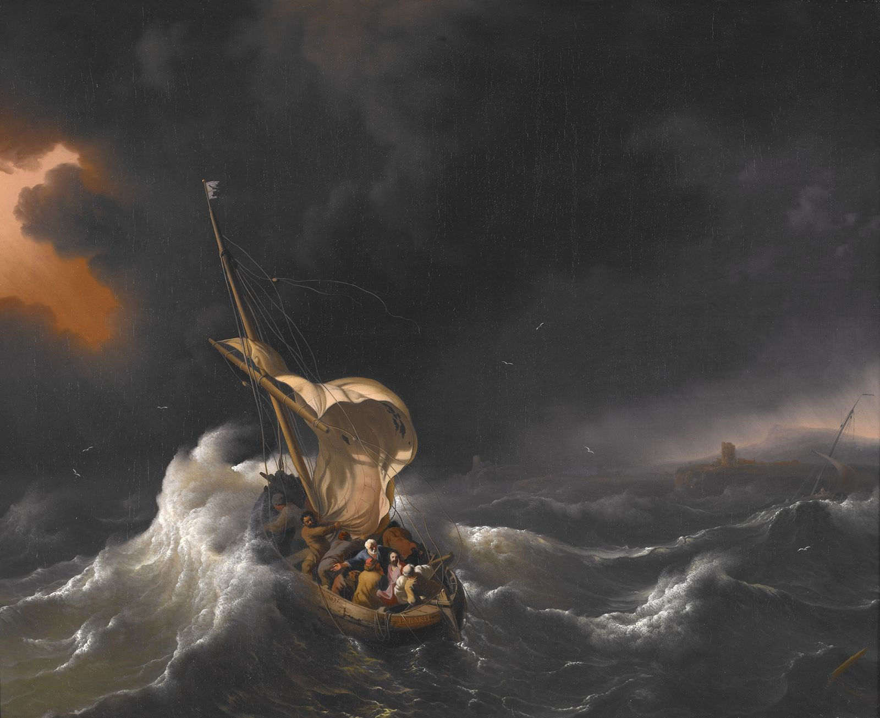
JONAH CHAPTER ONE
WHO GETS SAVED?
THE MARINERS
(WE WHO BELIEVE)

Slide 3
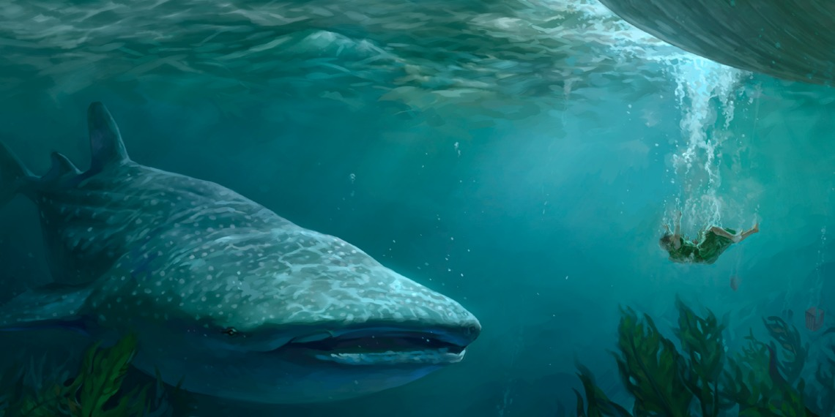
JONAH CHAPTER TWO
WHO GETS SAVED?
JONAH
(JESUS THE CHRIST)

Slide 4
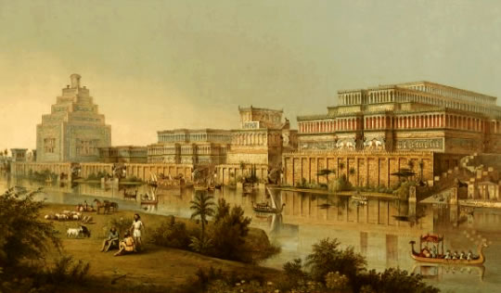
JONAH CHAPTER THREE - WHO GETS SAVED?
NINEVAH
(THOSE ON WHOM THE LORD HAS MERCY)

Slide 5
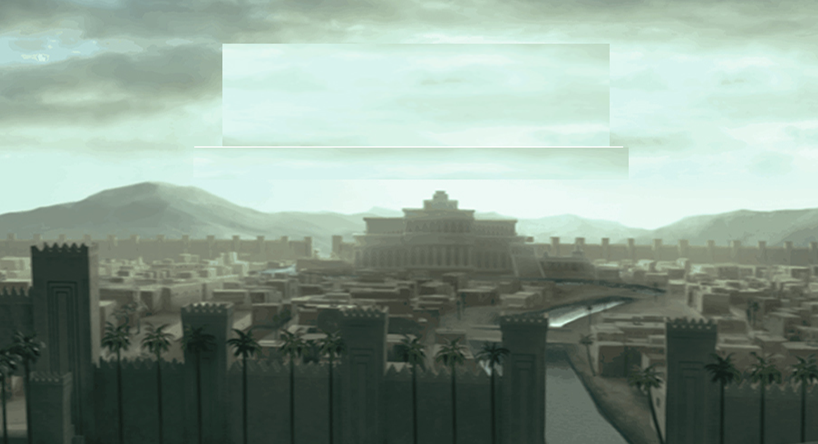
JONAH
CHAPTER FOUR
WHO GETS SAVED?

Slide 6
“Salvation is of the Lord.”
Jonah 2: 9

Slide 7
For God did not send His Son into the world to condemn the world, but that the world through Him might be saved.
John 3:17
For this reason the Jews persecuted Jesus, and sought to kill Him, because He had done these things on the Sabbath. But Jesus answered them, “My Father has been working until now, and I have been working.”
John 5: 16, 17
And we know that in all things God works for the good of those who love him, who have been called according to his purpose.
Romans 8: 28 (NIV)

Slide 8
For as you were once disobedient to God, yet have now obtained mercy through their disobedience, even so these also have now been disobedient, that through the mercy shown you they also may obtain mercy.
Romans 11: 30, 31
But as for you, you meant evil against me; but God meant it for good, in order to bring it about as it is this day, to save many people alive.
Genesis 50: 20

Slide 9
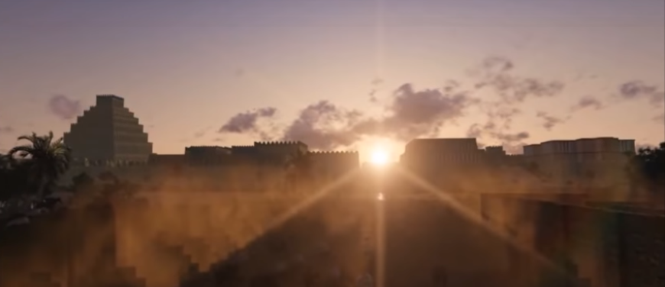
But it displeased Jonah exceedingly, and he became angry. … Then the Lord said, “Is it right for you to be angry?” So Jonah went out of the city and sat on the east side of the city. There he made himself a shelter and sat under it in the shade, till he might see what would become of the city. Jonah 4: 1 - 6

Slide 10
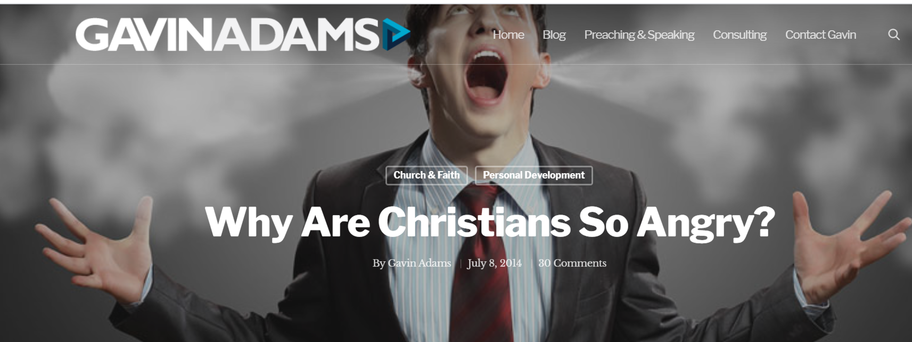

Slide 11
Now his older son … heard music and dancing. … But he was angry and would not go in.
Therefore his father came out and pleaded with him…. “you never gave me a young goat, that I might make merry with my friends!”
“Son … it was right that we should make merry and be glad, for your brother was dead and is alive again.”
Luke 15: 25 - 32
But it displeased Jonah exceedingly, and he became angry. …
So Jonah went out of the city and sat on the east side of the city. …
Then God said to Jonah, “Is it right for you to be angry?” … And he said, “It is right for me to be angry, even to death!”
But the Lord said, … “And should I not pity Nineveh, that great city, in which are more than one hundred and twenty thousand persons who cannot discern between their right hand and their left—and much livestock?”
Jonah 4: 1 - 11

Slide 12
But it displeased Jonah exceedingly, and he became angry. … Then the Lord said, “Is it right for you to be angry?” So Jonah went out of the city and sat on the east side of the city. There he made himself a shelter and sat under it in the shade, till he might see what would become of the city. Jonah 4: 1 - 6

Slide 13
There was a mighty tempest on the sea, so that the ship was about to be broken up. Then the mariners were afraid … and threw the cargo that was in the ship into the sea, to lighten the load.
But Jonah had gone down into the lowest parts of the ship, had lain down, and was fast asleep. So the captain came to him, and said to him, “What do you mean, sleeper? Jonah 1: 4 - 6

Slide 14
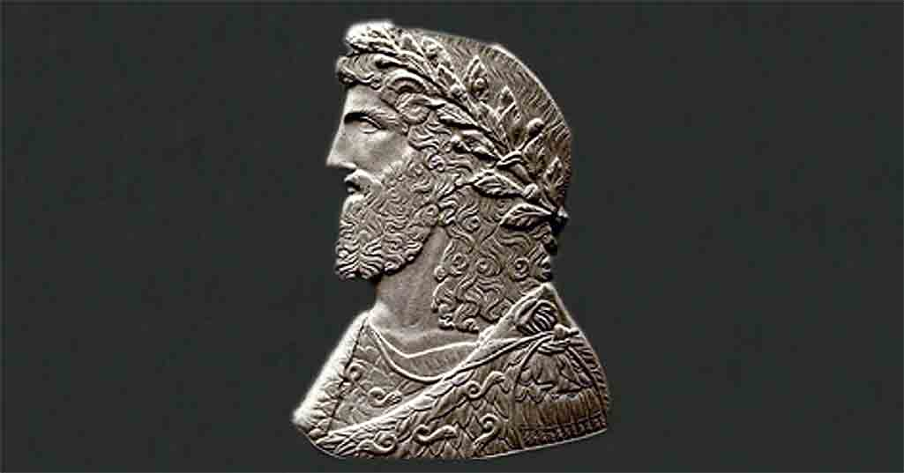
To Arsacius, High Priest of Galatia
The Hellenic religion does not yet prosper as I desire, and it is the fault of those who profess it; for the worship of the gods is on a splendid and magnificent scale, surpassing every prayer and every hope. May Adrasteia pardon my words, for indeed no one, a little while ago, would have ventured even to pray for a change of such a sort or so complete within so short a time. Why, then, do we think that this is enough, why do we not observe that it is their benevolence to strangers, their care for the graves of the dead and the … holiness of their lives that have done most to increase atheism [Christianity]? I believe that we ought really and truly to practice every one of these virtues …. For it is disgraceful that, when no Jew ever has to beg, and the impious Galileans support not only their own poor but ours as well, all men see that our people lack aid from us.

Slide 15
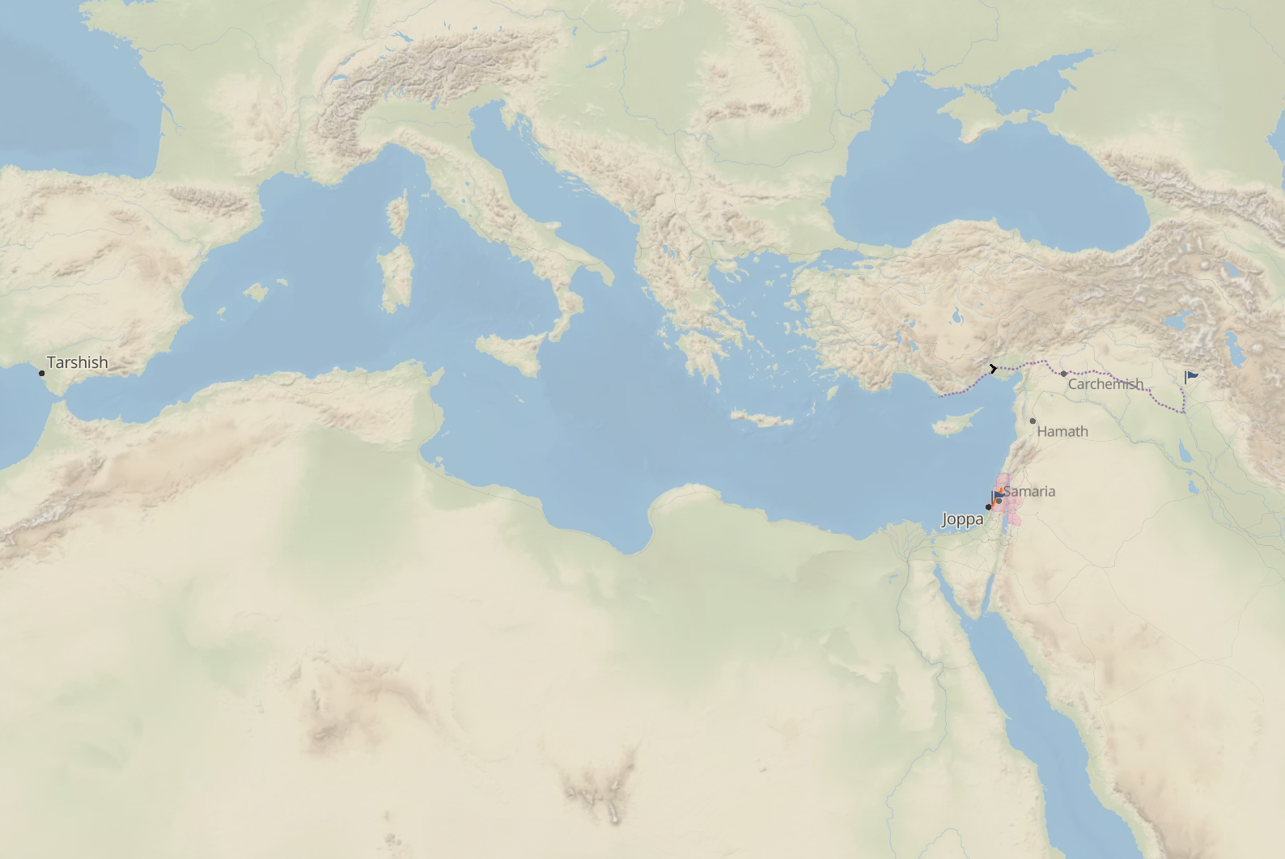
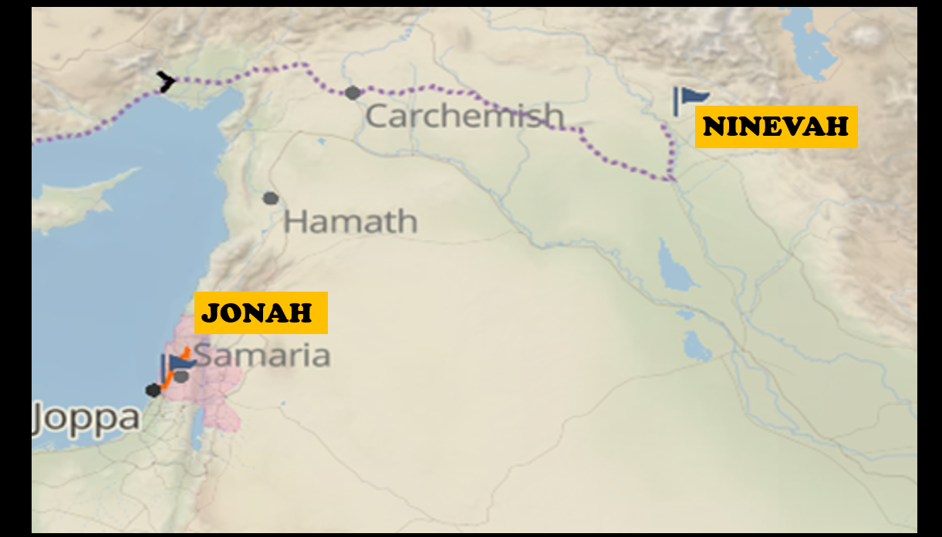
Now the word of the Lord came to Jonah … “Arise, go to Nineveh, that great city, and preach to it the message that I tell you.” So Jonah arose and went to Nineveh, according to the word of the Lord. Jonah 3: 1 - 3
TARSHISH
How then shall they call on Him in whom they have not believed? And how shall they believe in Him of whom they have not heard? And how shall they hear without a preacher? And how shall they preach unless they are sent? Romans 10: 14, 15

Slide 16
Now the word of the Lord came to Jonah … “Arise, go to Nineveh, that great city, and preach to it the message that I tell you.” So Jonah arose and went to Nineveh, according to the word of the Lord. Jonah 3: 1 - 3
TARSHISH
And Jesus came and spoke to them …
“Go therefore and make disciples of all the nations … teaching them to observe all things that I have commanded you; and lo, I am with you always, even to the end of the age.”
Matthew 28: 18 - 20

Slide 17
Now the word of the Lord came to Jonah … “Arise, go to Nineveh, that great city, and preach to it the message that I tell you.” So Jonah arose and went to Nineveh, according to the word of the Lord. Jonah 3: 1 - 3
TARSHISH
And Jesus came and spoke to them …
“Go therefore and make disciples of all the nations … teaching them to observe all things that I have commanded you; and lo, I am with you always, even to the end of the age.”
Matthew 28: 18 - 20

Slide 18
Now the word of the Lord came to Jonah … “Arise, go to Nineveh, that great city, and preach to it the message that I tell you.” So Jonah arose and went to Nineveh, according to the word of the Lord. Jonah 3: 1 - 3
TARSHISH
How then shall they call on Him in whom they have not believed? And how shall they believe in Him of whom they have not heard? And how shall they hear without a preacher? And how shall they preach unless they are sent? Romans 10: 14, 15

Slide 19
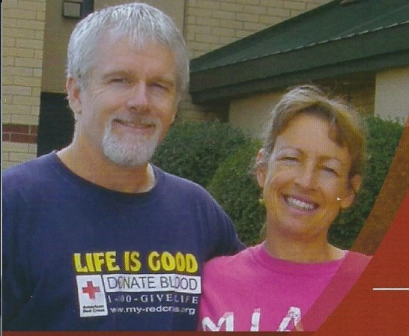
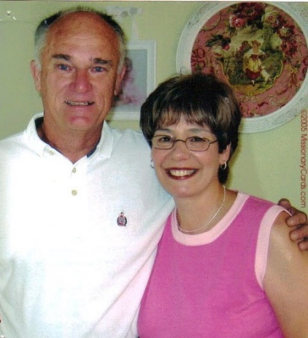
Missions Supported by FRBC in January
This Month We Highlight Ministries
to Foreign Mission Fields
Mike & Terri Blackburn
Central Asia, Uzbek Speakers
.
Fred & Cathy Ruff
Ministry to the Chinese
Ministry to Middle East Refugees
For more information see the Bulletin Boards in the Foyer and Library

Slide 20
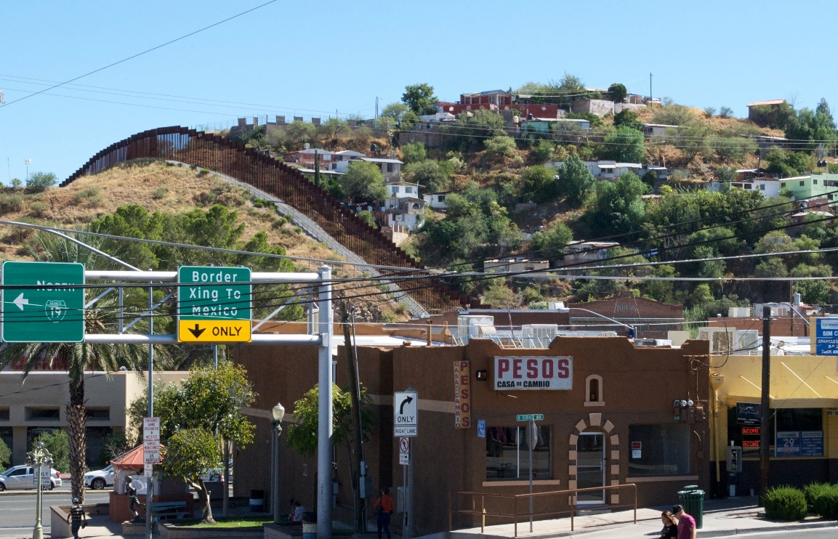
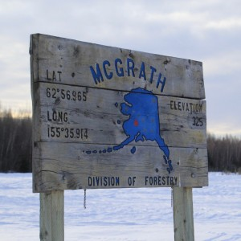

Slide 21
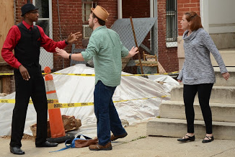
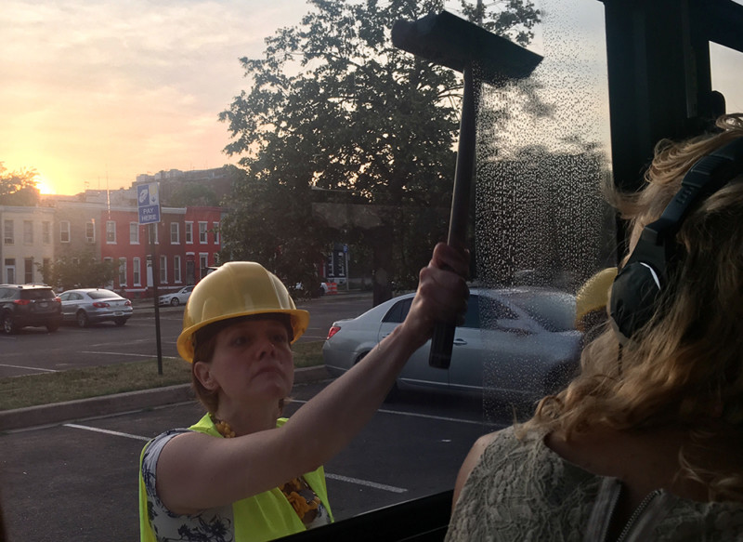
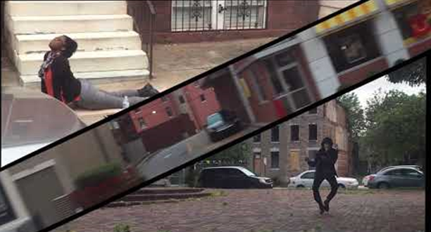

Slide 22
JONAH
CHAPTER FOUR
WHO GETS SAVED?

Slide 23
“Salvation is of the Lord.”
Jonah 2: 9
For the promise is to you and to your children, and to all who are afar off, as many as the Lord our God will call.
Acts 2: 38

Slide 24
Facing a task unfinished
That drives us to our knees
A need that, undiminished
Rebukes our slothful ease
We, who rejoice to know Thee
Renew before Thy throne
The solemn pledge we owe Thee
To go and make Thee known

Slide 25
Where other lords beside Thee
Hold their unhindered sway
Where forces that defied Thee
Defy Thee still today
With none to heed their crying
For life, and love, and light
Unnumbered souls are dying
And pass into the night

Slide 26
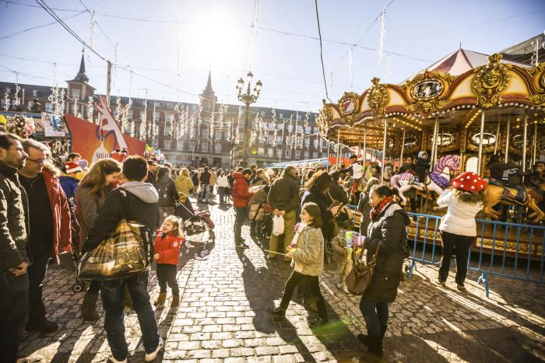
We go to all the world
With kingdom hope unfurled
No other name has the power to save
But Jesus Christ, the Lord

Slide 27
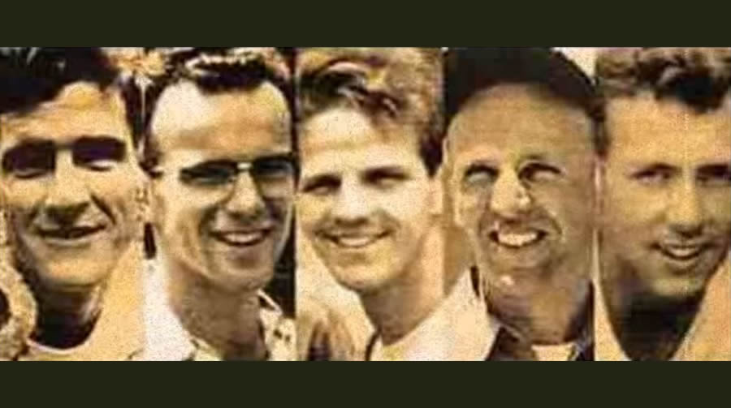
We bear the torch that flaming
Fell from the hands of those
Who gave their lives proclaiming
That Jesus died and rose
Ours is the same commission
The same glad message ours
Fired by the same ambition
To Thee we yield our powers

Slide 28
We go to all the world
With kingdom hope unfurled
No other name has the power to save
But Jesus Christ, the Lord

Slide 29
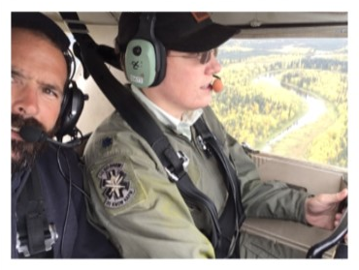
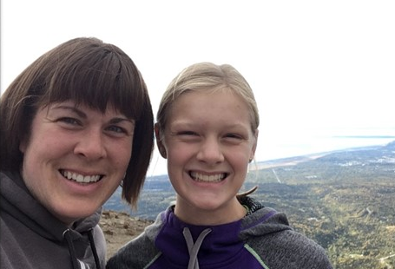
O Father who sustained them
O Spirit who inspired
Savior, whose love constrained them
To toil with zeal untired
From cowardice defend us
From lethargy awake!
Forth on Thine errands send us
To labor for Thy sake

Slide 30
We go to all the world
With kingdom hope unfurled
No other name has the power to save
But Jesus Christ, the Lord

Slide 31
“Salvation is of the Lord.”
Jonah 2: 9

