Slide 1
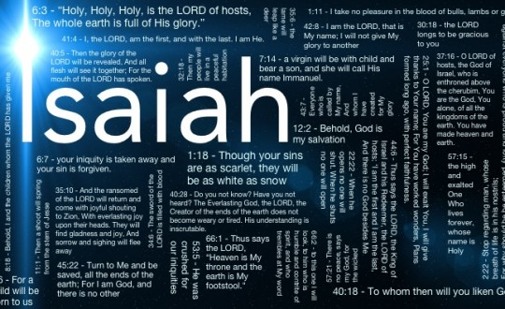
ISAIAH 49:I have inscribed you on My palms

Slide 3
I Peter 1:10-12
… this is the salvation the prophets have inquired about and searched carefully…of the grace that would come to you,
Searching what or what manner of time, ﻿﻿the Spirit of Christ (who was in them) was indicating when He testified ahead of time the sufferings of Christ and the glories that would follow.
To them it was revealed… not to them… but to ﻿﻿us they were ministering the things which now have been reported to you through those who have preached the gospel to you by the Holy Spirit…things which ﻿﻿angels desire to look into.

Slide 5
Isaiah 49:1-7 (NLT)
Listen to me, all you in distant lands! Pay attention, you who are far away! The Lord called me before my birth; from within the womb he called me by name.
He made my words of judgment as sharp as a sword. He has hidden me in the shadow of his hand. I am like a sharp arrow in his quiver.
He said to me, “You are my servant, Israel, and you will bring me glory.”
I replied, “But my work seems so useless! I have spent my strength for nothing and to no purpose. et I leave it all in the Lord’s hand; I will trust God for my reward.”
And now the Lord speaks—the one who formed me in my mother’s womb to be his servant, who commissioned me to bring Israel back to him. The Lord has honored me, and my God has given me strength.
He says, “You will do more than restore the people of Israel to me. I will make you a light to the Gentiles, and you will bring my salvation to the ends of the earth.”
The Lord, the Redeemer and Holy One of Israel, says to the one who is despised and rejected by the nations, to the one who is the servant of rulers: “Kings will stand at attention when you pass by…

Slide 7
Acts 13:46-47 (NLT)
It was necessary that the word of God should be spoken to you first; but ﻿﻿since you rejected it…﻿we turn to the Gentiles. ^{﻿47} For so the Lord has commanded us: “I have made you a light to the Gentiles, to bring salvation farthest corners of the earth”

Slide 9
Isaiah 49:8-13 (NLT)
This is what the Lord says: “At just the right time, I hear you and I will respond to you. On the day of salvation I will help you. I will protect you and give you to the people as my covenant with them. Through you I will reestablish the land of Israel and assign it to its own people again.
I will say to the prisoners, Come out in freedom,’ and to those in darkness, ‘Come into the light.’ They will be my sheep, grazing in green pastures and on hills that were previously bare.
They will neither hunger nor thirst. The searing sun will not reach them anymore. For the Lord in his mercy will lead them; he will lead them beside cool waters.
And I will make my mountains into level paths for them. The highways will be raised above the valleys. ¹² See, my people will return from far away, from lands to the north and west, and from as far south as Egypt.”
Sing for joy, O heavens! Rejoice, O earth! Burst into song, O mountains! For the Lord has comforted his people and will have compassion on them in their suffering.

Slide 11
Ex. 34:14
For you shall worship no other god, for the Lord, whose ﻿﻿name is Jealous, is a ﻿﻿jealous God.

Slide 13
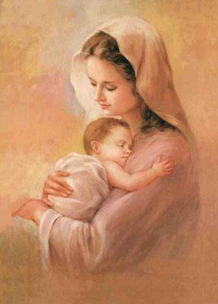
Isaiah 49:15
Can a woman forget her nursing child, And not have compassion on the son of her womb? Surely they may forget, Yet I will not forget you.

Slide 15
…For the Lord your God…goes with you. He will not leave you nor forsake you.
Dt.31:6
…Surely they may forget, Yet I will not forget you.
Isa. 49:15
…I will never leave you nor forsake you.
Heb: 13:5b

Slide 17
Isaiah 49:14-16 (NLT)
But Zion said: The Lord has forsaken me, And my Lord has forgotten me.
Can a woman forget her nursing child, And not have compassion on the son of her womb? Surely they may forget, Yet I will not forget you.
See, I have inscribed you on the palms of My hands; Your walls are continually before Me.

Slide 19
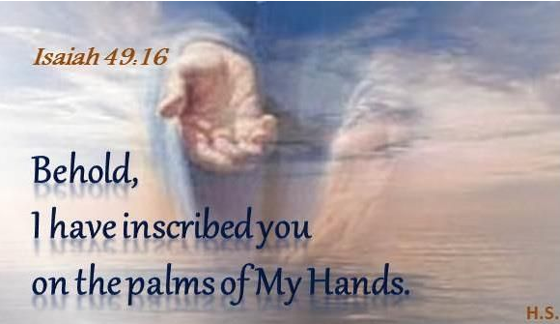
Isaiah 49:16
Shaqaq: Carve or cut into with a hammer and chisel. (Heb.)

Slide 21
Isaiah 49:17-21 (NLT)
Soon your descendants will come back, and all who are trying to destroy you will go away.
Look around you and see, for all your children will come back to you. As surely as I live,” says the Lord, “they will be like jewels or bridal ornaments for you to display.
Even the most desolate parts of your abandoned land will soon be crowded with your people. Your enemies who enslaved you will be far away. The generations born in exile will return and say, ‘We need more room! It’s crowded here!’
Then you will think to yourself, ‘Who has given me all these descendants? For most of my children were killed, and the rest were carried away into exile. I was left here all alone. Where did all these people come from? Who bore these children? Who raised them for me?’”

Slide 23
Isaiah 49:22-26 (NLT)
This is what the Sovereign Lord says:“See, I will give a signal to the godless nations. They will carry your little sons back to you in their arms; they will bring your daughters on their shoulders. ²³ Kings and queens will serve you and care for all your needs. They will bow to the earth before you and lick the dust from your feet. Then you will know that I am the Lord. Those who trust in me will never be put to shame.”
Who can snatch the plunder of war from the hands of a warrior? Who can demand that a tyrant let his captives go?
But the Lord says, “The captives of warriors will be released, and the plunder of tyrants will be retrieved. For I will fight those who fight you, and I will save your children.
I will feed your enemies with their own flesh. They will be drunk with rivers of their own blood. All the world will know that I, the Lord, am your Savior and your Redeemer, the Mighty One of Israel

Slide 25
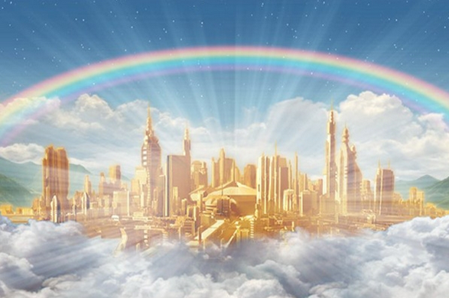
Revelation 21:3-5
And I heard a loud voice from heaven saying, Behold, the tabernacle of God is with men, and He will dwell with them, and they shall be His people. God Himself will be with them and be their God.
And God will wipe away every tear from their eyes; there shall be no more death, nor sorrow, nor crying. There shall be no more pain, for the former things have passed away.”
Then He who sat on the throne said, Behold, I make all things new.

