Slide 1
Mark 10:46-52
20/20 Vision for Jesus in 2020

Slide 2
JESUS HEALS BLIND BARTIMAEUS
46 Now they came to Jericho. As He went out of Jericho with His disciples and a great multitude, blind Bartimaeus, the son of Timaeus, sat by the road begging. 47 And when he heard that it was Jesus of Nazareth, he began to cry out and say, “Jesus, Son of David, have mercy on me!”
48 Then many warned him to be quiet; but he cried out all the more, “Son of David, have mercy on me!”
49 So Jesus stood still and commanded him to be called.
Then they called the blind man, saying to him, “Be of good cheer. Rise, He is calling you.”

Slide 3
JESUS HEALS BLIND BARTIMAEUS
50 And throwing aside his garment, he rose and came to Jesus.
51 So Jesus answered and said to him, “What do you want Me to do for you?”
The blind man said to Him, “Rabboni, that I may receive (recover) my sight.”
52 Then Jesus said to him, “Go your way; your faith has made you well.” And immediately he received his sight and followed Jesus on the road.

Slide 4
New Years Resolutions
Lose weight
Exercise more
Get organized
Learn a new skill or hobby
Live life to the fullest
Save more money / spend less money
Quit smoking
Spend more time with family and friends
Travel more
Read more

Slide 5
Average Time Looking in Mirror???
2015 study finds men look in mirror about 10 minutes per day.
Over the course of one year, that is approximately 6 ½ days!

Slide 7
The Lukewarm Church
17 Because you say, ‘I am rich, have become wealthy, and have need of nothing’—and do not know that you are wretched, miserable, poor, blind, and naked— 18 I counsel you to buy from Me gold refined in the fire, that you may be rich; and white garments, that you may be clothed, that the shame of your nakedness may not be revealed; and anoint your eyes with eye salve, that you may see.

Slide 8
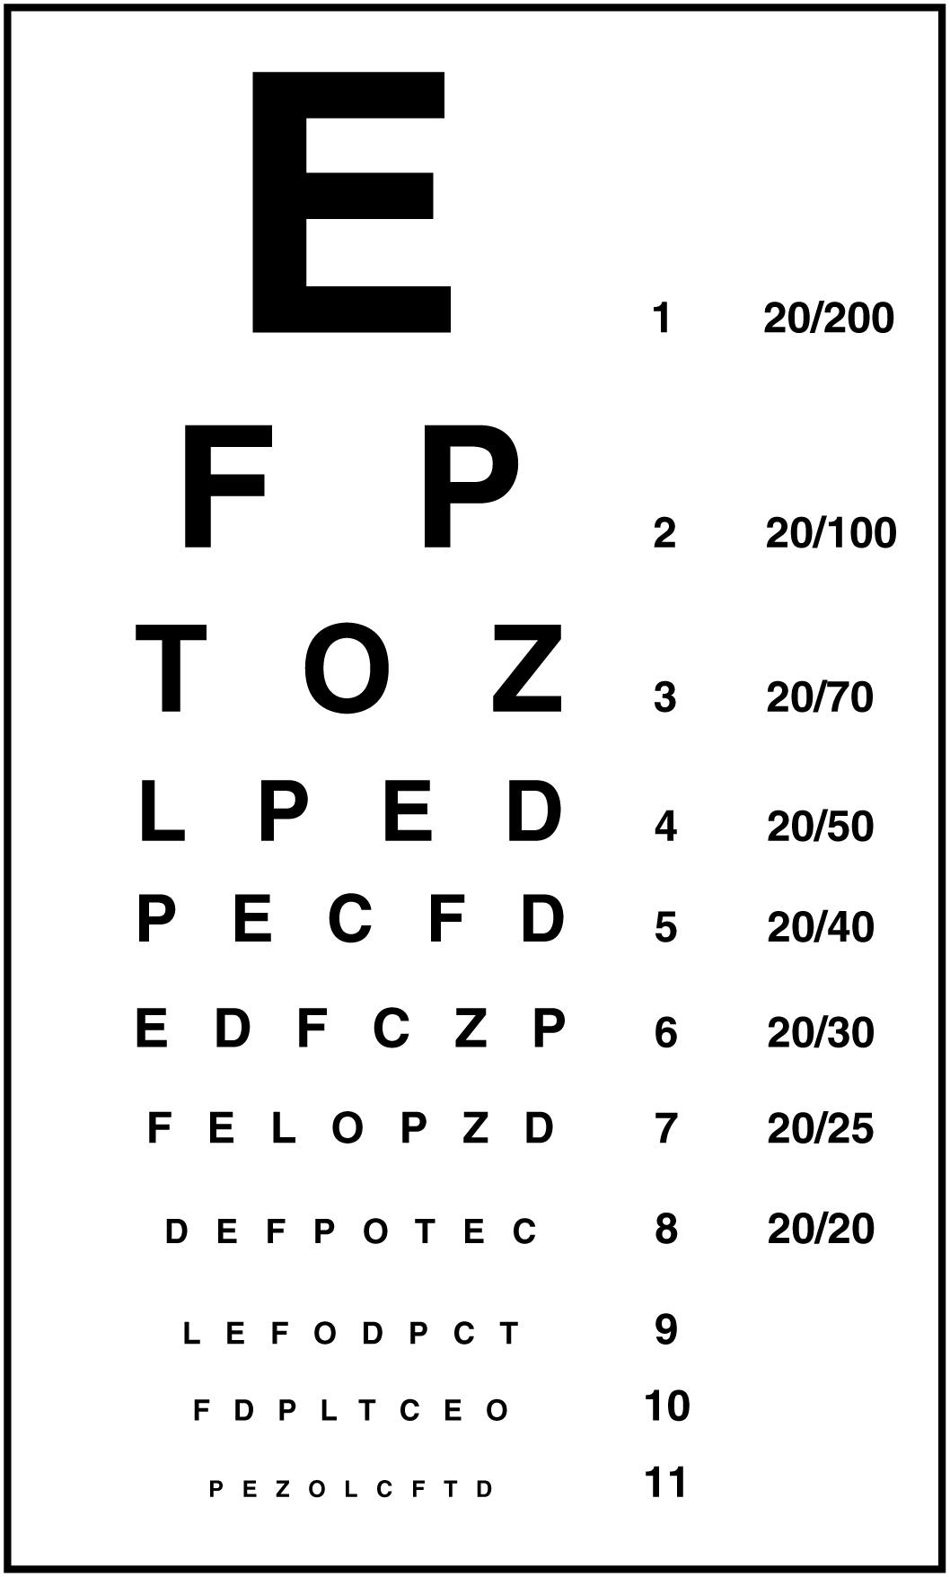
As part of your 20/20 vision, make a personal commitment to accept Jesus Christ as your savior
J E S U S C H R I S T

Slide 9
As part of your 20/20 vision, resolve to engage in the lives of others in the body of Christ
J E S U S C H R I S T

Slide 10
As part of your 20/20 vision, humble yourself and allow the merciful healing of Jesus to bind up your broken spirit (unforgiveness, bitterness, hurts, and disappointments -LET ‘EM GO!)
J E S U S C H R I S T

Slide 11
Luke 11:9
9 So I say to you, ask, and it shall be given you; seek, and ye shall find; knock, and it shall be opened unto you:

Slide 12
As part of your 20/20 vision, resolve to love the Lord God with all of your heart, mind, soul, and strength. Persist in prayer and right living regardless of the personal cost.
J E S U S C H R I S T

Slide 13
This year as part of your 20/20 vision, resolve that you are going to get up from past regrets, throw off old sinful ways of thinking, and follow Christ.
J E S U S C H R I S T

