Slide 2
The Condemnation of Nineveh

Slide 3
Advice For Raising Children as a Church Community
Advice For Parenting

Slide 4
Young People’s Ministries supported at FRBC

Slide 6
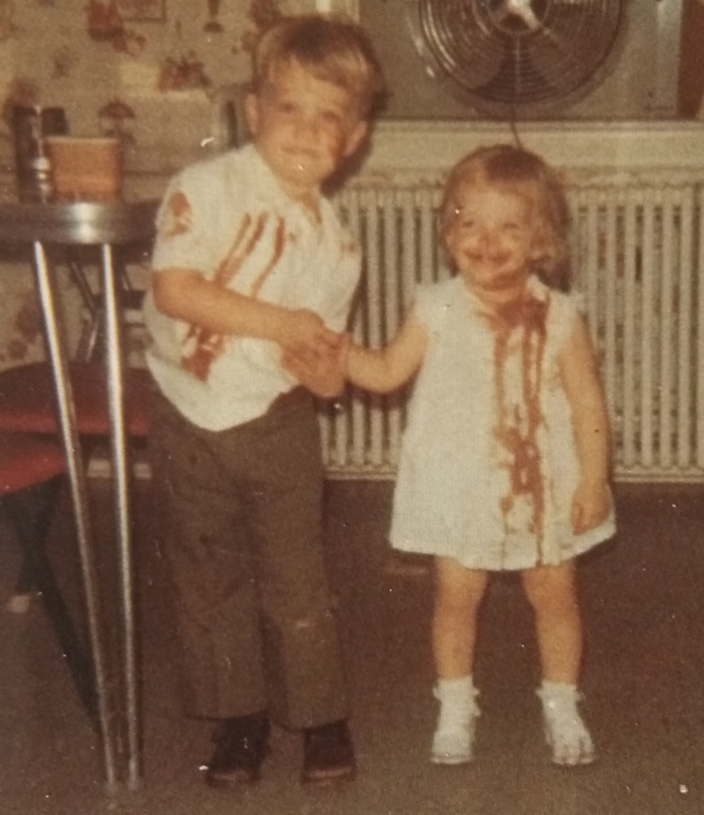
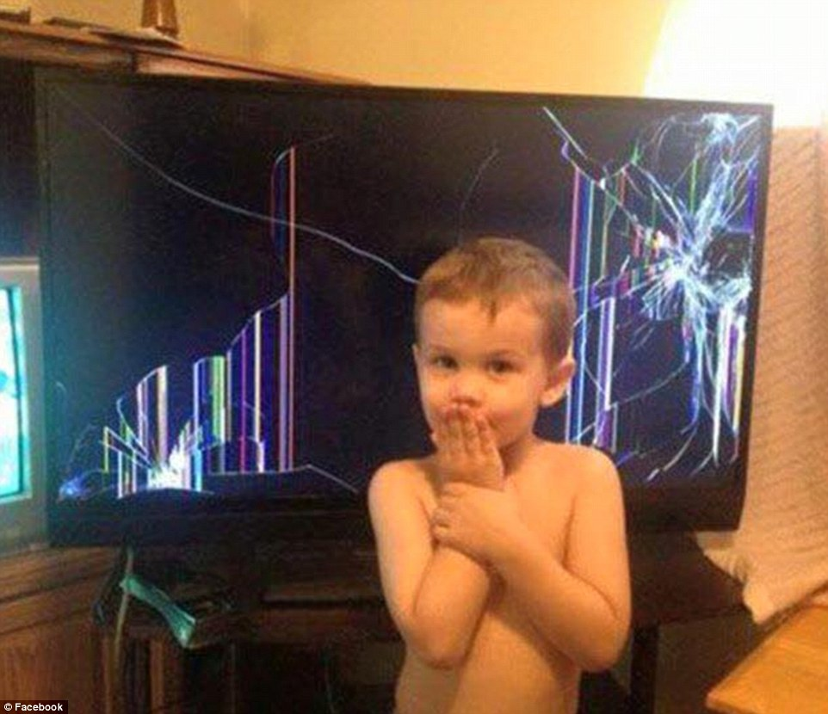
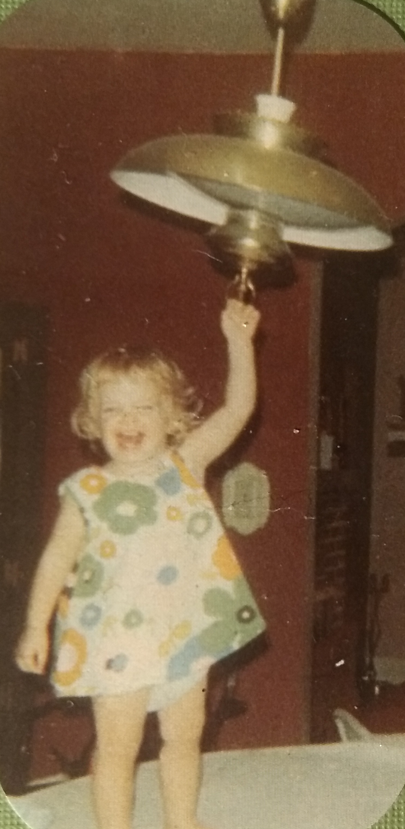
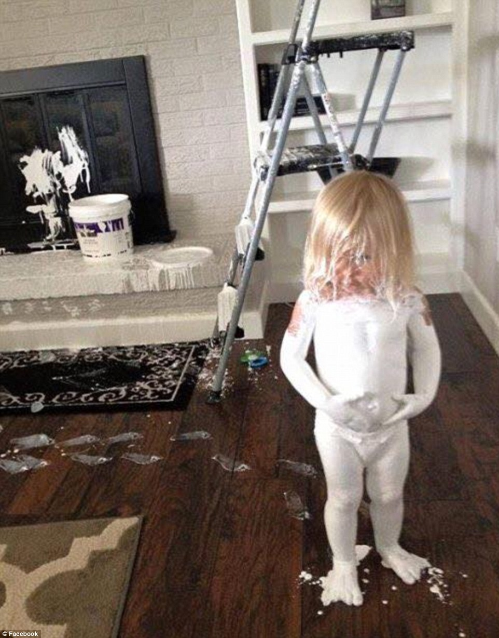
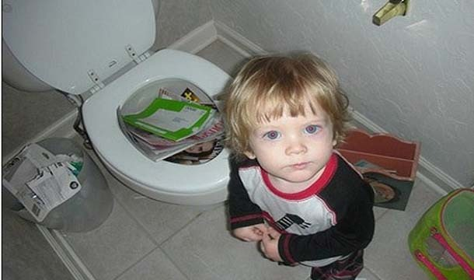
Kids don’t come with an instruction manual

Slide 8
2 Timothy 3:14-17
But as for you, continue in what you have learned and have firmly believed, knowing from whom you learned it and how from childhood you have been acquainted with the sacred writings, which are able to make you wise for salvation through faith in Christ Jesus. All Scripture is breathed out by God and profitable for teaching, for reproof, for correction, and for training in righteousness, that the man of God may be complete, equipped for every good work.

Slide 9
2 Timothy 3:14-17
But as for you, continue in what you have learned and have firmly believed, knowing from whom you learned it and how from childhood you have been acquainted with the sacred writings, which are able to make you wise for salvation through faith in Christ Jesus. All Scripture is breathed out by God and profitable for teaching, for reproof, for correction, and for training in righteousness, that the man of God may be complete, equipped for every good work.

Slide 10
“Wisdom is the power to see, and the inclination to choose, the best and highest goal, together with the surest means of attaining it.”
Packer

Slide 11
“Wisdom is the power to see, and the inclination to choose, the best and highest goal, together with the surest means of attaining it.”
Packer
2 Timothy 3:14-17
.....to make you wise for salvation through faith in Christ Jesus.

Slide 12
2 Timothy 3:14-17
...All Scripture is breathed out by God and profitable for ¹teaching, ²for reproof, ³for correction, ⁴and for training in righteousness, that the man of God may be complete, equipped for every good work.

Slide 14
Ephesians 6:1-3
Children, obey your parents in the Lord, for this is right. "Honor your father and mother" this is the first commandment with a promise, "that it may go well with you and that you may live long in the land."
You shall have no other gods before me.
You shall not take the name of the Lord your God in vain
You shall not make for yourself a carved image
Remember the Sabbath day, to keep it holy
Honor your father and your mother

Slide 15
Ephesians 6:1-3
Children, obey your parents in the Lord, for this is right. "Honor your father and mother" this is the first commandment with a promise, "that it may go well with you and that you may live long in the land."
You shall have no other gods before me.
You shall not take the name of the Lord your God in vain
You shall not make for yourself a carved image
Remember the Sabbath day, to keep it holy
Honor your father and your mother that your days may be long in the land that the Lord your God is giving you.
You shall have no other gods before me.
You shall not take the name of the Lord your God in vain
You shall not make for yourself a carved image
Remember the Sabbath day, to keep it holy
Honor your father and your mother

Slide 17
My son, do not forget my teaching, but let your heart keep my commandments, for length of days and years of life and peace they will add to you. Let not steadfast love and faithfulness forsake you; bind them around your neck; write them on the tablet of your heart. So you will find favor and good success in the sight of God and man.
Train up a child in the way he should go; even when he is old he will not depart from it.

Slide 18
My son, do not forget my teaching, but let your heart keep my commandments, for length of days and years of life and peace they will add to you. Let not steadfast love and faithfulness forsake you; bind them around your neck; write them on the tablet of your heart. So you will find favor and good success in the sight of God and man.
Proverbs 3:1-4
Train up a child in the way he should go; even when he is old he will not depart from it.
Proverbs 22:6

Slide 20
Proverbs is a book of general wise practices that lead to probable positive outcomes.

Slide 21
Wisdom – Having practical skill for living well in God’s world.

Slide 22
Wisdom leads to a right fear of God :
a healthy sense of reverence and awe of God and a correct view of my place in the universe. It is a recognition that I am not God and that I need to embrace God’s definition of right and wrong even when that is inconvenient for me.

Slide 23
the value of speaking the truth
building strong, quality friendships
fearing God
honoring the Lord with your life and choices
living with a social conscience and looking out for others
working hard
respecting and obeying the Bible
honoring the Lord with your life
seeking a Godly spouse
valuing discipline and on and on it goes.

Slide 25
Proverbs 4:20-27
20 My son, be attentive to my words; incline your ear to my sayings.
21 Let them not escape from your sight; keep them within your heart.
22 For they are life to those who find them, and healing to all their flesh.
23 Keep your heart with all vigilance, for from it flow the springs of life.
24 Put away from you crooked speech, and put devious talk far from you.
25 Let your eyes look directly forward, and your gaze be straight before you.
26 Ponder the path of your feet; then all your ways will be sure.
27 Do not swerve to the right or to the left; turn your foot away from evil.

