Slide 1
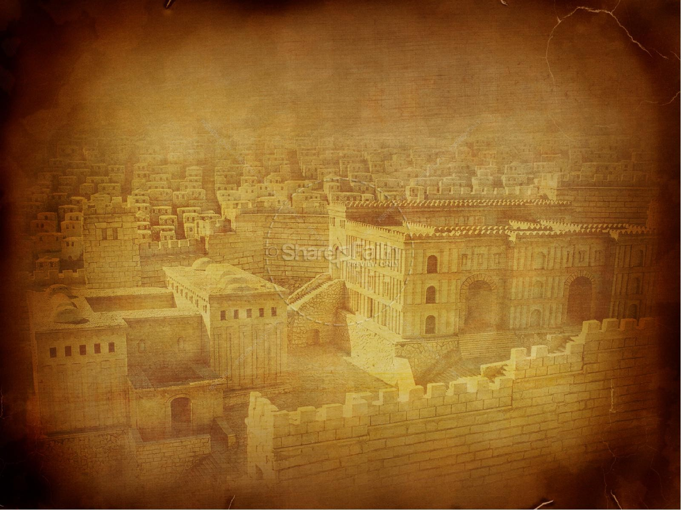
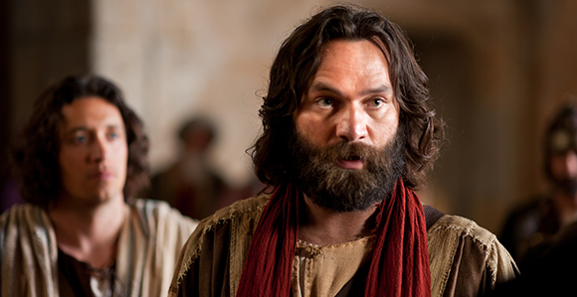
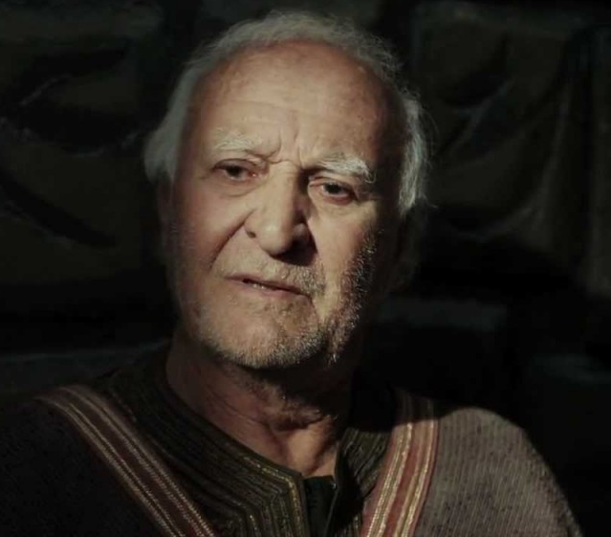
PETER, an apostle of JESUS CHRIST
Boldness , Acts 4
October 6, 2019
Notes:
As we go through the slides and chapter
Yellow text is from the Bible (NKJV)
Green text is for emphasis
Blue text is commentary

Slide 2
Last Week in Chapter 3
Peter , accompanied by John, healed a well-known cripple
“in the name of Jesus Christ of Nazareth”
Peter explained to the awed crowd:
preached the Gospel
Notes:
Peter and John must have shouted the message multiple times to many people who in turn told others

Slide 3
Notes:
Beautiful Gate see line to Court of Women
To get to that level there are many steps from the outside
Solomon’s Porch – Jn 10:23 Jesus walked there – shaded/cool, look at the Beautiful Gate and Temple
Note the Antonia Fortress (Big Brother was watching)

Slide 4
Notes:
Note temple raised above the Gentiles Courtyard and it was those steps in front of the Beautiful Gate where the miracle took place.

Slide 5
Chapter 4
1 Now as they spoke to the people, the priests, (those who had duties in the temple) the captain of the temple, (charged with keeping the peace, the police) and the Sadducees (members of the ruling party) came upon them, 2 being greatly disturbed that they taught the people and preached in Jesus the resurrection from the dead. 3 And they laid hands on them, and put them in custody until the next day, for it was already evening.
Notes:
Were causing a disturbance
Not sanctioned to teach
Sadducees who were in control of the religious leadership said that there was no resurrection.

Slide 6
Chapter 4
Custody
Typical Jail
No or very little light
No bedding
No food or water
No sanitary facilities
Usually chained with heavy, rusty, noisy, painful chains
Notes:
Prison is bad enough in this country in 1st century Judea conditions were appalling

Slide 7
Chapter 4
4 However, many of those who heard the word believed; and the number of the men came to be about five thousand.
The cat was already out of the bag!!
Notes:
The cover up was dead from the start and the conversions had already started rolling in

Slide 8
Chapter 4
5 And it came to pass, on the next day, that their rulers, elders, and scribes, 6 as well as Annas the high priest, Caiaphas, John, and Alexander, and as many as were of the family of the high priest, were gathered together at Jerusalem. (all the religious and political power of the Jews) 7 And when they had set them in the midst, they asked, “By what power or by what name have you done this?”
Notes:
Hadn’t they already been told that by the priests and Captain of the guard who witnessed the event?
See verse 13
probably thought that these ignoramasuses would crumble into a stammering cringing jelly.
Their speech branded them as Galilean
(Remember that Peter was recognized as a Gallilean by his speech on the night of Jesus trial)
like Hokie, a derogatory term implying a lower-class person
also Hick, Hillbilly, hay see, Lynchburg vs Roanoke

Slide 9
Notes:
This group of Who’s who in Jewish religious circles traces back to Moses’ time. Numbers 11:16
M0ses said he needed help with the complaints in the wilderness
God said pick out 70 good men + Moses = 71
The accused/witness is effectively surrounded
Very intimidating

Slide 10
Notes:
Location of Sanhedrin's meeting room

Slide 11
Chapter 4
8 Then Peter, filled with the Holy Spirit, said to them, “Rulers of the people and elders of Israel:.
Notes:
Filled - Not a new event but a condition that Peter was in
We are told to Be filled with the Spirit (an on going or renewable condition) (Eph. 5:18);

Slide 12
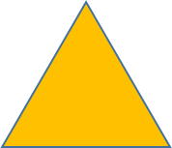
Filled
.
Work
Fun
Holy Spirit
Holy Spirit
Family
Notes:
Which person is filled with the Holy Spirit?
We are told to Be filled with the Spirit (an on going or renewable condition) (Eph. 5:18);
the seven men (deacons) should be full of the Spirit (Acts 6:3); those filled with the Spirit:
Bezalel (Exod. 31:3; Exod. 35:31); John the Baptist - from his mother’s womb (Luke 1:15); Barnabas (Acts 11:24); Elizabeth (Luke 1:41); Jesus (Luke 4:1); Paul (Acts 9:17; Acts 13:9); Peter (Acts 4:8); Stephen (Acts 6:5; Acts 7:55); Zechariah (Luke 1:67);
the disciples in Jerusalem (Acts 2:4; Acts 4:31);
the disciples in Antioch of Pisidia (Acts 13:52).

Slide 13
Chapter 4
8 Then Peter, filled with the Holy Spirit, said to them, “Rulers of the people and elders of Israel: 9 If we this day are judged for a good deed done to a helpless man, by what means he has been made well, 10 let it be known to you all, and to all the people of Israel, that by the name of Jesus Christ of Nazareth, whom you crucified, whom God raised from the dead, by Him this man stands here before you whole.
.
Notes:
Filled - Not a new event but a condition that Peter was in
We are told to Be filled with the Spirit (an on going or renewable condition) (Eph. 5:18);

Slide 14
Chapter 4
11 This is the ‘stone which was rejected by you builders, which has become the chief cornerstone.’ 12 Nor is there salvation in any other, for there is no other name under heaven given among men by which we must be saved.”
13 Now when they saw the boldness of Peter and John, and perceived that they were uneducated and untrained men, they marveled.
Notes:
Ps 118:22
Peter does not leave any doubt about Jesus
Being filled with the Spirit results in boldness for Christ
BOLDNESS
1959 Melrose Chapel meeting Gorgeous, blonde, white complexion with enough freckles to add interest
Sunday School, Youth Group, VA young peoples conference
1963 father gave me passes for bowling Then I was bold enough

Slide 15
Chapter 4
13b And they realized that they had been with Jesus. 14 And seeing the man who had been healed standing with them, they could say nothing against it.
Notes:
Authorities backed into a corner

Slide 16
Chapter 4
15 But when they had commanded them to go aside out of the council, they conferred among themselves, 16 saying, “What shall we do to these men? For, indeed, that a notable miracle has been done through them is evident to all who dwell in Jerusalem, and we cannot deny it. 17 But so that it spreads no further among the people, let us severely threaten them, that from now on they speak to no man in this name.”
Notes:
Just like today’s politicians they would have covered it up if they could
No cover up possible, can’t put a “spin” on it so let's stop the propagation.

Slide 17
Chapter 4
18 So they called them and commanded them not to speak at all nor teach in the name of Jesus. 19 But Peter and John answered and said to them, “Whether it is right in the sight of God to listen to you more than to God, you judge. 20 For we cannot but speak the things which we have seen and heard.” 21 So when they had further threatened them, they let them go, finding no way of punishing them, because of the people, since they all glorified God for what had been done. 22 For the man was over forty years old on whom this miracle of healing had been performed.
Notes:
Both Peter and John bold
Filled with the Spirit?
Make sure that your direction comes from God and not your intellect or bias

Slide 18
Chapter 4
23 And being let go, they went to their own companions and reported all that the chief priests and elders had said to them. 24 So when they heard that, they raised their voice to God with one accord and said: “Lord, You are God, who made heaven and earth and the sea, and all that is in them, 25 who by the mouth of Your servant David have said:
Notes:
Not hiding in a corner but at a meeting of the church
Not fear and trembling but PRAISE

Slide 19
Chapter 4
‘Why did the nations rage,
And the people plot vain things?
26 The kings of the earth took their stand,
And the rulers were gathered together
Against the LORD and against His Christ.’
Notes:
Psalm 2

Slide 20
Chapter 4
27 “For truly against Your holy Servant Jesus, whom You anointed, both Herod and Pontius Pilate, with the Gentiles and the people of Israel, were gathered together 28 to do whatever Your hand and Your purpose determined before to be done.
Notes:
Leaves no doubt about the facts, the fulfillment of that stage of prophesy
Leaves no doubt about who is in charge

Slide 21
Chapter 4
29 Now, Lord, look on their threats, and grant to Your servants that with all boldness they may speak Your word, 30 by stretching out Your hand to heal, and that signs and wonders may be done through the name of Your holy Servant Jesus.”
Notes:
Note the request not for protection but for boldness to speak God’s word
Is that our request?
Perhaps when I pray for Toshi & Tainla Jamir in Nagaland; Shobit Masih in Punjab, or the Blackburns in Central Asia I should not concentrate so much on resources, health, and safety but for boldness.

Slide 22
Chapter 4
31 And when they had prayed, the place where they were assembled together was shaken; and they were all filled with the Holy Spirit, and they spoke the word of God with boldness.
Notes:
God said OK and provided an earthquake to make the point.
The whole group were filled with the Holy Spirit and were bold.

Slide 23
Chapter 4
32 Unity
33 great power great grace was upon them all.
34, 35 Sharing
36 Barnabas introduced
Notes:
Church unity is very important
That does not exist in today’s worldwide church, even in the Baltimore area church
We should strive to ensure that unity does exist in FRBC
From unity comes power

Slide 24
Spirit Filled for Boldness
So the way to test whether we are filled with the Spirit is to ask: Are we full of thankfulness? Are we full of praise? Do we sing to ourselves and to one another in psalms and hymns and spiritual songs? Do we make melody in our hearts? Do we praise God when we are alone? Do we delight in praising Him with others? Do we delight in praising Him in public as well as in private? Are we full of the spirit of praise, of thanksgiving, of worship and adoration? It is an inevitable consequence of being filled with the Spirit. D.M. Lloyd-Jones, 1997
Notes:
Galatians 5 similarities
That does not exist in today’s worldwide church, even in the Baltimore area church
We should strive to ensure that unity does exist in FRBC
From unity comes power

Slide 25
PETER, an apostle of JESUS CHRIST
Boldness , Acts 5
October 13, 2019
Notes:
Next week Jim Traband will talk about Boldness in Acts 5

