Slide 1
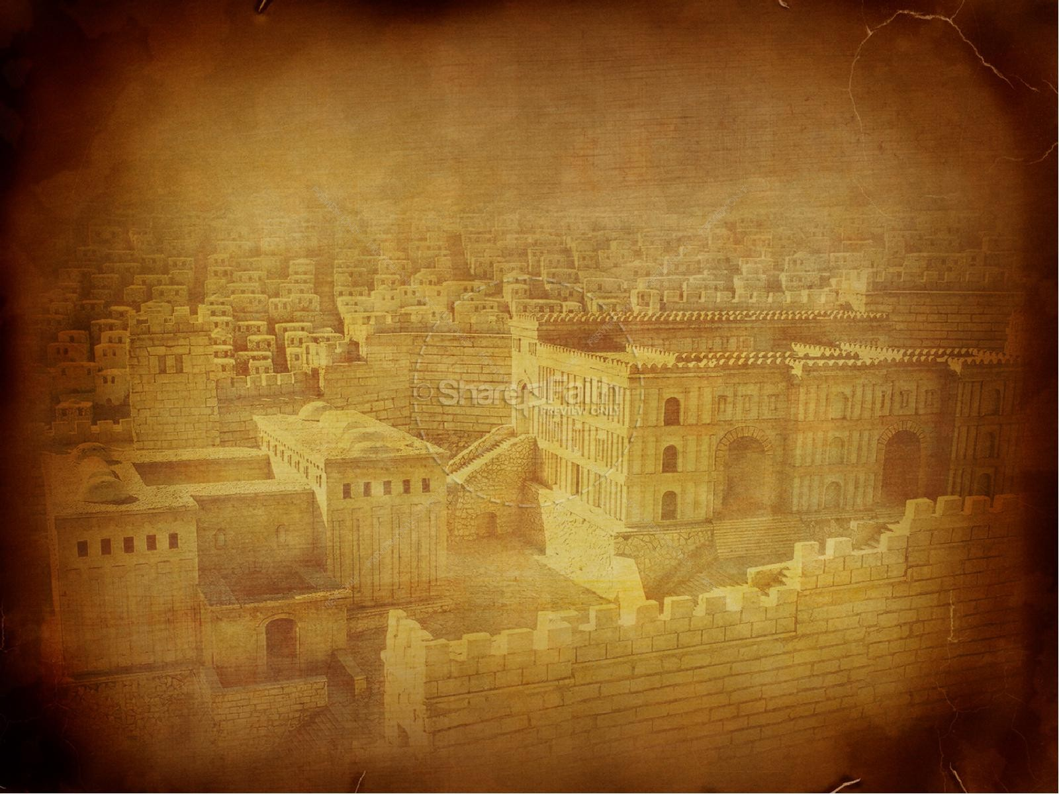
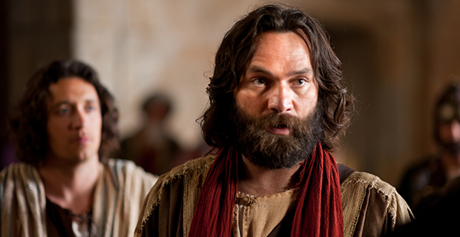
PETER, an apostle of JESUS CHRIST
Acts Chapter 3

Slide 2
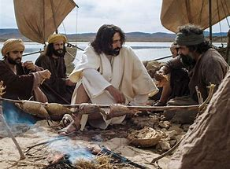

Slide 3
Acts 3 Outline
1. Brief review of Acts chapters 1 and 2
2. Acts chapter 3 (Our text)
a. The healing of a lame man- A physical demonstration of the power of Jesus Christ
b. Peter preaches a sermon- He uses this miracle of the healing to proclaim the power of Jesus Christ to forgive sins
3. Peter’s calling was unique but his mission was to care for and build up the church
4. We have a unique calling, but our mission is the same as Peter’s- that is to care for and build up the church
5. Obey your calling and you will fulfill the mission God has given you.

Slide 4
PETER, an apostle of JESUS CHRIST
Acts Chapter 3

Slide 5
The Day of Pentecost Acts chapter 2

Slide 6
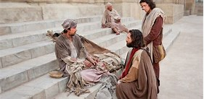
Now Peter and John went up together to the temple at the hour of prayer,…..

Slide 7
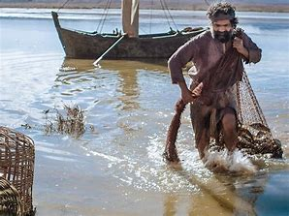
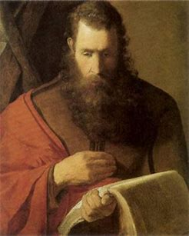
John
Peter

Slide 8
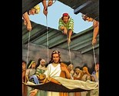
Jesus heals a paralyzed man

Slide 9
By the physical demonstration of this miracle, this tangible thing that everybody could see, Jesus is giving evidence that he also had the power to do something that was intangible and unsee-able and that was to forgive this man’s sins.

Slide 10
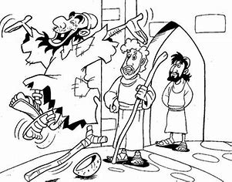
So he, leaping up, stood and walked and entered the temple with them—walking, leaping, and praising God.
Acts 3:8

Slide 11
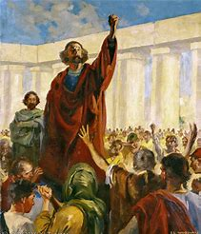
So when Peter saw it, he responded to the people: “Men of Israel, why do you marvel at this? Or why look so intently at us, as though by our own power or godliness we had made this man walk?.....
Acts 3:12

Slide 12
13 The God of Abraham, Isaac, and Jacob, the God of our fathers, glorified His Servant Jesus, whom you delivered up and denied in the presence of Pilate, when he was determined to let Him go. 14 But you denied the Holy One and the Just, and you asked for a murderer to be granted to you, 15 and killed the Prince of life, whom God raised from the dead, of which we are witnesses.
Acts 3:13-15

Slide 13
Repentance and conversion by faith in Jesus Christ is the solution for mankind’s sin problem. It is the ONLY solution.

Slide 14
Peter the Apostle

Slide 15
The Great Commission Part 2???
So when they had eaten breakfast, Jesus said to Simon Peter, “Simon, son of Jonah,[fn] do you love Me more than these?” He said to Him, “Yes, Lord; You know that I love You.”He said to him, “Feed My lambs.” He said to him again a second time, “Simon, son of Jonah,[fn] do you love Me?” He said to Him, “Yes, Lord; You know that I love You.” He said to him, “Tend My sheep.” He said to him the third time, “Simon, son of Jonah,[fn] do you love Me?” Peter was grieved because He said to him the third time, “Do you love Me?”And he said to Him, “Lord, You know all things; You know that I love You.”Jesus said to him, “Feed My sheep. Most assuredly, I say to you, when you were younger, you girded yourself and walked where you wished; but when you are old, you will stretch out your hands, and another will gird you and carry you where you do not wish.” This He spoke, signifying by what death he would glorify God. And when He had spoken this, He said to him, “Follow Me.” Then Peter, turning around, saw the disciple whom Jesus loved following, who also had leaned on His breast at the supper, and said, “Lord, who is the one who betrays You?” Peter, seeing him, said to Jesus, “But Lord, what about this man?” Jesus said to him, “If I will that he remain till I come, what is that to you? You follow Me.”
John 21: 15-22

Slide 16
“Returning to my favorite characters of the Old Testament reminded me that purpose is found in the ordinary…………They might all have had notions that they were “made for more”, but we don’t find them erratically searching for it or begging God to reveal it. They were about the business of the ordinary until God did something extra-ordinary.”
Stacey March

Slide 17
