Slide 1
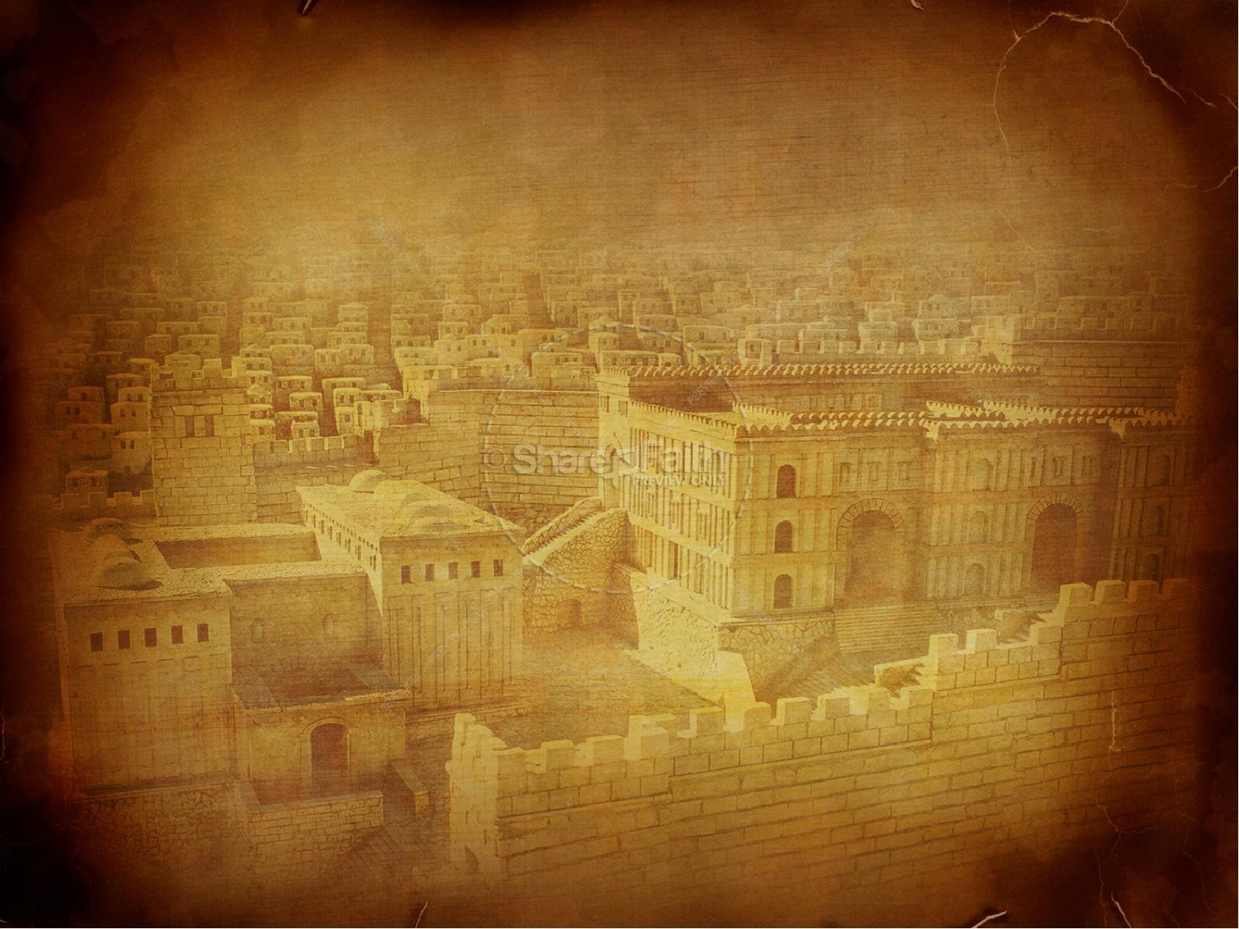
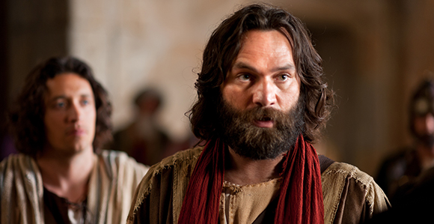
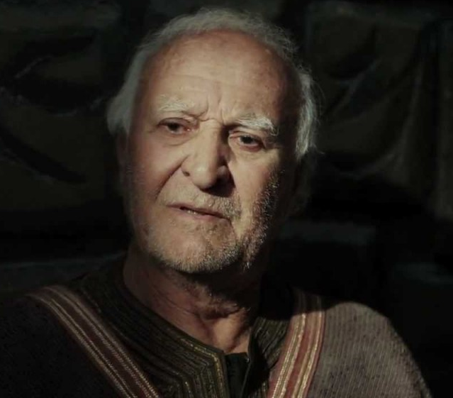
Peter, an apostle of Jesus Christ
Acts 2

Slide 2
“He brought him to Jesus. Jesus looked at him and said, ‘You are Simon the son of John. You shall be called Cephas’ (which means Peter).”
John 1:42

Slide 3
“And while staying with them He ordered them not to depart from Jerusalem, but to wait for the promise of the Father, which, He said, ‘you heard from me; for John baptized with water, but you will be baptized with the Holy Spirit not many days from now.’”
Acts 1:4-5

Slide 4
“You shall count seven weeks. Begin to count the seven weeks from the time the sickle is first put to the standing grain. Then you shall keep the Feast of Weeks to the LORD your God with the tribute of a freewill offering from your hand, which you shall give as the LORD your God blesses you. And you shall rejoice before the LORD your God, you and your son and your daughter, your male servant and your female servant, the Levite who is within your towns, the sojourner, the fatherless, and the widow who are among you, at the place that the LORD your God will choose, to make His name dwell there.”
Deuteronomy 16:9-11

Slide 5
“You shall keep the Feast of Harvest, of the firstfruits of your labor, of what you sow in the field.”
Exodus 23:16
“On the Day of the Firstfruits, when you offer a grain offering of new grain to the LORD at your Feast of Weeks, you shall have a holy convocation.”
Numbers 28:26

Slide 6
ACTS 2:1-15

Slide 7
“The LORD said to Moses, ‘See, I have called by name Bezalel the son of Uri, son of Hur, of the tribe of Judah, and I have filled him with the Spirit of God, with ability and intelligence, with knowledge and all craftsmanship, to devise artistic designs, to work in gold, silver, and bronze, in cutting stones for setting, and in carving wood, to work in every craft.’”
Exodus 31:1-5

Slide 8
“I myself did not know Him, but He who sent me to baptize with water said to me, ‘He on whom you see the Spirit descend and remain, this is He who baptizes with the Holy Spirit.’ And I have seen and have borne witness that this is the Son of God.”
John 1:33-34

Slide 9
“But when the Helper comes, whom I will send to you from the Father, the Spirit of truth, who proceeds from the Father, He will bear witness about Me. And you also will bear witness, because you have been with Me from the beginning.”
John 15:26

Slide 10
“When the Spirit of truth comes, He will guide you into all truth, for He will not speak on His own authority, but whatever He hears He will speak, and He will declare to you the things that are to come. He will glorify Me, for He will take what is mine and declare it to you. All that the Father has is mine; therefore I said that He will take what is mine and declare it to you.”
John 16:13-15

Slide 11
“From His co-ordinate rank with the Father and Son there emerges yet another proof of His Godhead. He is presented in association with them in terms of perfect equality at Christ’s baptism, at the Pentecostal outpouring, in the apostolic commission and in the baptismal formula. The whole Trinity is represented as working in perfect unison for the accomplishment of man’s redemption;
‘How much more shall the blood of Christ Who through the eternal Spirit offered Himself without spot to God, purge your conscience from dead works.’ [Hebrews 9:14]…
We are baptized into the name (not names) of the Holy Spirit as well as of the Father and the Son.”
J. Oswald Sanders, The Holy Spirit and His Gifts

Slide 12
ACTS 2:16-41

Slide 13
“Concerning this salvation, the prophets who prophesied about the grace that was to be yours searched and inquired carefully, inquiring what person or time the Spirit of Christ in them was indicating when He predicted the sufferings of Christ and the subsequent glories. It was revealed to them that they were serving not themselves but you, in the things that have now been announced to you through those who preached the good news to you by the Holy Spirit sent from heaven, things into which angels long to look.”
1 Peter 1:10-12

