Slide 1
Worshiping a Holy God

Slide 2
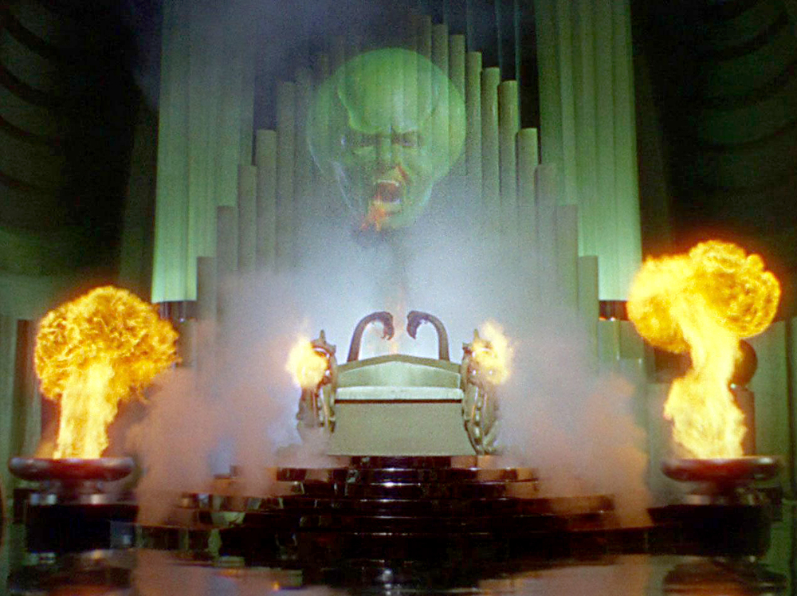

Slide 4
Who is the subject of our worship?
Does he demand a certain kind of worship?
What does that mean for us in 2019?

Slide 5
“Woman, believe me, the hour is coming when neither on this mountain nor in Jerusalem will you worship the Father. You worship what you do not know; we worship what we know, for salvation is from the Jews. But the hour is coming, and is now here, when true worshipers will worship the Father in spirit and truth, for the Father is seeking such people to worship him. God is spirit, and those who worship him must worship in spirit and truth.”
--John 4:21-24

Slide 6
On the first day of the week, when we were gathered together to break bread, Paul talked with them, intending to depart the next day, and he prolonged his speech until midnight. -- Acts 20: 7
Now concerning the collection for the saints: as I directed the churches of Galatia, so you are also to do. On the first day of every week, each of you is to put something aside and store it up, as he may prosper, so that there will be no collecting when I come. -- 1 Corinthians 16: 1-2

Slide 7
Corporate worship
But you are a chosen race, a royal priesthood, a holy nation, a people for his own possession, that you may proclaim the excellencies of him who called you out of darkness into his marvelous light. Once you were not a people, but now you are God’s people; once you had not received mercy, but now you have received mercy.
--1 Peter 2: 9-10

Slide 8
In the year that King Uzziah died I saw the Lord sitting upon a throne, high and lifted up; and the train of his robe filled the temple. Above him stood the seraphim. Each had six wings: with two he covered his face, and with two he covered his feet, and with two he flew. And one called to another and said:
“Holy, holy, holy is the Lord of hosts;
the whole earth is full of his glory!”
--Isaiah 6: 1-5

Slide 9
And the foundations of the thresholds shook at the voice of him who called, and the house was filled with smoke.
And I said, “Woe is me! For I am lost; for I am a man of unclean lips, and I dwell in the midst of a people of unclean lips; for my eyes have seen the King, the Lord of hosts!”
--Isaiah 6: 1-5

Slide 10
And Simon answered, “Master, we toiled all night and took nothing! But at your word I will let down the nets.” And when they had done this, they enclosed a large number of fish, and their nets were breaking. They signaled to their partners in the other boat to come and help them. And they came and filled both the boats, so that they began to sink. But when Simon Peter saw it, he fell down at Jesus’ knees, saying, “Depart from me, for I am a sinful man, O Lord.”
--Luke 5:5-8

Slide 11
Then I turned to see the voice that was speaking to me, and on turning I saw … one like a son of man, clothed with a long robe and with a golden sash around his chest. The hairs of his head were white, like white wool, like snow. His eyes were like a flame of fire, his feet were like burnished bronze, refined in a furnace, and his voice was like the roar of many waters.
--Revelation 1: 12-17

Slide 12
In his right hand he held seven stars, from his mouth came a sharp two-edged sword, and his face was like the sun shining in full strength. When I saw him, I fell at his feet as though dead.
--Revelation 1: 12-17

Slide 14
If his gift for a burnt offering is from the flock, from the sheep or goats, he shall bring a male without blemish, and he shall kill it on the north side of the altar before the Lord, and Aaron’s sons the priests shall throw its blood against the sides of the altar.
-- Leviticus 1: 10-11

Slide 15
Therefore, brothers, since we have confidence to enter the holy places by the blood of Jesus, by the new and living way that he opened for us through the curtain, that is, through his flesh, and since we have a great priest over the house of God, let us draw near with a true heart in full assurance of faith, with our hearts sprinkled clean from an evil conscience and our bodies washed with pure water.
--Hebrews 10:19-22

Slide 16
Worshiping in Spirit:
(pneuma) (pneuma) : a current of air; a breath

Slide 17
“…true worship is carried along by the Holy Spirit and is happening mainly as an inward, spiritual event, not mainly as an outward, bodily event.”
--John Piper
Expository Exultation

Slide 18
Worshiping in spirit necessarily involves
the mind
and
the heart.

Slide 19
“we are not to essay anything in religion rashly or unthinkingly. For unless there is knowledge present, it is not God we worship, but a spectre or a ghost.”
-- John Calvin
John 1-10,
Calvin’s New Testament Commentaries vol. 4

Slide 21
Truth:
Reality as perceived by God

Slide 22
They are not of the world, just as I am not of the world. Sanctify them in the truth; your word is truth.
-- John 17: 16-17

Slide 23
Let the word of Christ dwell in you richly, teaching and admonishing one another in all wisdom, singing psalms and hymns and spiritual songs, with thankfulness in your hearts to God. And whatever you do, in word and deed, do everything in the name of the Lord Jesus, giving thanks to God the Father through him.
--Colossians 3:16
(see also Eph. 5 and 1 Corinthians 14)

Slide 24
Worship recognizing the holiness of God and our unworthiness
Worship with our heart and our mind
Worship using scripture as our foundation
Worship giving thanks to the Father, through the Lord Jesus Christ

Slide 25
Let the word of Christ dwell in you richly, teaching and admonishing one another in all wisdom, singing psalms and hymns and spiritual songs, with thankfulness in your hearts to God. And whatever you do, in word and deed, do everything in the name of the Lord Jesus, giving thanks to God the Father through him.
--Colossians 3:16

Slide 26
Let the word of Christ dwell in you richly, teaching and admonishing one another in all wisdom, singing psalms and hymns and spiritual songs, with thankfulness in your hearts to God. And whatever you do, in word and deed, do everything in the name of the Lord Jesus, giving thanks to God the Father through him.
--Colossians 3:16

Slide 27
Let the word of Christ dwell in you richly, teaching and admonishing one another in all wisdom, singing psalms and hymns and spiritual songs, with thankfulness in your hearts to God. And whatever you do, in word and deed, do everything in the name of the Lord Jesus, giving thanks to God the Father through him.
--Colossians 3:16

Slide 28
How beautiful upon the mountains
are the feet of him who brings good news,
who publishes peace, who brings good news of
happiness,
who publishes salvation,
who says to Zion, “Your God reigns.”
--Isaiah 52:7

Slide 29
In the beginning was the Word,
and the Word was with God
and the Word was God.
--John 1:1

Slide 30
Let the word of Christ dwell in you richly, teaching and admonishing one another in all wisdom, singing psalms and hymns and spiritual songs, with thankfulness in your hearts to God. And whatever you do, in word and deed, do everything in the name of the Lord Jesus, giving thanks to God the Father through him.
--Colossians 3:16

Slide 31
Let the words of my mouth and the meditation of
my heart be acceptable in your sight, O Lord, my rock and my redeemer.
--Psalm 19:14

Slide 32
To worship is to quicken the conscience by the holiness of God,
to feed the mind with the truth of God,
to purge the imagination by the beauty of God,
to open the heart by the love of God,
to devote the will to the purpose of God.
--William Temple
Nature, Man and God

