Slide 1
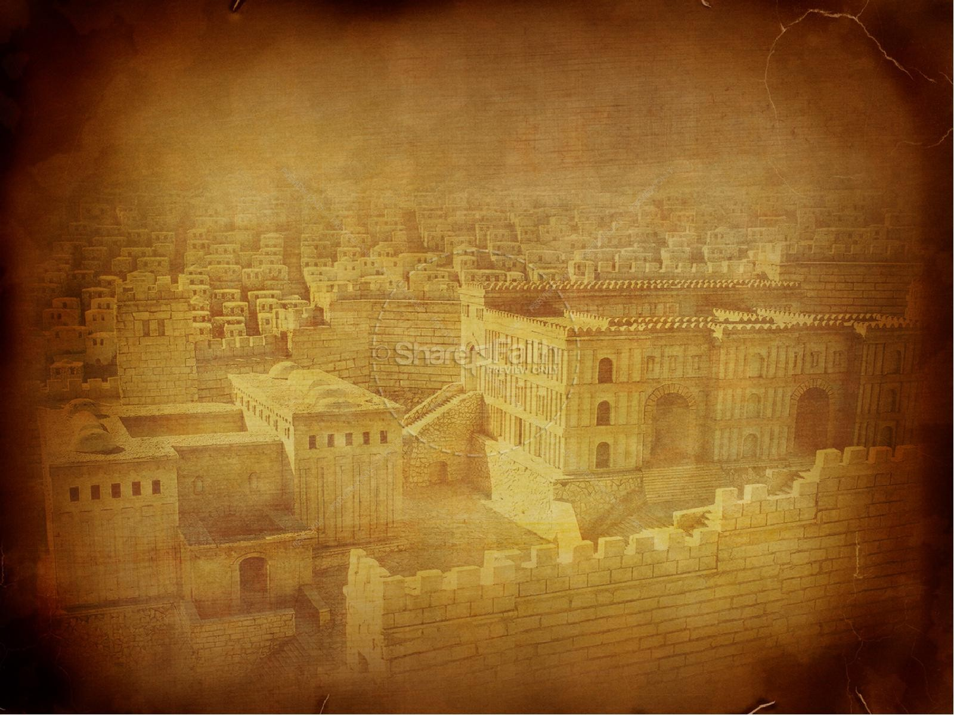
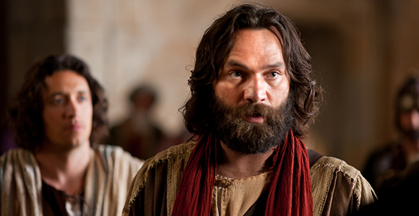
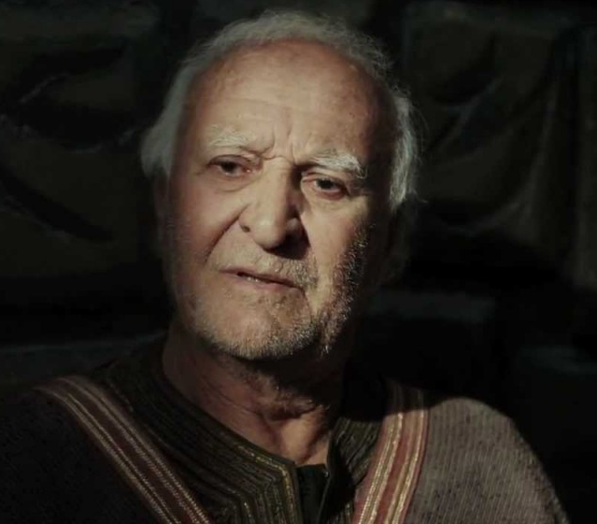
PETER, an apostle of JESUS CHRIST
Acts 12
Prison

Slide 2
Beloved, do not think it strange concerning the fiery trial which is to try you, as though some strange thing happened to you; but rejoice to the extent that you partake of Christ’s sufferings, that when His glory is revealed, you may also be glad with exceeding joy. If you are reproached for the name of Christ, blessed are you, for the Spirit of glory and of God rests upon you. On their part He is blasphemed, but on your part He is glorified. But let none of you suffer as a murderer, a thief, an evildoer, or as a busybody in other people’s matters. Yet if anyone suffers as a Christian, let him not be ashamed, but let him glorify God in this matter.
For the time has come for judgment to begin at the house of God; and if it begins with us first, what will be the end of those who do not obey the gospel of God? Now
“If the righteous one is scarcely saved, Where will the ungodly and the sinner appear?”
Therefore let those who suffer according to the will of God commit their souls to Him in doing good, as to a faithful Creator.
I Peter 4: 12 - 19

Slide 4
Self Assessment Survey
Instructions: Rate yourself from 1-10 with 1 being the statement does not describe you very well to 10 being it describes you to a tee:
When your well-made plans begin to unravel you get stressed out.
Uncertainty in your life causes you to experience fear.
You become anxious when others have power to dictate events in your life and they choose things you would not.
You wake up at night thinking about upcoming events/responsibilities and you can’t go back to sleep because of the worry that results.
You get nervous and doubt God’s working in your life when He is clearly pointing you in a direction you would rather not go.
Discomfort causes you stress.

Slide 5
Score | Meaning
0-20 | You are doing well resting in God’s sovereign care. You may not need the content of this message as much as others but take good notes anyway because you probably know someone who does.
21-40 | You are making strides towards resting in God’s sovereign care. May this message encourage you to continue moving towards full rest in Him through all circumstances.
41-60 | You are not alone! Many people struggle with worry, anxiety, fear, doubt, and stress. This is not what God desires for us. Let’s see if we can learn something from Peter about that will help us experience relief from these human struggles.

Slide 6
These verses help me but also haunt me....
Matthew 6:34
“Therefore do not worry about tomorrow, for tomorrow will worry about its own things. Sufficient for the day is its own trouble.”
Philippians 4:6
“Be anxious for nothing, but in everything by prayer and supplication, with thanksgiving, let your requests be made known to God”
Psalms 27:1
“The LORD is my light and my salvation; Whom shall I fear? The LORD is the strength of my life; Of whom shall I be afraid?”
Isaiah 41:10
“Fear not, for I am with you; Be not dismayed, for I am your God. I will strengthen you, Yes, I will help you, I will uphold you with My righteous right hand.”
John 14:27
“Peace I leave with you, My peace I give to you; not as the world gives do I give to you. Let not your heart be troubled, neither let it be afraid.”

Slide 8
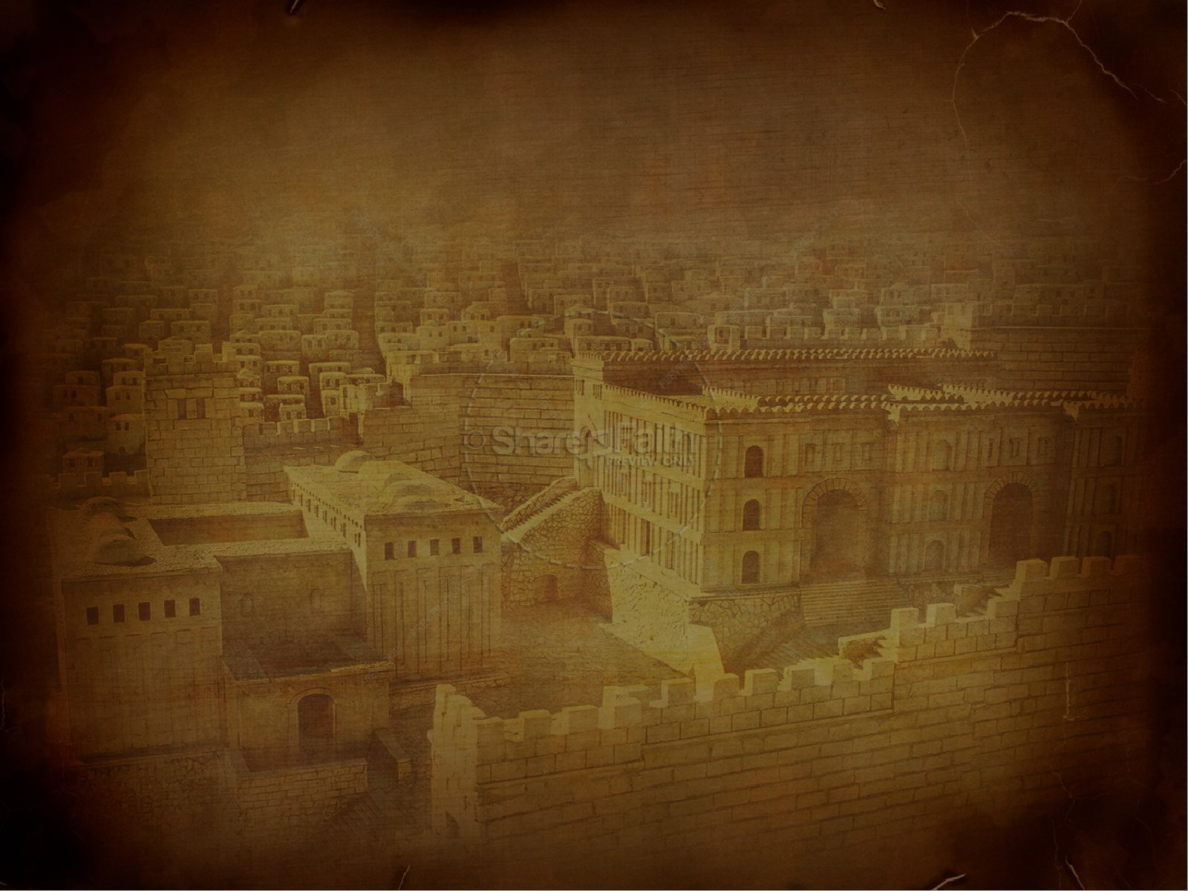
PETER, an apostle of JESUS CHRIST
“You will keep him in perfect peace, whose mind is stayed on You, because he trusts in You.”
Isaiah 26:3
How can we live in perfect peace regardless of the circumstances swirling around us?
Acts 12 - Freed From Prison

Slide 10
Be filled with the Spirit and be bold for Christ (in your testimony to others)
Be filled with the Spirit and know the peace of God in your everyday circumstances

Slide 11
Acts 12:1-12
1 About that time Herod the king laid violent hands on some who belonged to the church. 2 He killed James the brother of John with the sword, 3 and when he saw that it pleased the Jews, he proceeded to arrest Peter also. This was during the days of Unleavened Bread. 4 And when he had seized him, he put him in prison, delivering him over to four squads of soldiers to guard him, intending after the Passover to bring him out to the people. 5 So Peter was kept in prison, but earnest prayer for him was made to God by the church.

Slide 12
6 Now when Herod was about to bring him out, on that very night, Peter was sleeping between two soldiers, bound with two chains, and sentries before the door were guarding the prison. 7 And behold, an angel of the Lord stood next to him, and a light shone in the cell. He struck Peter on the side and woke him, saying, "Get up quickly." And the chains fell off his hands. 8 And the angel said to him, "Dress yourself and put on your sandals." And he did so. And he said to him, "Wrap your cloak around you and follow me." 9 And he went out and followed him. He did not know that what was being done by the angel was real, but thought he was seeing a vision.

Slide 13
10 When they had passed the first and the second guard, they came to the iron gate leading into the city. It opened for them of its own accord, and they went out and went along one street, and immediately the angel left him. 11 When Peter came to himself, he said, "Now I am sure that the Lord has sent his angel and rescued me from the hand of Herod and from all that the Jewish people were expecting." 12 When he realized this, he went to the house of Mary, the mother of John whose other name was Mark, where many were gathered together and were praying.

Slide 15
Acts 12:1
About that time Herod the king laid violent hands on some who belonged to the church.

Slide 16
Acts 12:2-5
2 He killed James the brother of John with the sword, 3 and when he saw that it pleased the Jews, he proceeded to arrest Peter also. This was during the days of Unleavened Bread. 4 And when he had seized him, he put him in prison, delivering him over to four squads of soldiers to guard him, intending after the Passover to bring him out to the people. 5 So Peter was kept in prison, but earnest prayer for him was made to God by the church.

Slide 17
John 21:18-19
“I tell you the truth, when you were young, you were able to do as you liked; you dressed yourself and went wherever you wanted to go. But when you are old, you will stretch out your hands, and others will dress you and take you where you don’t want to go.” Jesus said this to let him know by what kind of death he would glorify God. Then Jesus told him, “Follow me.”

Slide 18
Acts 12:6
Now when Herod was about to bring him out, on that very night, Peter was sleeping between two soldiers, bound with two chains, and sentries before the door were guarding the prison.

Slide 19
Acts 12:7
And behold, an angel of the Lord stood next to him, and a light shone in the cell. He struck Peter on the side and woke him, saying, "Get up quickly." And the chains fell off his hands.

Slide 20
Acts 12:8
And the angel said to him, "Dress yourself and put on your sandals." And he did so. And he said to him, "Wrap your cloak around you and follow me."

Slide 21
Acts 12:9
And he went out and followed him. He did not know that what was being done by the angel was real, but thought he was seeing a vision.

Slide 22
Acts 12:10
When they had passed the first and the second guard, they came to the iron gate leading into the city. It opened for them of its own accord, and they went out and went along one street, and immediately the angel left him.

Slide 23
Acts 12:11
When Peter came to himself, he said, "Now I am sure that the Lord has sent his angel and rescued me from the hand of Herod and from all that the Jewish people were expecting."

Slide 24
Acts 12:12
When he realized this, he went to the house of Mary, the mother of John whose other name was Mark, where many were gathered together and were praying.

Slide 25
Isaiah 26:3
You keep him in perfect peace whose mind is stayed on you, because he trusts in you.

Slide 26
1 Peter 4:12-14
12 Beloved, do not think it strange concerning the fiery trial which is to try you, as though some strange thing happened to you; 13 but rejoice to the extent that you partake of Christ's sufferings, that when His glory is revealed, you may also be glad with exceeding joy. 14 If you are reproached for the name of Christ, blessed are you, for the Spirit of glory and of God rests upon you. On their part He is blasphemed, but on your part He is glorified.

Slide 27
James 1:2-4
2 My brethren, count it all joy when you fall into various trials, 3 knowing that the testing of your faith produces patience. 4 But let patience have its perfect work, that you may be perfect and complete, lacking nothing.

Slide 28
2 Corinthians 4:7-10
7 But we have this treasure in earthen vessels, that the excellence of the power may be of God and not of us. 8 We are hard pressed on every side, yet not crushed; we are perplexed, but not in despair; 9 persecuted, but not forsaken; struck down, but not destroyed-- 10 always carrying about in the body the dying of the Lord Jesus, that the life of Jesus also may be manifested in our body.

Slide 30
Psalms 118:6
The Lord is on my side; I will not fear. What can man do to me?

Slide 31
1 Peter 4:12-14
12 Beloved, do not think it strange concerning the fiery trial which is to try you, as though some strange thing happened to you; 13 but rejoice to the extent that you partake of Christ's sufferings, that when His glory is revealed, you may also be glad with exceeding joy. 14 If you are reproached for the name of Christ, blessed are you, for the Spirit of glory and of God rests upon you. On their part He is blasphemed, but on your part He is glorified.

Slide 33
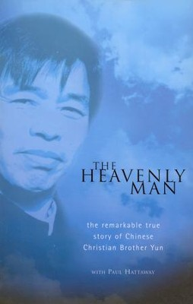

Slide 35
Verse 1:
My way, as others, is not decorated with flowers,
fragrant roses do not grow along it;
my way is among the thorns
where blackthorn needles only grow.
Verse 2:
I walk, with battered limbs,
and it seems a difficult road ahead.
But the voice in my heart somewhere deep inside,
confidently whispers: "Do not be afraid, come!"

Slide 36
Verse 3:
That's the voice of heaven that invites me:
"Tired, exhausted traveler,
holy reward awaits you,
in heavenly glory, come quickly!"
Verse 4:
Oh God, God, give me strength
To lay my soul down for those close to me
And in my pure heart to the grave
To forgive all wrong doings of my enemies

Slide 37
Verse 5:
Let them throw stones at my chest
Not recognizing the feelings of saints,
Let them hate, curse -
I will lay down my soul for them

