Slide 1
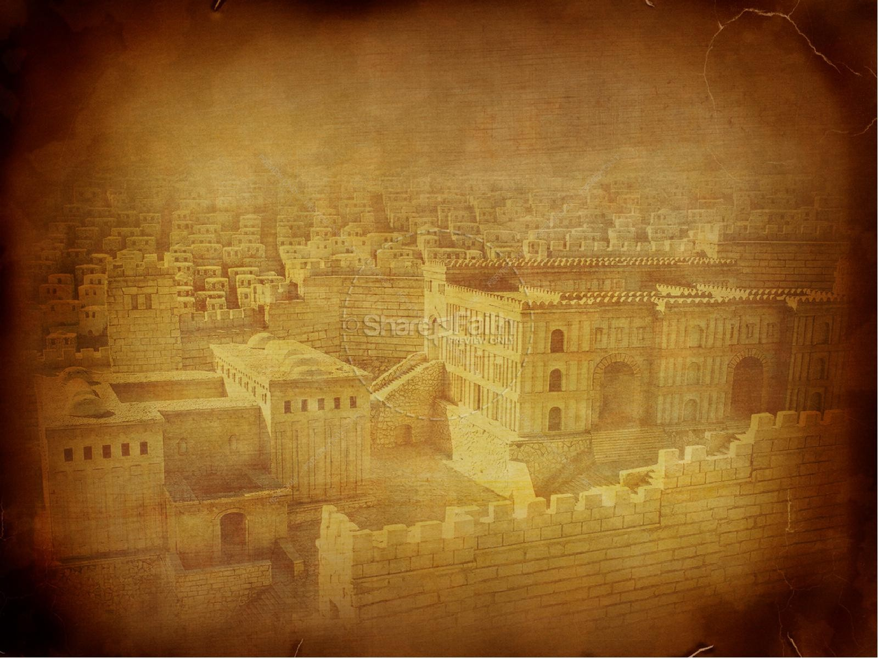
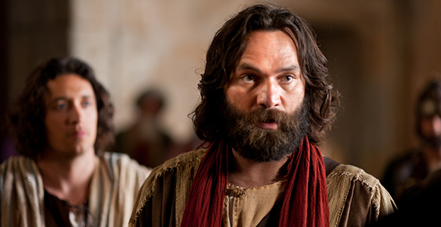
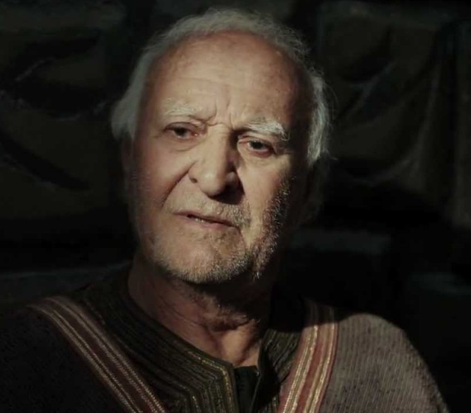
PETER, an apostle of JESUS CHRIST
Above All Love One Another Dearly
Acts 9
1 Peter 4:8-11

Slide 2
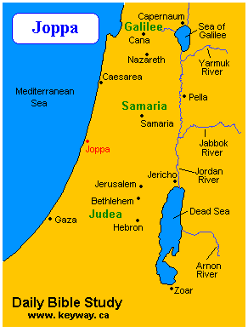
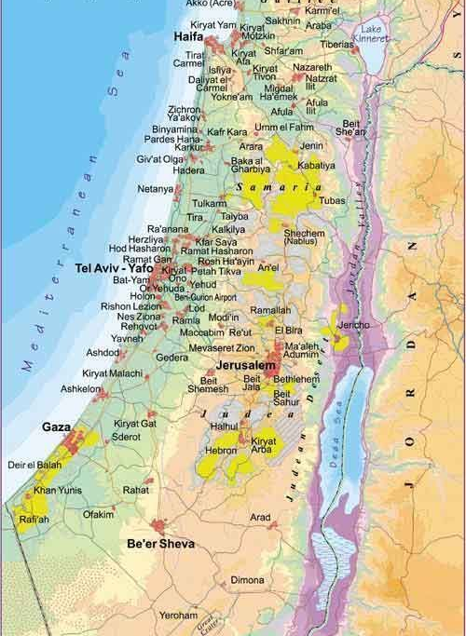

Slide 4
Acts 9:40–41 But Peter put them all outside, and knelt down and prayed; and turning to the body he said, “Tabitha, arise.” And she opened her eyes, and when she saw Peter she sat up. And he gave her his hand and raised her up. Then, calling the saints and widows, he presented her alive.

Slide 5
1 Peter 4:8 Above all, keep loving one another earnestly, since love covers a multitude of sins.

Slide 6
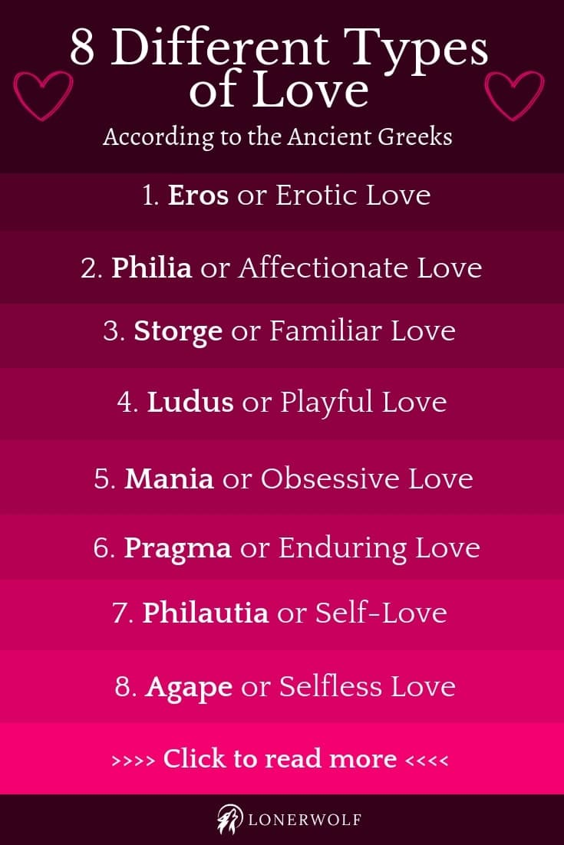

Slide 7
“Love One Another Dearly”

Slide 8
“Love One Another Dearly”
Love those who love you

Slide 9
“Love One Another Dearly”
Love those who love you
Love those who don’t know you

Slide 10
“Love One Another Dearly”
Love those who love you
Love those who don’t know you
1 Peter 4:8–11 Above all, keep loving one another earnestly, since love covers a multitude of sins. [9] Show hospitality to one another without grumbling. [10] As each has received a gift, use it to serve one another, as good stewards of God's varied grace: [11] whoever speaks, as one who speaks oracles of God; whoever serves, as one who serves by the strength that God supplies—in order that in everything God may be glorified through Jesus Christ. To him belong glory and dominion forever and ever. Amen.

Slide 11
“Love One Another Dearly”
Love those who love you
Love those who don’t know you
1 Peter 4:8–11 Above all, keep loving one another earnestly, since love covers a multitude of sins. [9] Show hospitality to one another without grumbling. [10] As each has received a gift, use it to serve one another, as good stewards of God's varied grace: [11] whoever speaks, as one who speaks oracles of God; whoever serves, as one who serves by the strength that God supplies—in order that in everything God may be glorified through Jesus Christ. To him belong glory and dominion forever and ever. Amen.

Slide 12
“Love One Another Dearly”
Love those who love you
Love those who don’t know you
1 Peter 4:8–11 Above all, keep loving one another earnestly, since love covers a multitude of sins. [9] Show hospitality to one another without grumbling. [10] As each has received a gift, use it to serve one another, as good stewards of God's varied grace: [11] whoever speaks, as one who speaks oracles of God; whoever serves, as one who serves by the strength that God supplies—in order that in everything God may be glorified through Jesus Christ. To him belong glory and dominion forever and ever. Amen.

Slide 13
Micah 4:4 “but they shall sit every man under his vine and under his fig tree, and no one shall make them afraid”
Zech 3:10 In that day, declares the LORD, every one of you will invite his neighbor to come under his vine and under his fig tree.”

Slide 14
“Love One Another Dearly”
Love those who love you
Love those who don’t know you
Love those who don’t like you

Slide 15
“Love One Another Dearly”
Love those who love you
Love those who don’t know you
Love those who don’t like you
Love your enemies

Slide 16
Luke 6:32 “If you love those who love you, what benefit is that to you? For even sinners love those who love them.
Luke 6:35 But love your enemies, and do good, and lend, expecting nothing in return, and your reward will be great, and you will be sons of the Most High, for he is kind to the ungrateful and the evil.

Slide 17
East Asia Persecution & the "New Normal“ (June 2019)
“In December, we wrote about the start of the biggest persecution crackdown we've seen here with arrests, interrogations, beatings, seizing of church and small group meeting places, heavily monitoring believers, landlords kicking tenants out, families separated, missing people, deportations and more... so we prayed for our brothers and sisters just cities away from us.”
“And now - starting a few weeks ago, the persecution suddenly came to us very personally. Even though #@!$%* was interrogated and threatened before as a student for his faith - now as a family with different citizenships/passports and kids to think about, it's a different story with different worries, fears and risks.”

Slide 18
Acts 9:10–11 Now there was a disciple at Damascus named Ananias. The Lord said to him in a vision, “Ananias.” And he said, “Here I am, Lord.” And the Lord said to him, “Rise and go to the street called Straight, and at the house of Judas look for a man of Tarsus named Saul, for behold, he is praying
Acts 9:13–15 But Ananias answered, “Lord, I have heard from many about this man, how much evil he has done to your saints at Jerusalem. And here he has authority from the chief priests to bind all who call on your name.” But the Lord said to him, “Go, for he is a chosen instrument of mine…”
Acts 9:17 So Ananias departed and entered the house.

