Slide 1
Acts 5:12-42
Be Filled with the Spirit and Be Bold For Christ!

Slide 2
12 At the hands of the apostles many signs and wonders were taking place among the people; and they were all with one accord in Solomon’s portico. 13 But none of the rest dared to associate with them; however, the people held them in high esteem.
14 And all the more believers in the Lord, multitudes of men and women, were constantly added to their number, 15 to such an extent that they even carried the sick out into the streets and laid them on cots and pallets, so that when Peter came by at least his shadow might fall on any one of them. 16 Also the people from the cities in the vicinity of Jerusalem were coming together, bringing people who were sick or afflicted with unclean spirits, and they were all being healed.

Slide 3
First Point
True boldness comes from the Holy Spirit

Slide 4
13 But none of the rest dared to associate with them; however, the people held them in high esteem.

Slide 5
Imprisonment and Release
17 But the high priest rose up, along with all his associates (that is the sect of the Sadducees), and they were filled with jealousy. 18 They laid hands on the apostles and put them in a public jail. 19 But during the night an angel of the Lord opened the gates of the prison, and taking them out he said, 20 “Go, stand and speak to the people in the temple the whole message of this Life.” 21 Upon hearing this, they entered into the temple about daybreak and began to teach.

Slide 6
Imprisonment and Release
Now when the high priest and his associates came, they called the Council together, even all the Senate of the sons of Israel, and sent orders to the prison house for them to be brought. 22 But the officers who came did not find them in the prison; and they returned and reported back, 23 saying, “We found the prison house locked quite securely and the guards standing at the doors; but when we had opened up, we found no one inside.” 24 Now when the captain of the temple guard and the chief priests heard these words, they were greatly perplexed about them as to what would come of this. 25 But someone came and reported to them, “The men whom you put in prison are standing in the temple and teaching the people!”

Slide 7
26 Then the captain went along with the officers and proceeded to bring them back without violence (for they were afraid of the people, that they might be stoned).

Slide 8
Second Point
Where there is boldness for Christ, expect opposition, and stand firm!

Slide 9
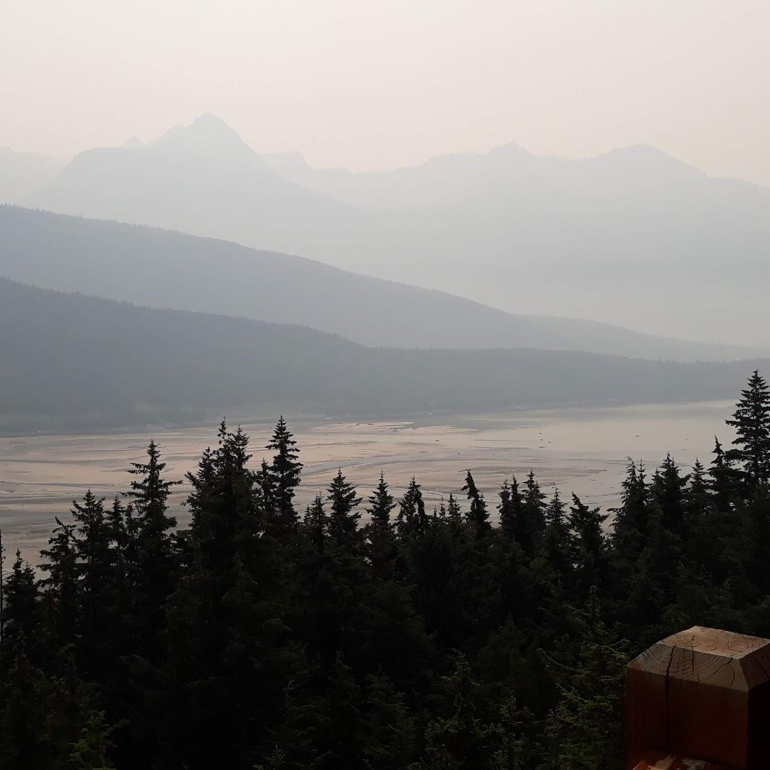
Third Point
Boldness for Christ speaks the whole Gospel truth

Slide 10
Imprisonment and Release
27 When they had brought them, they stood them before the Council. The high priest questioned them, 28 saying, “We gave you strict orders not to continue teaching in this name, and yet, you have filled Jerusalem with your teaching and intend to bring this man’s blood upon us.”

Slide 11
Imprisonment and Release
29 But Peter and the apostles answered, “We must obey God rather than men. 30 The God of our fathers raised up Jesus, whom you had put to death by hanging Him on a cross. 31 He is the one whom God exalted to His right hand as a Prince and a Savior, to grant repentance to Israel, and forgiveness of sins. 32 And we are witnesses of these things; and so is the Holy Spirit, whom God has given to those who obey Him.”

Slide 12
Gamaliel’s Advice
38 And now I say to you, keep away from these men and let them alone; for if this plan or this work is of men, it will come to nothing; 39 but if it is of God, you cannot overthrow it—lest you even be found to fight against God.”

Slide 13
War and Peace
“In historic events the so-called great men are labels giving names to events, and like labels they have but the smallest connexion with the event itself. Every act of theirs, which appears to them an act of their own will, is in a historical sense, involuntary, and is related to the whole course of history and predestined from eternity”.
Leo Tolstoy
Book 9, Chapter 1

Slide 14
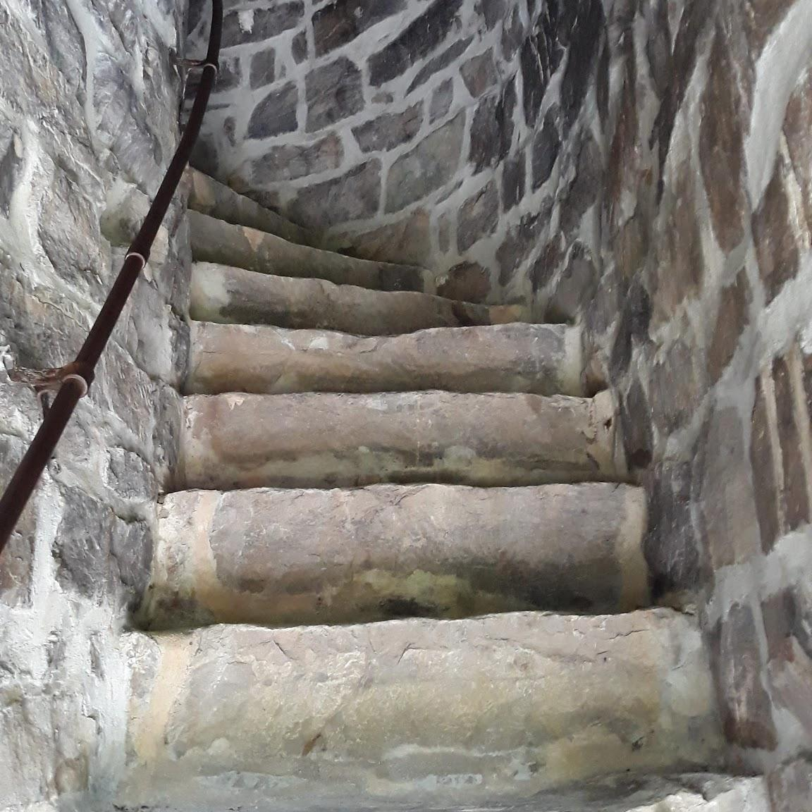
Fourth Point
Be Bold!You’re on the winning team!

Slide 15
Apostles Continue Preaching
40 And they agreed with him, and when they had called for the apostles and beaten them, they commanded that they should not speak in the name of Jesus, and let them go. 41 So they departed from the presence of the council, rejoicing that they were counted worthy to suffer shame for His name. 42 And daily in the temple, and in every house, they did not cease teaching and preaching Jesus as the Christ.

