Slide 1
ENCOURAGEMENT FOR THE SPIRITUAL LIFE
1 JOHN 2:12-14

Slide 2
1 John 2:12-14
12 I write to you, little children, because your sins are forgiven you for His name’s sake.
13 I write to you, fathers, because you have known Him who is from the beginning.
I write to you, young men, because you have overcome the wicked one.
I write to you, little children, because you have known the Father.
14 I have written to you, fathers, because you have known Him who is from the beginning.
I have written to you, young men, because you are strong, and the word of God abides in you, and you have overcome the wicked one.

Slide 3
1 John 2:12-14
12 I write to you, little children, because your sins are forgiven you for His name’s sake.
13 I write to you, fathers, because you have known Him who is from the beginning.
I write to you, young men, because you have overcome the wicked one.
I write to you, little children, because you have known the Father.
14 I have written to you, fathers, because you have known Him who is from the beginning.
I have written to you, young men, because you are strong, and the word of God abides in you, and you have overcome the wicked one.

Slide 4
1 John 2:12-14
12 I write to you, little children, because your sins are forgiven you for His name’s sake.
13 I write to you, fathers, because you have known Him who is from the beginning.
I write to you, young men, because you have overcome the wicked one.
I write to you, little children, because you have known the Father.
14 I have written to you, fathers, because you have known Him who is from the beginning.
I have written to you, young men, because you are strong, and the word of God abides in you, and you have overcome the wicked one.

Slide 5
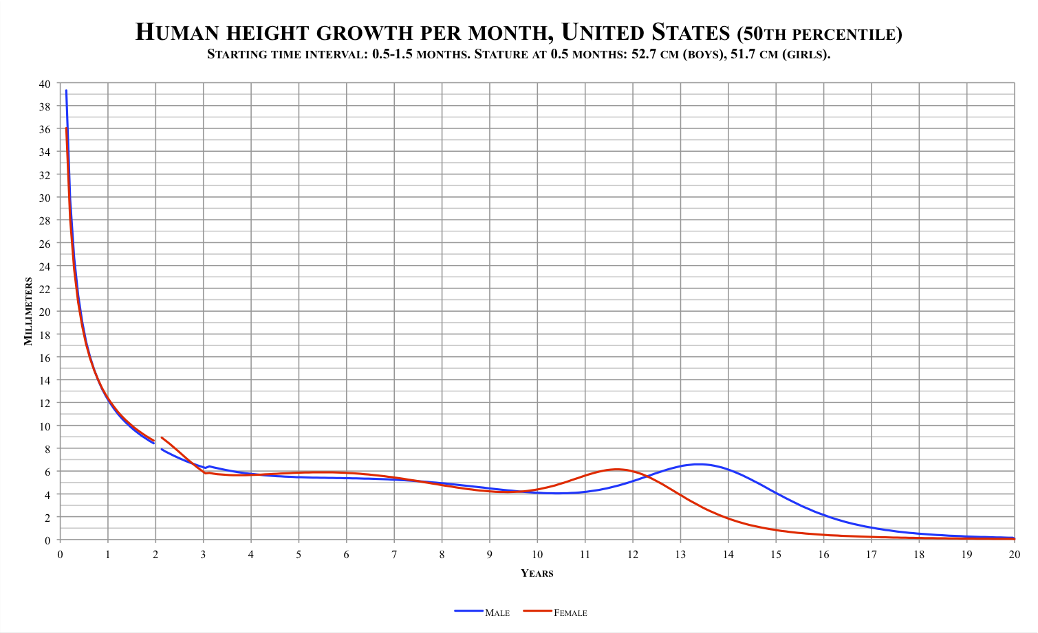

Slide 6
1 John 2:12-14
12 I write to you, little children, because your sins are forgiven you for His name’s sake.
13 I write to you, fathers, because you have known Him who is from the beginning.
I write to you, young men, because you have overcome the wicked one.
I write to you, little children, because you have known the Father.
14 I have written to you, fathers, because you have known Him who is from the beginning.
I have written to you, young men, because you are strong, and the word of God abides in you, and you have overcome the wicked one.

Slide 8
1 John 2:12-14
12 I write to you, little children, because your sins are forgiven you for His name’s sake.
13 I write to you, fathers, because you have known Him who is from the beginning.
I write to you, young men, because you have overcome the wicked one.
I write to you, little children, because you have known the Father.
14 I have written to you, fathers, because you have known Him who is from the beginning.
I have written to you, young men, because you are strong, and the word of God abides in you, and you have overcome the wicked one.

Slide 9
John 14:6-7
6 Jesus said to him, “I am the way, the truth, and the life. No one comes to the Father except through Me.
7 “If you had known Me, you would have known My Father also; and from now on you know Him and have seen Him.”

Slide 10
1 Thessalonians 2:13 - For this reason we also thank God without ceasing, because when you received the word of God which you heard from us, you welcomed it not as the word of men, but as it is in truth, the word of God, which also effectively works in you who believe.
James 1:22-25 - But be doers of the word, and not hearers only, deceiving yourselves. For if anyone is a hearer of the word and not a doer, he is like a man observing his natural face in a mirror; for he observes himself, goes away, and immediately forgets what kind of man he was. But he who looks into the perfect law of liberty and continues in it, and is not a forgetful hearer but a doer of the work, this one will be blessed in what he does.

Slide 11
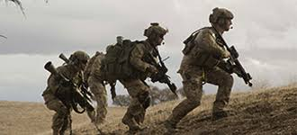
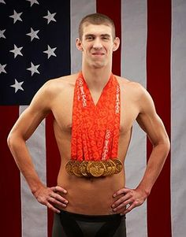
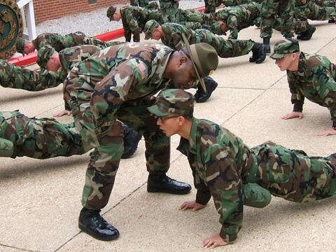

Slide 12
1 John 2:12-14
12 I write to you, little children, because your sins are forgiven you for His name’s sake.
13 I write to you, fathers, because you have known Him who is from the beginning.
I write to you, young men, because you have overcome the wicked one.
I write to you, little children, because you have known the Father.
14 I have written to you, fathers, because you have known Him who is from the beginning.
I have written to you, young men, because you are strong, and the word of God abides in you, and you have overcome the wicked one.

Slide 13
Psalm 143:8
Cause me to hear Your lovingkindness in the morning, for in You do I trust;
Cause me to know the way in which I should walk, for I lift up my soul to You.

Slide 14
1 Peter 5:8-9
Be sober, be vigilant; because your adversary the devil walks about like a roaring lion, seeking whom he may devour. Resist him, steadfast in the faith, knowing that the same sufferings are experienced by your brotherhood in the world.
James 4:7-8
Therefore submit to God. Resist the devil and he will flee from you. Draw near to God and He will draw near to you.

Slide 15
2 Timothy 2:15
Be diligent to present yourself approved to God, a worker who does not need to be ashamed, rightly dividing the word of truth

Slide 16
1 John 2:12-14
12 I write to you, little children, because your sins are forgiven you for His name’s sake.
13 I write to you, fathers, because you have known Him who is from the beginning.
I write to you, young men, because you have overcome the wicked one.
I write to you, little children, because you have known the Father.
14 I have written to you, fathers, because you have known Him who is from the beginning.
I have written to you, young men, because you are strong, and the word of God abides in you, and you have overcome the wicked one.

Slide 17
Psalm 1:1-2
Blessed is the man who walks not in the counsel of the ungodly, nor stands in the path of sinners, nor sits in the seat of the scornful; but his delight is in the law of the Lord, and in His law he meditates day and night.
John 14:16-17
And I will pray the Father, and He will give you another Helper, that He may abide with you forever - the Spirit of truth, whom the world cannot receive, because it neither sees Him nor knows Him; but you know Him, for He dwells with you and will be in you.

Slide 18
ENCOURAGEMENT FOR THE SPIRITUAL LIFE
1 JOHN 2:12-14

