Slide 2
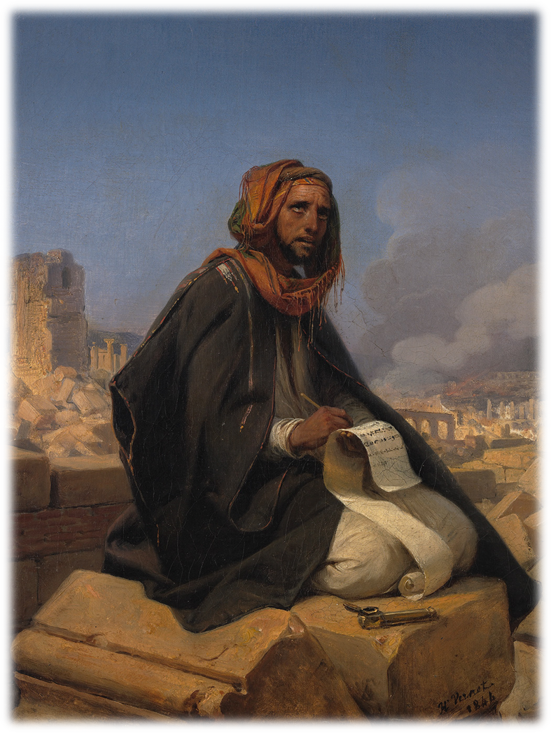
JEREMIAH Prophet of Crisis and Hope Part Twelve
Do Not Go To Egypt
Chapter 42

Slide 6
December 16, 1863 – September 26, 1952), philosopher, essayist, poet, and novelist

Slide 7
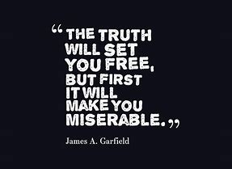

Slide 8
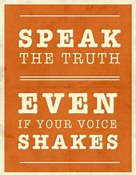

Slide 9
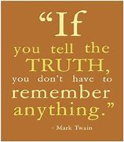

Slide 10
Winston Churchill
Men occasionally stumble over the truth, but most of them pick themselves up and hurry off as if nothing happened

Slide 11
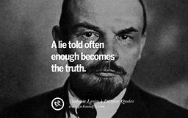

Slide 12
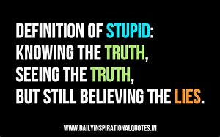

Slide 14
Jerusalem, once so crowded, lies deserted and lonely. This city that was known all over the world is now like a widow. This queen of the nations is now enslaved. Lamentations 1:1 (CEV)
Jeremiah weeping over Jerusalem, yet in the midst of tears. He speaks without moderating his message of judgement to a people who had so much and yet turned away
Through an Exposition of Lamentations, Jeremiah and the opening chapters of Romans, Dr. Schaeffer exposes the nature of our world and presents the message the church must speak if it is to give real answers to significant men.

Slide 16
Last Kings of Judah
Josiah: The Last Righteous King 31years
Johoahaz: Unrighteous 3 months
Jehoiakim: Unrighteous 11 years
Jehoiachin: Unrighteous 3 months
Zedekiah: Unrighteous 11 years

Slide 17
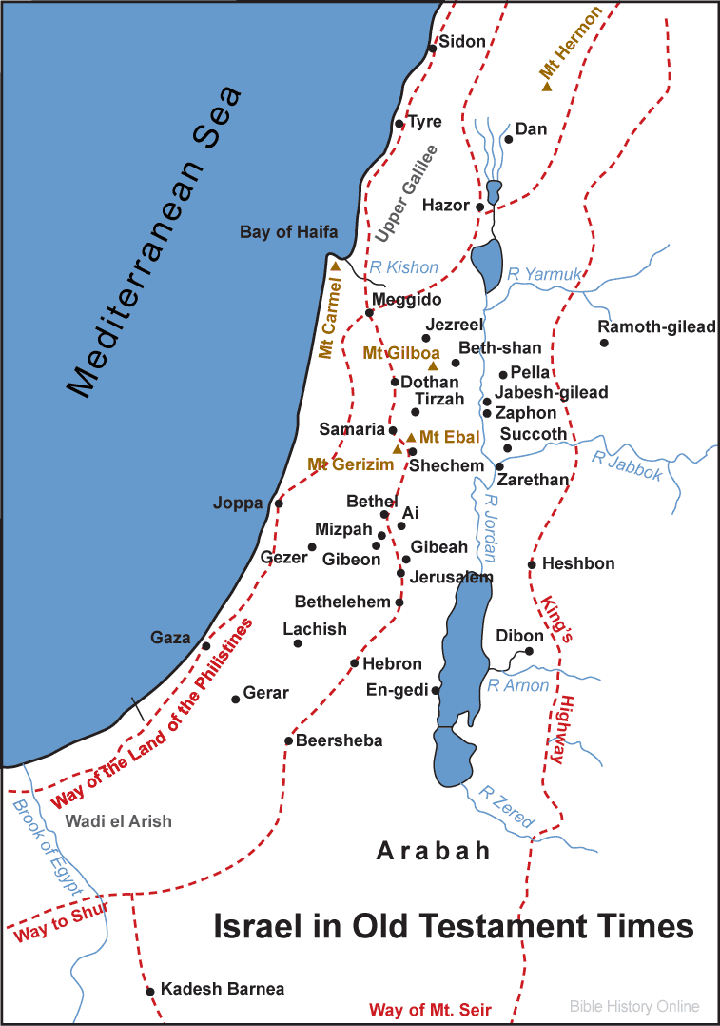
Israel before the Invasion

Slide 18
The Lord says: Don’t be afraid of the king of Babylon! ‘I am with you, to save you and deliver you from his hand!
¹² …I’ll show you mercy by having him have mercy on you and cause you to return to your own land.’

Slide 19
Jeremiah 42
The request 1- 6 The people ask for prayer
The answer 7-12 I will protect you if you stay here
The warning 13-19 Don’t go to Egypt
The hypocrisy 20-22 Disobeyed the Lord
Conclusion: Chapter 43

Slide 21
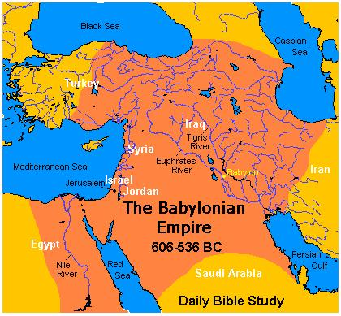

Slide 22
Jeremiah 42
The request 1- 6 The people ask for prayer
The answer 7-12 I will protect you if you stay here
The warning 13-19 Don’t go to Egypt
The hypocrisy 20-22 Disobeyed the Lord
Conclusion: Chapter 43

Slide 24
Lamentations 3:22-26
The steadfast love of the Lord never ceases; his mercies never come to an end; they are new every morning; great is Your faithfulness.
The Lord is my portion, says my soul, therefore I will hope in Him.
The Lord is good to those who wait for Him, to the soul who seeks Him.
It is good that one should wait quietly for the salvation of the Lord.

