Slide 1
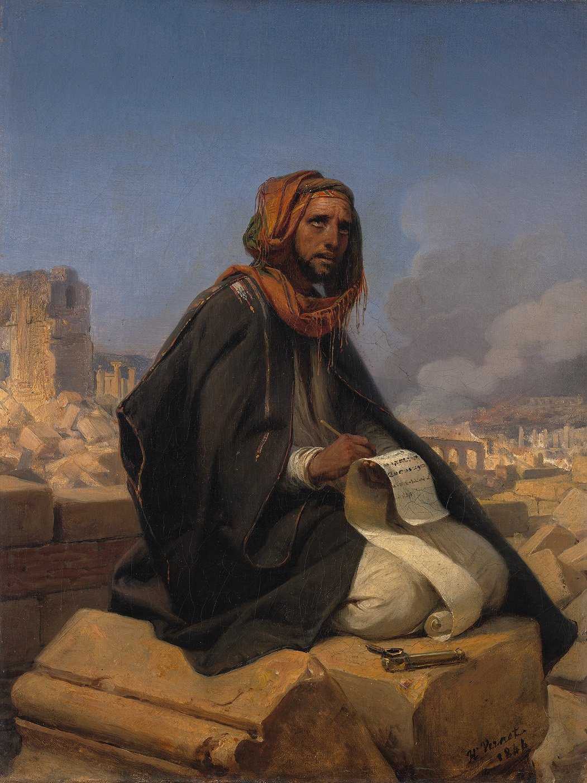
JEREMIAH
Prophet of
Crisis and Hope
Part Eleven:
Jeremiah 31
TWO LAWYERS LOOK AT
THE NEW COVENANT
Jeremiah on the Ruins of Jerusalem, Emil Jean Horace Vernet (1844)

Slide 2
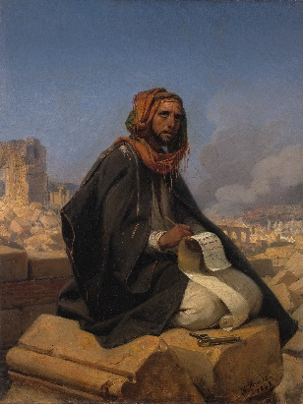
“Behold, the days are coming, says the Lord, when I will make a new covenant with the house of Israel and with the house of Judah— not according to the covenant that I made with their fathers in the day that I took them by the hand to lead them out of the land of Egypt, My covenant which they broke, though I was a husband to them, says the Lord. But this is the covenant that I will make with the house of Israel after those days, says the Lord: I will put My law in their minds, and write it on their hearts; and I will be their God, and they shall be My people. No more shall every man teach his neighbor, and every man his brother, saying, ‘Know the Lord,’ for they all shall know Me, from the least of them to the greatest of them, says the Lord. For I will forgive their iniquity, and their sin I will remember no more.” Jeremiah 31: 31 - 34

Slide 3
For if that first covenant had been faultless, then no place would have been sought for a second. … In that He says, “A new covenant,” He has made the first obsolete. Now what is becoming obsolete and growing old is ready to vanish away. Hebrews 8: 7, 13
For where there is a testament, there must also of necessity be the death of the testator. For a testament is in force after men are dead, since it has no power at all while the testator lives. Therefore not even the first covenant was dedicated without blood. For when Moses had spoken every precept to all the people according to the law, he took the blood of calves and goats, with water, scarlet wool, and hyssop, and sprinkled both the book itself and all the people, saying, “This is the blood of the covenant which God has commanded you.” Hebrews 9: 16 – 20

Slide 4
“This is the covenant that I will make with them after those days, says the Lord: I will put My laws into their hearts, and in their minds I will write them,” then He adds, “Their sins and their lawless deeds I will remember no more.”
Now where there is remission of these, there is no longer an offering for sin. Hebrews 10: 16 – 18

Slide 5
For you are all sons of God through faith in Christ Jesus….
Now I say that the heir, as long as he is a child, does not differ at all from a slave, though he is master of all, but is under guardians and stewards until the time appointed by the father. Even so we, when we were children, were in bondage under the elements of the world. But when the fullness of the time had come, God sent forth His Son, born of a woman, born under the law, to redeem those who were under the law, that we might receive the adoption as sons.
And because you are sons, God has sent forth the Spirit of His Son into your hearts, crying out, “Abba, Father!” Therefore you are no longer a slave but a son, and if a son, then an heir of God through Christ.
Galatians 3: 26; 4: 1 - 7

Slide 6
Now I say that the heir, as long as he is a child, does not differ at all from a slave, though he is master of all, but is under guardians and stewards until the time appointed by the father. Even so we, when we were children, were in bondage under the elements of the world. But when the fullness of the time had come, God sent forth His Son, born of a woman, born under the law, to redeem those who were under the law, that we might receive the adoption as sons.
Galatians 4: 1 – 5
But when the time of the promise drew near … Acts 7: 17
Of this salvation the prophets have inquired and searched carefully, who prophesied of the grace that would come to you, searching what, or what manner of time, the Spirit of Christ who was in them was indicating … I Peter 1: 10, 11

Slide 7
JEREMIAH
Prophet of
Crisis and Hope
Part Twelve:
Jeremiah 42
DO NOT GO TO EGYPT
Jeremiah on the Ruins of Jerusalem, Emil Jean Horace Vernet (1844)

