Slide 1
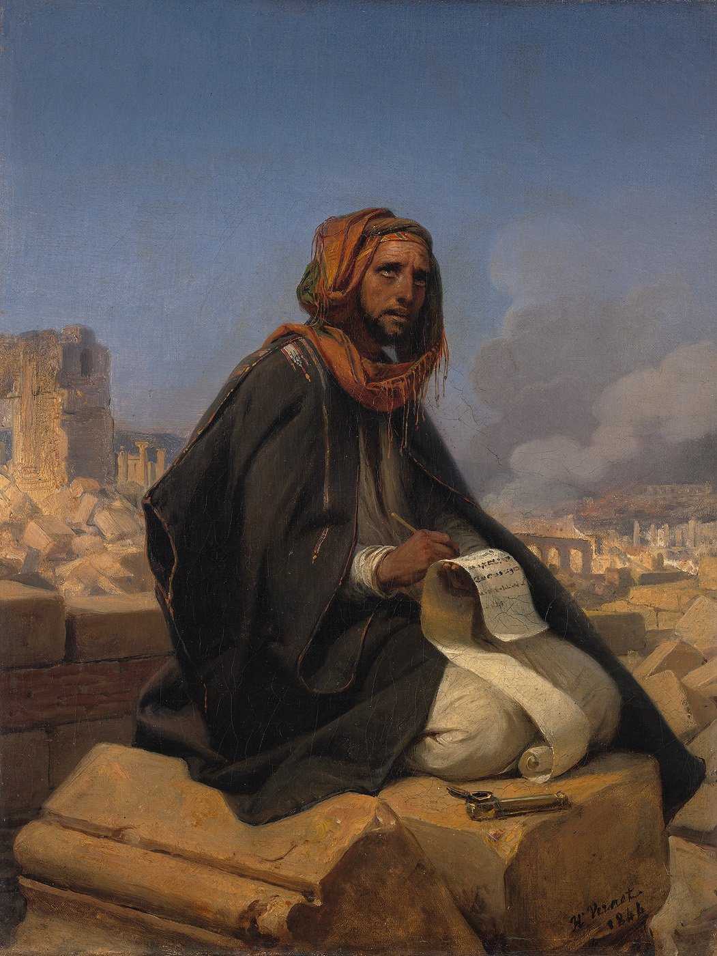
JEREMIAH
Prophet of
Crisis and Hope
Part Eleven:
The Horrible Consequences of Sin but the Great Attributes of God
Jeremiah on the Ruins of Jerusalem, Emil Jean Horace Vernet (1844)

Slide 2
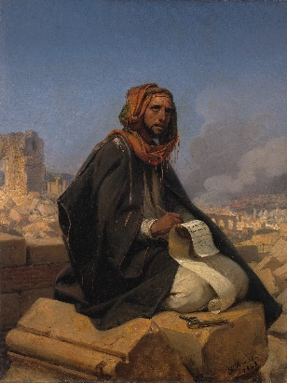
Jeremiah 52:1-16
Zedekiah was twenty-one years old when he became king, and he reigned eleven years in Jerusalem. His mother’s name was Hamutal the daughter of Jeremiah of Libnah. ² He also did evil in the sight of the Lord, according to all that Jehoiakim had done. ³ For because of the anger of the Lord this happened in Jerusalem and Judah, till He finally cast them out from His presence. Then Zedekiah rebelled against the king of Babylon.⁴ Now it came to pass in the ninth year of his reign, in the tenth month, on the tenth day of the month, that Nebuchadnezzar king of Babylon and all his army came against Jerusalem and encamped against it they built a siege wall against it all around. ⁵ So the city was besieged until the eleventh year of King Zedekiah. ⁶ By the fourth month, on the ninth day of the month, the famine had become so severe in the city that there was no food for the people of the land. ⁷ Then the city wall was broken through, and all the men of war fled and went out of the city at night by way of the gate between the two walls, which was by the king’s garden, even though the Chaldeans were near the city all around. And they went by way of the plain.

Slide 3
⁸ But the army of the Chaldeans pursued the king, and they overtook Zedekiah in the plains of Jericho. All his army was scattered from him. ⁹ So they took the king and brought him up to the king of Babylon at Riblah in the land of Hamath, and he pronounced judgment on him. ¹⁰ Then the king of Babylon killed the sons of Zedekiah before his eyes. And he killed all the princes of Judah in Riblah. ¹¹ He also put out the eyes of Zedekiah; and the king of Babylon bound him in ^{[b]}bronze fetters, took him to Babylon, and put him in prison till the day of his death.
The Temple and City Plundered and Burned
¹² Now in the fifth month, on the tenth day of the month (which was the nineteenth year of King Nebuchadnezzar king of Babylon), Nebuzaradan, the captain of the guard, who served the king of Babylon, came to Jerusalem. ¹³ He burned the house of the Lord and the king’s house; all the houses of Jerusalem, that is, all the houses of the great, he burned with fire. ¹⁴ And all the army of the Chaldeans who were with the captain of the guard broke down all the walls of Jerusalem all around.

Slide 4
¹⁵ Then Nebuzaradan the captain of the guard carried away captive some of the poor people, the rest of the people who remained in the city, the defectors who had deserted to the king of Babylon, and the rest of the craftsmen. ¹⁶ But Nebuzaradan the captain of the guard left some of the poor of the land as vinedressers and farmers.

Slide 5
Jeremiah 52:4-7
4 So in the ninth year of Zedekiah’s reign, on the tenth day of the tenth month, Nebuchadnezzar king of Babylon marched against Jerusalem with his whole army. They encamped outside the city and built siege works all around it. 5 The city was kept under siege until the eleventh year of King Zedekiah.6 By the ninth day of the fourth month the famine in the city had become so severe that there was no food for the people to eat. 7 Then the city wall was broken through, and the whole army fled.

Slide 6
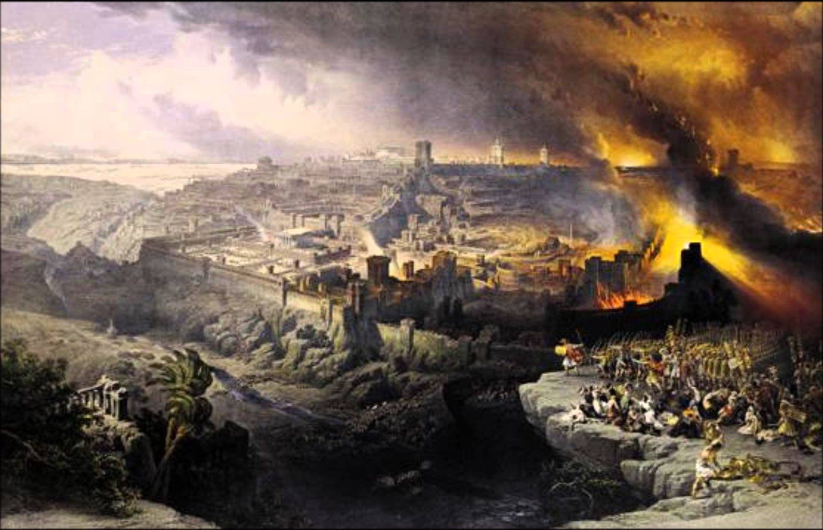

Slide 7
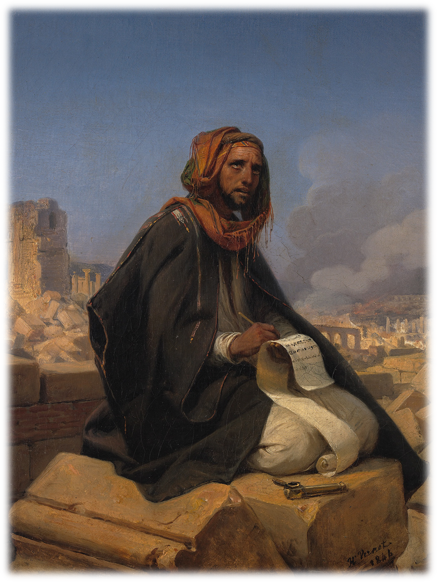
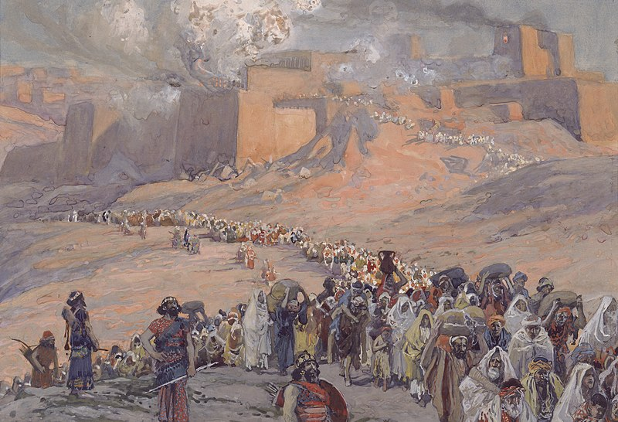
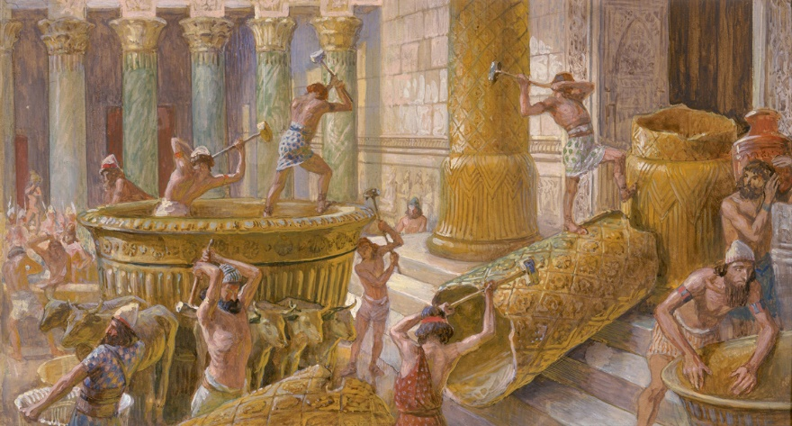
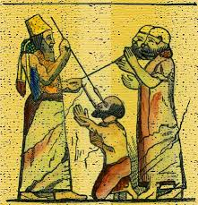

Slide 8
Joshua 24:19-24
19 Joshua said to the people, “You are not able to serve the Lord. He is a holy God; he is a jealous God. He will not forgive your rebellion and your sins. 20 If you forsake the Lord and serve foreign gods, he will turn and bring disaster on you and make an end of you, after he has been good to you.”
21 But the people said to Joshua, “No! We will serve the Lord.”
22 Then Joshua said, “You are witnesses against yourselves that you have chosen to serve the Lord.” “Yes, we are witnesses,” they replied.
23 “Now then,” said Joshua, “throw away the foreign gods that are among you and yield your hearts to the Lord, the God of Israel.”
24 And the people said to Joshua, “We will serve the Lord our God and obey him.”

Slide 10
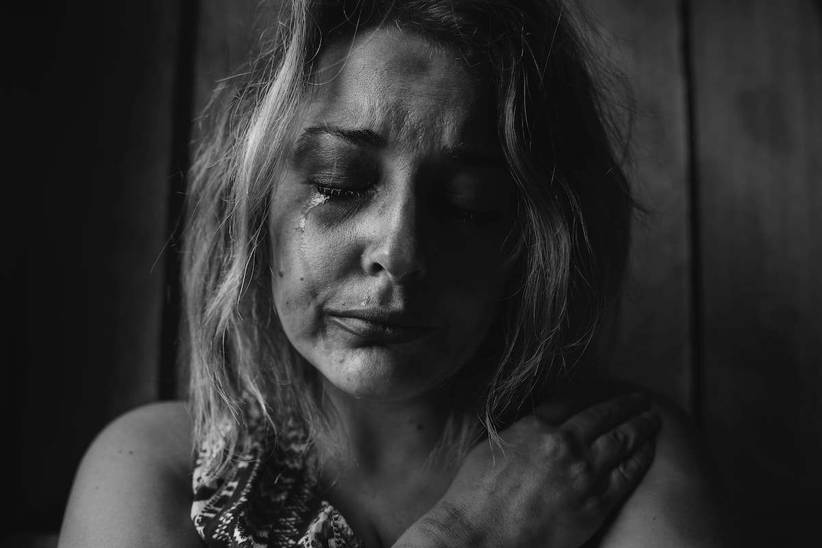
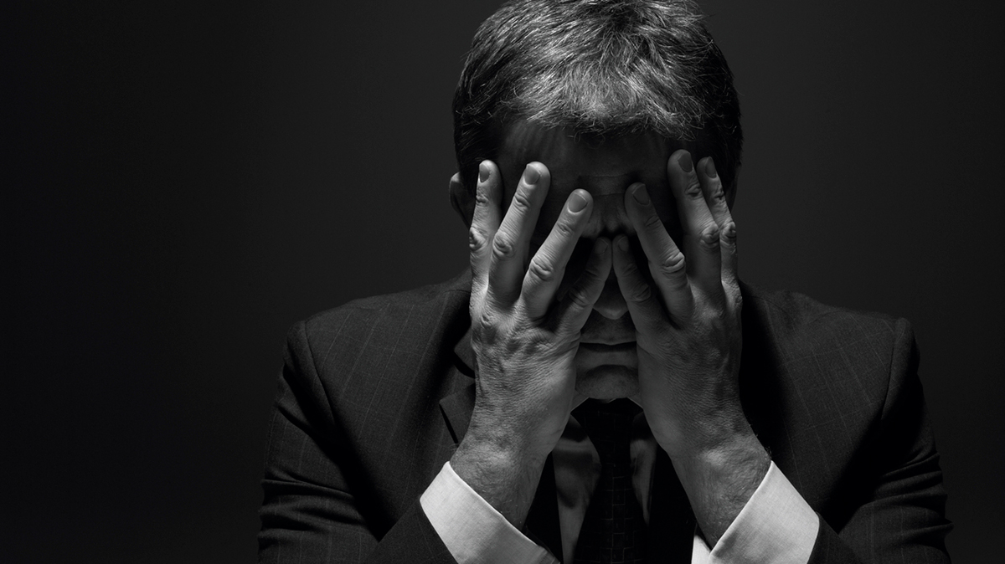
LAMENTATIONS
Lament = a passionate expression of grief or sorrow; to mourn

Slide 11
Forge Road Bible Chapel
F
R
B
C

Slide 12
Forge Road Bible Chapel
Families gathering to worship the Lord.
R
B
C

Slide 13
Forge Road Bible Chapel
Families gathering to worship the Lord.
Remembering the person and work of our Lord Jesus Christ.
B
C

Slide 14
Forge Road Bible Chapel
Families gathering to worship the Lord.
Remembering the person and work of our Lord Jesus Christ.
Believing in the authority of the scripture.
C

Slide 15
Forge Road Bible Chapel
Families gathering to worship the Lord.
Remembering the person and work of our Lord Jesus Christ.
Believing in the authority of the scripture.
Chilli cook-off in the fall.

Slide 16
LAMENTATIONS
5 chapters
Written in an emotional poetic style
Chapters 1, 2, 4, 5 – have 22 verses
Hebrew Alphabet has 22 characters
Chapter 3 – has 66 verses
Chapters 1, 2, 3, 4 – written as an acrostic

Slide 17
Jeremiah 5:30-31
30 “A horrible and shocking thing has happened in the land:
31 The prophets prophesy lies, the priests rule by their own authority and my people love it this way.
But what will you do in the end?

Slide 18
Lamentations 1:1-2
1How deserted lies the city, once so full of people!
How like a widow is she, who once was great among the nations!
She who was queen among the province has now become a slave.
2 Bitterly she weeps at night, tears are on her cheeks.
Among all her lovers there is no one to comfort her.
All her friends have betrayed her;
they have become her enemies.

Slide 19
Consequences of Sin:
- Makes us feel alone

Slide 20
Lamentations 1:7-9
7 In the days of her affliction and wandering Jerusalem remembers all the treasure that were hers in days of old. When her people fell into enemy hands, there was no one to help her. Her enemies looked at her
and laughed at her destruction. 8 Jerusalem has sinned greatly and so has become unclean. All who honored her despise her, for they have all seen her naked; she herself groans and turns away.
9 Her filthiness clung to her skirts; she did not consider her future.
Her fall was astounding; there was none to comfort her. “Look, Lord, on my affliction, for the enemy has triumphed.”

Slide 21
Lamentations 2:11-12
11 My eyes fail from weeping, I am in torment within;
my heart is poured out on the ground because my people are destroyed, because children and infants faint in the streets of the city.
12 They say to their mothers, “Where is bread and wine?”
as they faint like the wounded in the streets of the city,
as their lives ebb away in their mothers’ arms.

Slide 22
Consequences of Sin:
- Makes us feel alone
Affects others

Slide 23
Lamentations 3:
54 the waters closed over my head, and I thought I was about to perish.
55 I called on your name, Lord, from the depths of the pit.
48 Streams of tears flow from my eyes because my people are destroyed.
49 My eyes will flow unceasingly, without relief
Lamentations 3:
19 I remember my affliction and my wandering, the bitterness and the gall. 20 I well remember them, and my soul is downcast within me.

Slide 24
Consequences of Sin:
- Makes us feel alone
Affects others
Burdens us physically and emotionally

Slide 25
Lamentations 4:1-2
1 How the gold has lost its luster, the fine gold become dull! The sacred gems are scattered at every street corner.
2 How the precious children of Zion, once worth their weight in gold,
are now considered as pots of clay, the work of a potter’s hands!

Slide 26
Lamentations 4:7-10
7 Their princes were brighter than snow and whiter than milk,
their bodies more ruddy than rubies, their appearance like sapphires.
8 But now they are blacker than soot; they are not recognized in the streets.
Their skin has shriveled on their bones; it has become as dry as a stick.
9 Those killed by the sword are better off than those who die of famine;
racked with hunger, they waste away for lack of food from the field.
10 With their own hands compassionate women have cooked their own children, who became their food when my people were destroyed.

Slide 27
Consequences of Sin:
- Makes us feel alone
- Affects others
- Burdens us physically and emotionally
- Leaves us having done things we never thought we would do

Slide 28
JEREMIAH
Prophet of
Crisis and Hope

Slide 29
Lamentations 3:19-26
19 I remember my affliction and my wandering, the bitterness and the gall.
20 I well remember them, and my soul is downcast within me.
21 Yet this I call to mind and therefore I have hope:
22 Because of the Lord’s great love we are not consumed, for his compassions never fail.
23 They are new every morning; great is your faithfulness.
24 I say to myself, “The Lord is my portion; therefore I will wait for him.”
25 The Lord is good to those whose hope is in him, to the one who seeks him;
26 it is good to wait quietly for the salvation of the Lord.

Slide 30
Lamentations 3:40
40 Let us examine our ways and test them,
and let us return to the Lord.
Jeremiah 5:30-31
30 “A horrible and shocking thing has happened in the land:
31 The prophets prophesy lies, the priests rule by their own authority and my people love it this way.
But what will you do in the end?

Slide 31
Lamentations 3:19-26
19 I remember my affliction and my wandering, the bitterness and the gall.
20 I well remember them, and my soul is downcast within me.
21 Yet this I call to mind and therefore I have hope:
22 Because of the Lord’s great love we are not consumed, for his compassions never fail.
23 They are new every morning; great is your faithfulness.
24 I say to myself, “The Lord is my portion; therefore I will wait for him.”
25 The Lord is good to those whose hope is in him, to the one who seeks him;
26 it is good to wait quietly for the salvation of the Lord.

Slide 32
Consequences of Sin:
- Makes us feel alone
- Affects others
- Burdens us physically and emotionally
- Leaves us having done things we never thought we would do
God’s Great Attributes:
- The Lord is our portion!

Slide 33
Lamentations 3:19-26
19 I remember my affliction and my wandering, the bitterness and the gall.
20 I well remember them, and my soul is downcast within me.
21 Yet this I call to mind and therefore I have hope:
22 Because of the Lord’s great love WE are not consumed, for his compassions never fail.
23 They are new every morning; great is your faithfulness.
24 I say to myself, “The Lord is my portion; therefore I will wait for him.”
25 The Lord is good to those whose hope is in him, to the one who seeks him;
26 it is good to wait quietly for the salvation of the Lord.

Slide 34
Consequences of Sin:
- Makes us feel alone
- Affects others
- Burdens us physically and emotionally
- Leaves us having done things we never thought we would do
God’s Great Attributes:
- The Lord is our portion!
- Savior! We can worship him together.

Slide 35
Lamentations 3:19-26
19 I remember my affliction and my wandering, the bitterness and the gall.
20 I well remember them, and my soul is downcast within me.
21 Yet this I call to mind and therefore I have hope:
22 Because of the Lord’s great love we are not consumed, for his compassions never fail.
23 They are new every morning; great is your faithfulness.
24 I say to myself, “The Lord is my portion; therefore I will wait for him.”
25 The Lord is good to those whose hope is in him, to the one who seeks him;
26 it is good to wait quietly for the salvation of the Lord.

Slide 36
Consequences of Sin:
- Makes us feel alone
- Affects others
- Burdens us physically and emotionally
- Leaves us having done things we never thought we would do
God’s Great Attributes:
- The Lord is our portion!
- Savior! We can worship him together.
- The Lord is good to those who seek Him. He gives rest for the soul!

Slide 37
Lamentations 3:19-26
19 I remember my affliction and my wandering, the bitterness and the gall.
20 I well remember them, and my soul is downcast within me.
21 Yet this I call to mind and therefore I have hope:
22 Because of the Lord’s great love we are not consumed, for his compassions never fail.
23 They are new every morning; great is your faithfulness.
24 I say to myself, “The Lord is my portion; therefore I will wait for him.”
25 The Lord is good to those whose hope is in him, to the one who seeks him;
26 it is good to wait quietly for the salvation of the Lord.

Slide 38
Consequences of Sin:
- Makes us feel alone
- Affects others
- Burdens us physically and emotionally
- Leaves us having done things we never thought we would do
God’s Great Attributes:
- The Lord is our portion!
- Savior! We can worship him together.
- The Lord is good to those who seek Him. He gives rest for the soul!
- Provides new mercies every day! Great is His faithfulness!

Slide 39
JEREMIAH
Prophet of
Crisis and Hope
Next Week - Part Twelve:
Two Lawyers Look at the New Covenant
Jeremiah on the Ruins of Jerusalem, Emil Jean Horace Vernet (1844)

