Slide 1
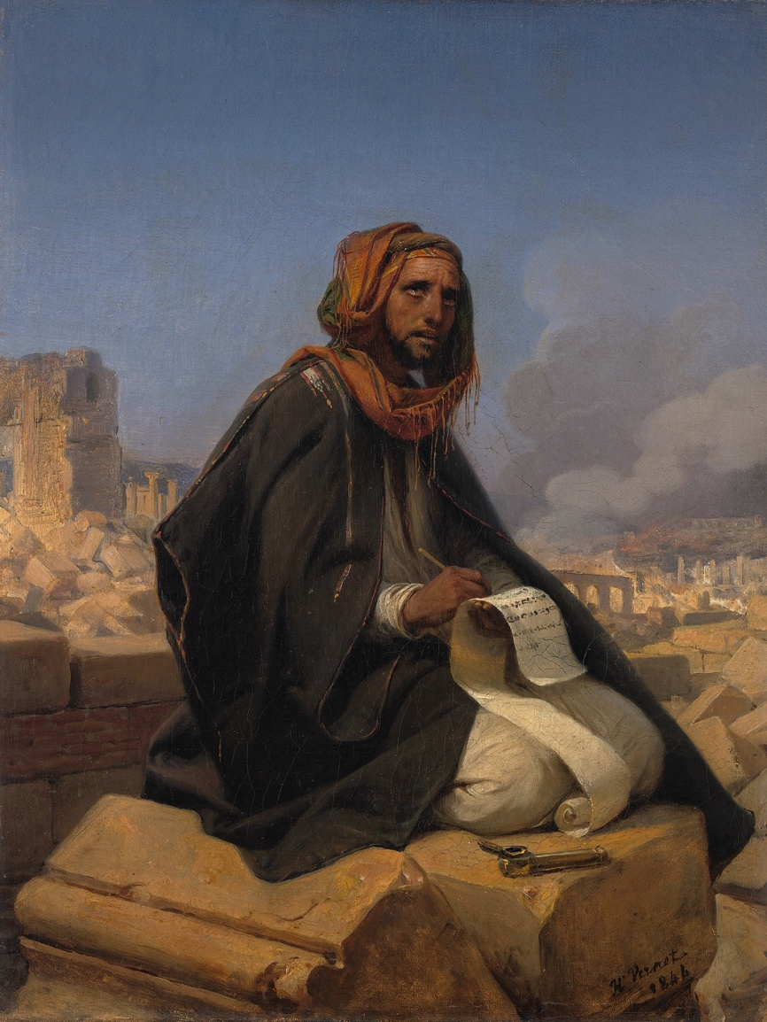
JEREMIAH
Prophet of
Crisis and Hope
The First Captives
Jeremiah on the Ruins of Jerusalem, Emil Jean Horace Vernet (1844)

Slide 2
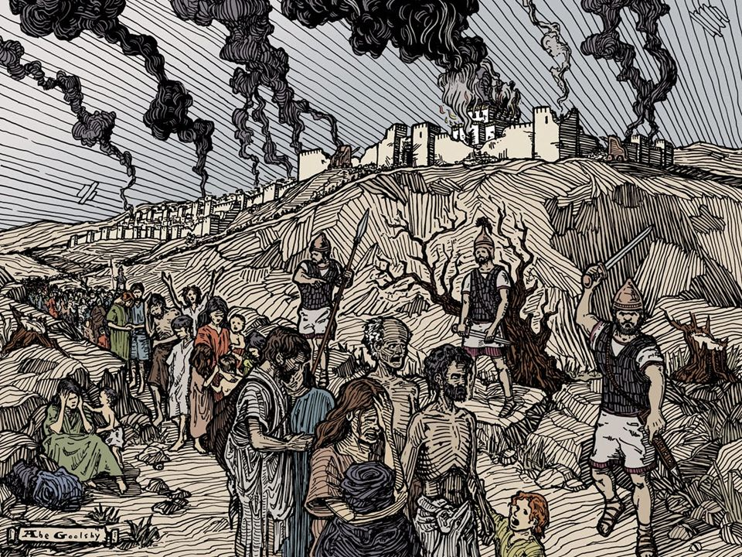
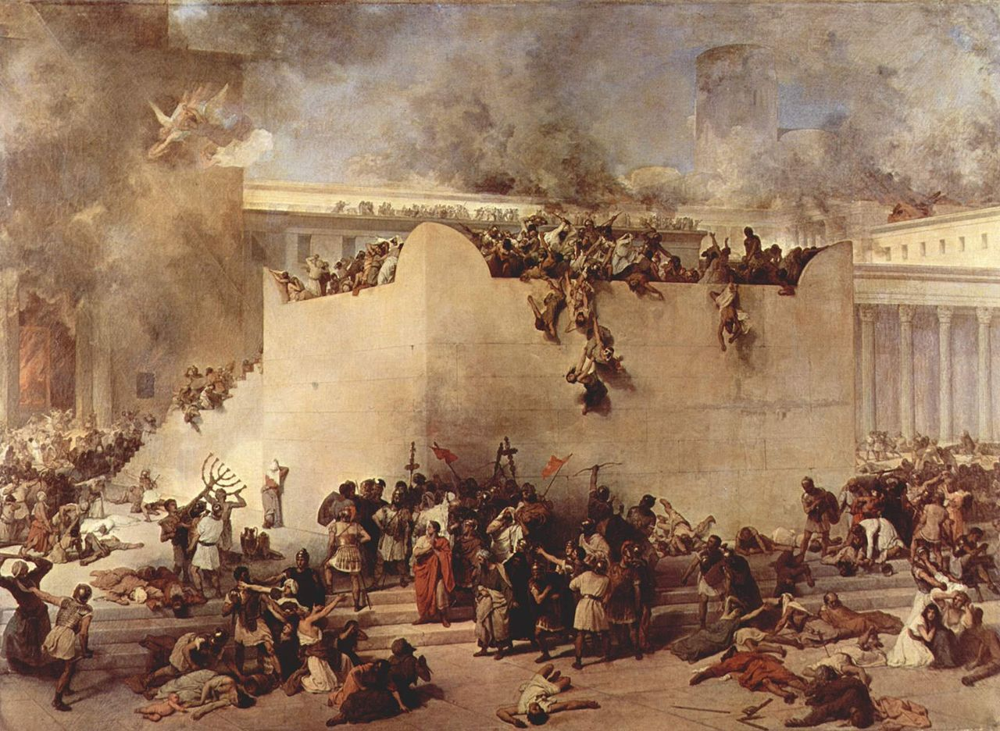
“From the measure of human tragedy, the worst events in all the Bible”
the besiegement of Jerusalem, the starvation of its populous, the destruction of its temple, the burning of the city to the ground,

Slide 3
God is in control and uses all the world as he wishes. He makes promises and he keeps his word.
We alone are responsible for how we choose to live and respond to the crisis we experience.
Jeremiah on the Ruins of Jerusalem, Emil Jean Horace Vernet (1844)

Slide 4
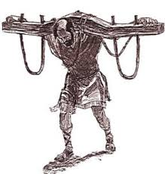
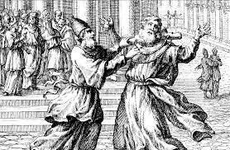
Jeremiah 27:1-11
The Yoke of Nebuchadnezzar
^{4 ’’}Thus says the Lord of hosts, the God of Israel: This is what you shall say to your masters: ⁵ “It is I who by my great power and my outstretched arm have made the earth, with the men and animals that are on the earth, and I give it to whomever it seems right to me.’’

Slide 5
God is in control and uses all the world as he wishes. He makes promises and he keeps his word.
605 - 562 BC,
ancient relief boundary stone

Slide 6
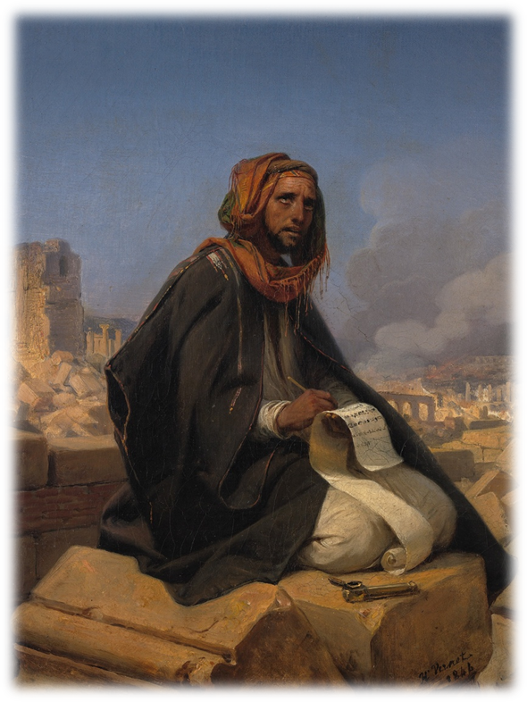
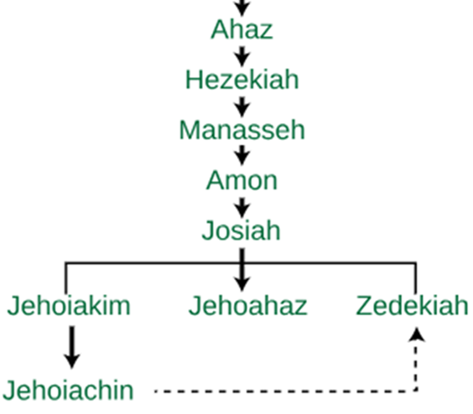
Began to prophesy 13th year of Josiah
Prophecy of Jerimiah 27

Slide 7
Daniel Chapter 1:1-7
1 In the third year of the reign of Jehoiakim king of Judah, Nebuchadnezzar king of Babylon came to Jerusalem and besieged it

Slide 8
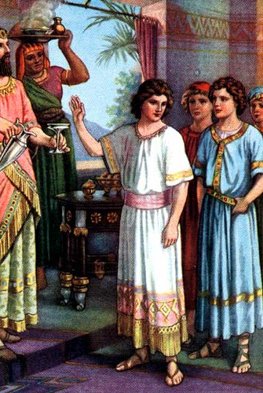
Daniel Chapter 1:1-7

Slide 9
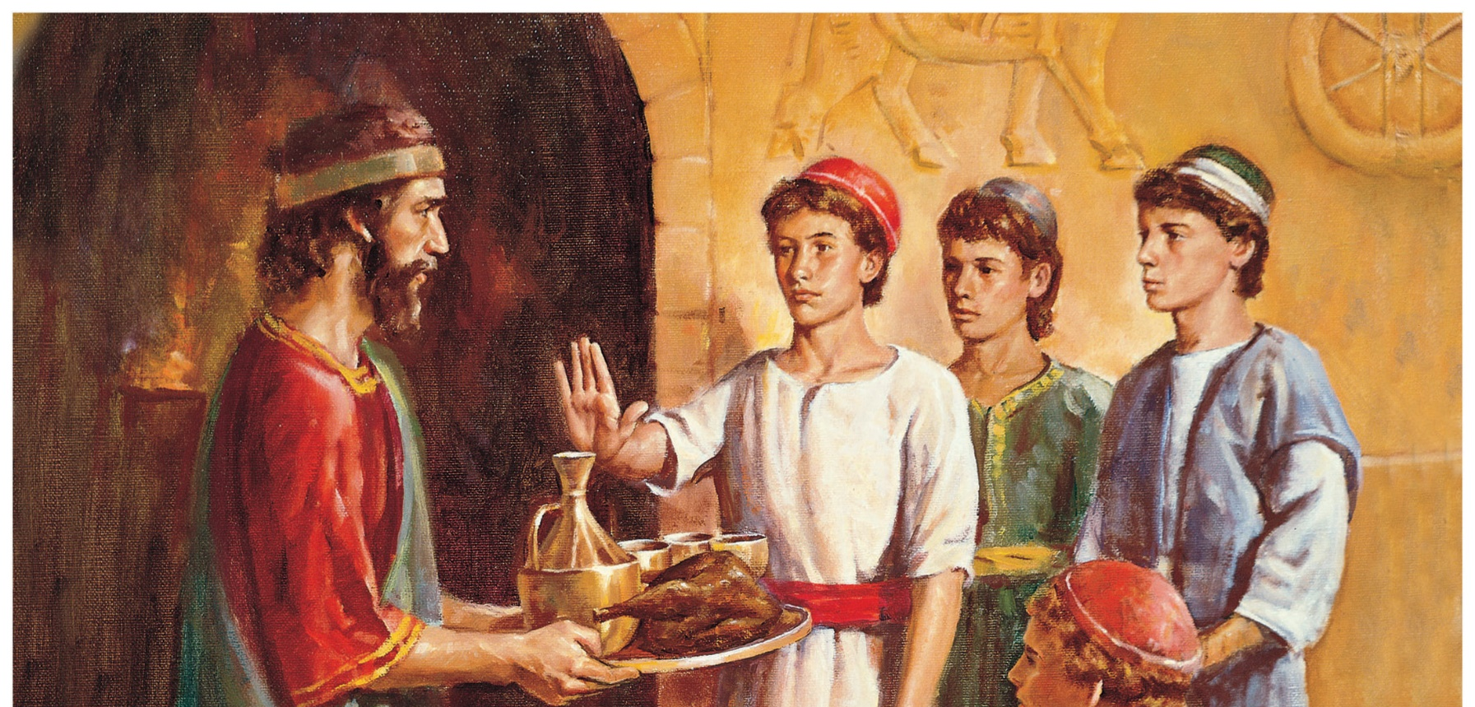
Daniel Chapter 1:8-21

Slide 10
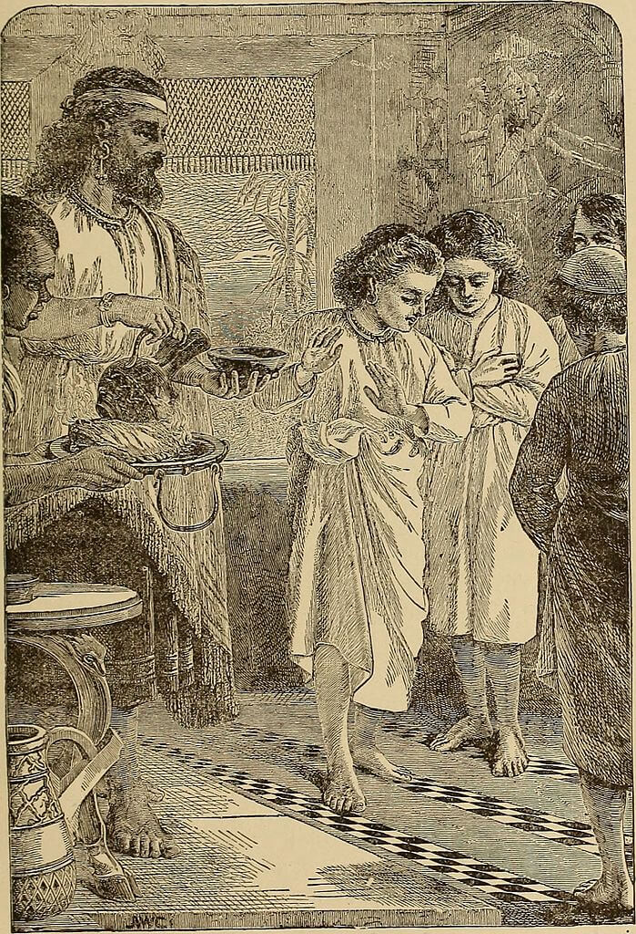
We alone are responsible for how we choose to live and respond to the crisis we experience.

Slide 11
Isaiah 41:10
¹⁰ Fear not, for I am with you; Be not dismayed, for I am your God. I will strengthen you, Yes, I will help you, I will uphold you with My righteous right hand.

Slide 12
JEREMIAH
Prophet of
Crisis and Hope
NEXT WEEK
The Idols and the LORD
Jeremiah on the Ruins of Jerusalem, Emil Jean Horace Vernet (1844)

