Slide 1
Part 1

Slide 2
Enter by the narrow gate. For the gate is wide and the way is easy that leads to destruction, and those who enter by it are many. For the gate is narrow and the way is hard that leads to life, and those who find it are few.
Beware of false prophets, who come to you in sheep's clothing but inwardly are ravenous wolves. You will recognize them by their fruits. Are grapes gathered from thorn-bushes, or figs from thistles? So, every healthy tree bears good fruit, but the diseased tree bears bad fruit. A healthy tree cannot bear bad fruit, nor can a diseased tree bear good fruit. Every tree that does not bear good fruit is cut down and thrown into the fire. Thus you will recognize them by their fruits.

Slide 3
Not everyone who says to me, ‘Lord, Lord,’ will enter the kingdom of heaven, but the one who does the will of my Father who is in heaven. On that day many will say to me, ‘Lord, Lord, did we not prophesy in your name, and cast out demons in your name, and do many mighty works in your name?’ And then will I declare to them, ‘I never knew you; depart from me, you workers of lawlessness.’

Slide 4
Everyone then who hears these words of mine and does them will be like a wise man who built his house on the rock. And the rain fell, and the floods came, and the winds blew and beat on that house, but it did not fall, because it had been founded on the rock. And everyone who hears these words of mine and does not do them will be like a foolish man who built his house on the sand. And the rain fell, and the floods came, and the winds blew and beat against that house, and it fell, and great was the fall of it.
And when Jesus finished these sayings, the crowds were astonished at his teaching, for he was teaching them as one who had authority, and not as their scribes.
Matthew 7:13-29

Slide 6
Two Gates: The majority will not follow because it’s hard

Slide 7
Two Gates: The majority will not follow because it’s hard
Two Plants: There will be false teachers

Slide 8
Two Gates: The majority will not follow because it’s hard
Two Plants: There will be false teachers
Two Followers: There will be imposters

Slide 9
Two Gates: The majority will not follow because it’s hard
Two Plants: There will be false teachers
Two Followers: There will be imposters
Two Builders

Slide 10
Everyone then who hears these words of mine and does them will be like a wise man who built his house on the rock. And the rain fell, and the floods came, and the winds blew and beat on that house, but it did not fall, because it had been founded on the rock.
And everyone who hears these words of mine and does not do them will be like a foolish man who built his house on the sand. And the rain fell, and the floods came, and the winds blew and beat against that house, and it fell, and great was the fall of it.

Slide 11
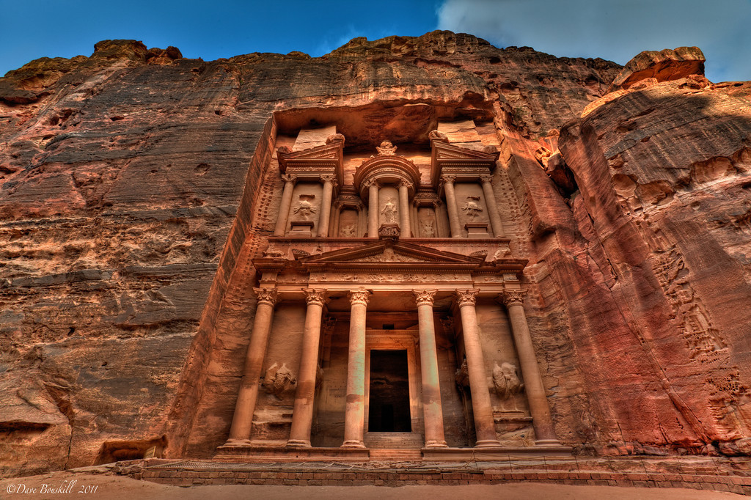

Slide 12
…he is like a man building a house, who dug deep and laid the foundation on the rock. And when a flood arose, the stream broke against that house and could not shake it, because it had been well built. But the one who hears and does not do them is like a man who built a house on the ground without a foundation. When the stream broke against it, immediately it fell, and the ruin of that house was great.
Luke 6:48-49

Slide 13
…he is like a man building a house, who dug deep and laid the foundation on the rock. And when a flood arose, the stream broke against that house and could not shake it, because it had been well built. But the one who hears and does not do them is like a man who built a house on the ground without a foundation. When the stream broke against it, immediately it fell, and the ruin of that house was great.
Luke 6:48-49

Slide 14
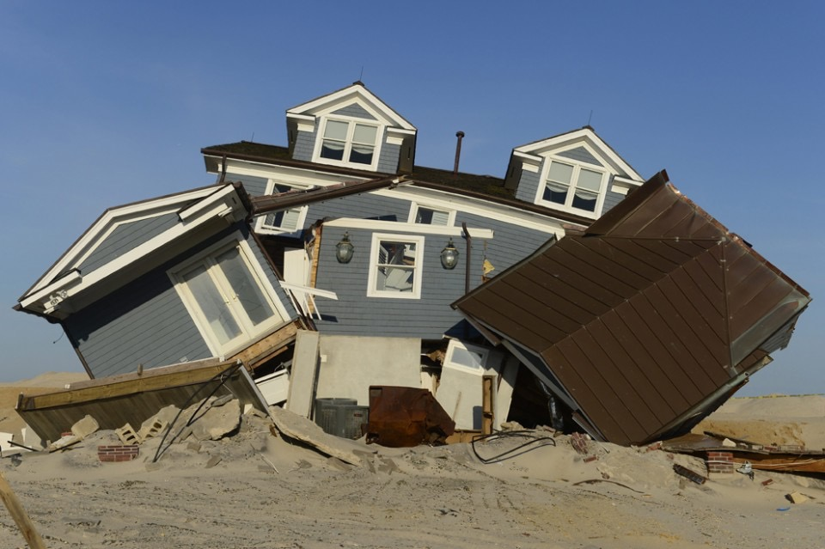

Slide 15
My hope is built on nothing less
than Jesus' blood and righteousness;
I dare not trust the sweetest frame,
but wholly lean on Jesus' name.
On Christ, the solid rock, I stand;
all other ground is sinking sand,
all other ground is sinking sand.

Slide 16
When darkness veils his lovely face,
I rest on his unchanging grace;
in every high and stormy gale,
my anchor holds within the veil.
On Christ, the solid rock, I stand;
all other ground is sinking sand,
all other ground is sinking sand.

Slide 17
When he shall come with trumpet sound,
O may I then in him be found,
dressed in his righteousness alone,
faultless to stand before the throne.
On Christ, the solid rock, I stand;
all other ground is sinking sand,
all other ground is sinking sand.

Slide 18
Part 2

Slide 19
^{Matthew 7:26-27}
²⁶ But everyone who hears these words of mine and does not put them into practice is like a foolish man who built his house on sand. ²⁷ The rain came down, the streams rose, and the winds blew and beat against that house, and it fell with a great crash.” (NIV)

Slide 20
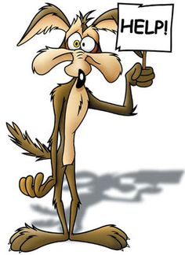
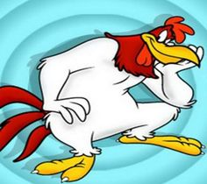
TWO
FOOLS

Slide 21
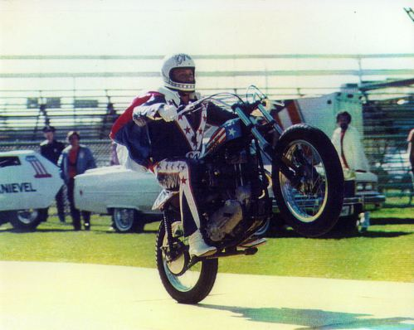
COOL
BRAVE
CONFIDENT
POPULAR

Slide 22
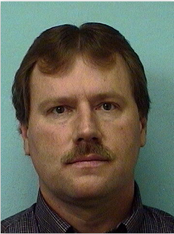
FOOL
FOOL

Slide 23
“I didn’t find Jesus because I was close to the end of my life. I found Jesus because he was there. He was there all the time. God has taken care of me. . . I’m so thankful, so thankful that I finally had my eyes opened.” Evel Knievel

Slide 24
^{Ezekiel 36:26}
I will give you a new heart and put a new spirit in you; I will remove from you your heart of stone and give you a heart of flesh. (NIV)

Slide 25
1 Corinthians 1:25
For the foolishness of God is wiser than human wisdom, and the weakness of God is stronger than human strength. (NIV)

Slide 26
Jesus said to Evel Knievel. . .
You’ve got to stop all this nonsense!

Slide 27
^{1 Corinthians 1:18}
For the message of the cross is foolishness to those who are perishing, but to us who are being saved it is the power of God. (NIV)

Slide 28
1 Peter 5:7 Cast all your anxiety on him because he cares for you. (NIV)
Matthew 11:28-30 “Come to me, all you who are weary and burdened, and I will give you rest. ²⁹ Take my yoke upon you and learn from me, for I am gentle and humble in heart, and you will find rest for your souls. ³⁰ For my yoke is easy and my burden is light.” (NIV)

Slide 29
Psalm 139:13-14 For you created my inmost being; you knit me together in my mother’s womb. ¹⁴ I praise you because I am fearfully and wonderfully made; your works are wonderful, I know that full well. (NIV)
Isaiah 49:13 Shout for joy, you heavens; rejoice, you earth; burst into song, you mountains! For the Lord comforts his people and will have compassion on his afflicted ones. (NIV)

Slide 30
Take the name of Jesus with you
Take the name of Jesus with you, Child of sorrow and of woe; It will joy and comfort give you, Take it then where’er you go
Precious name! Oh, how sweet! Hope of earth and joy of heav’n; Precious name! Oh, how sweet! Hope of earth and joy of heav’n.

