Slide 1
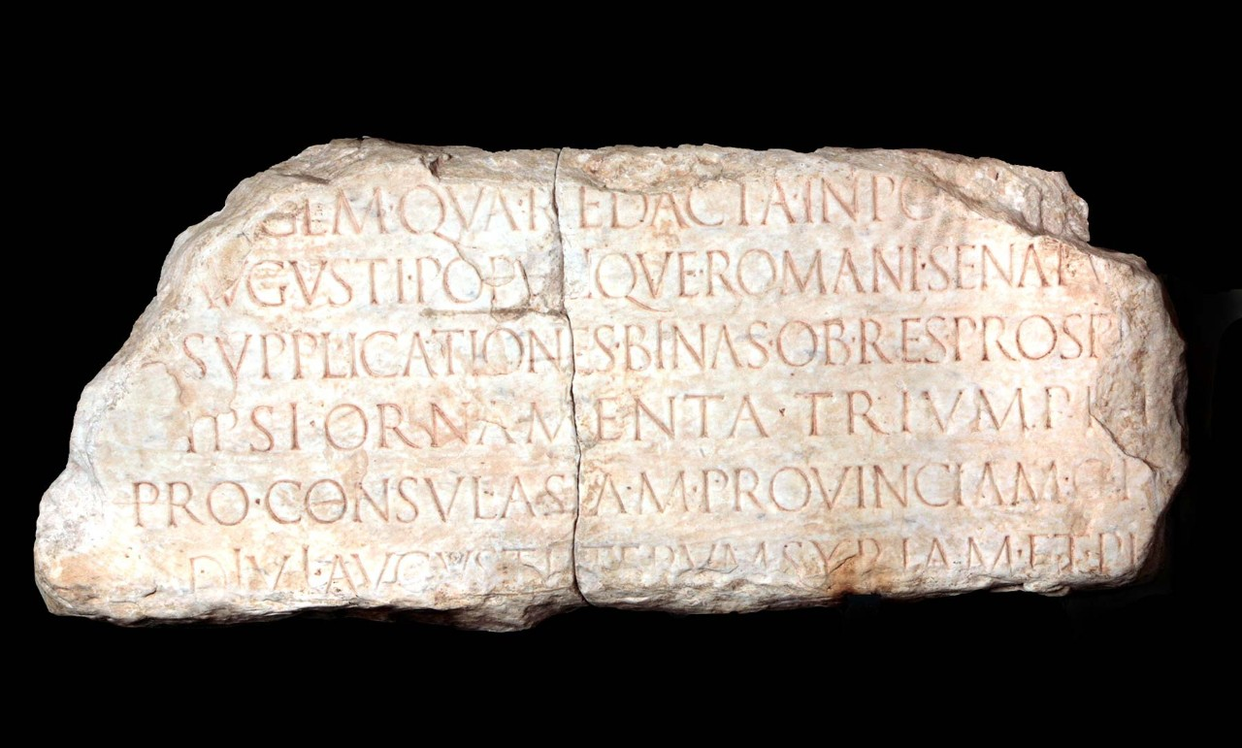
“And it came to pass in those days…”
A Story of Christmas

Slide 2
And it came to pass in those days, that there went out a decree from Caesar Augustus that all the world should be taxed. (And this taxing was first made when Quirinius was governor of Syria.)
And all went to be taxed, every one into his own city. And Joseph also went up from Galilee, out of the city of Nazareth, into Judaea, unto the city of David, which is called Bethlehem; (because he was of the house and lineage of David:) To be taxed with Mary his espoused wife, being great with child.
And so it was, that, while they were there, the days were accomplished that she should be delivered. And she brought forth her firstborn son, and wrapped him in swaddling clothes, and laid him in a manger; because there was no room for them in the inn.
Luke 2: 1 - 7

Slide 3
And it came to pass in those days, that there went out a decree from Caesar Augustus that all the world should be taxed. (And this taxing was first made when Quirinius was governor of Syria.)
And all went to be taxed, every one into his own city. And Joseph also went up from Galilee, out of the city of Nazareth, into Judaea, unto the city of David, which is called Bethlehem; (because he was of the house and lineage of David:) To be taxed with Mary his espoused wife, being great with child.
And so it was, that, while they were there, the days were accomplished that she should be delivered. And she brought forth her firstborn son, and wrapped him in swaddling clothes, and laid him in a manger; because there was no room for them in the inn.
Luke 2: 1 - 7

Slide 4
PART ONE: LUKE AND AN ORDERLY ACCOUNT
Inasmuch as many have taken in hand to set in order a narrative of those things which have been fulfilled among us, just as those who from the beginning were eyewitnesses and ministers of the word delivered them to us, it seemed good to me also, having had perfect understanding of all things from the very first, to write to you an orderly account, most excellent Theophilus, that you may know the certainty of those things in which you were instructed. Luke 1: 1 - 4

Slide 5
Now after Jesus was born in Bethlehem of Judea in the days of Herod the king, behold, wise men from the East came to Jerusalem saying “Where is He who has been born King of the Jews?
Matthew 2: 1, 2
Then the angel said to them, “Do not be afraid, for behold, I bring you good tidings of great joy which will be to all people. For there is born to you this day in the city of David a Savior, who is Christ the Lord.”
Luke 2: 10, 11

Slide 6
And it came to pass in those days, that there went out a decree from Caesar Augustus that all the world should be taxed. Luke 2: 1

Slide 7
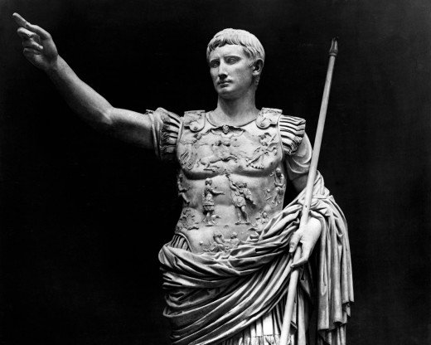
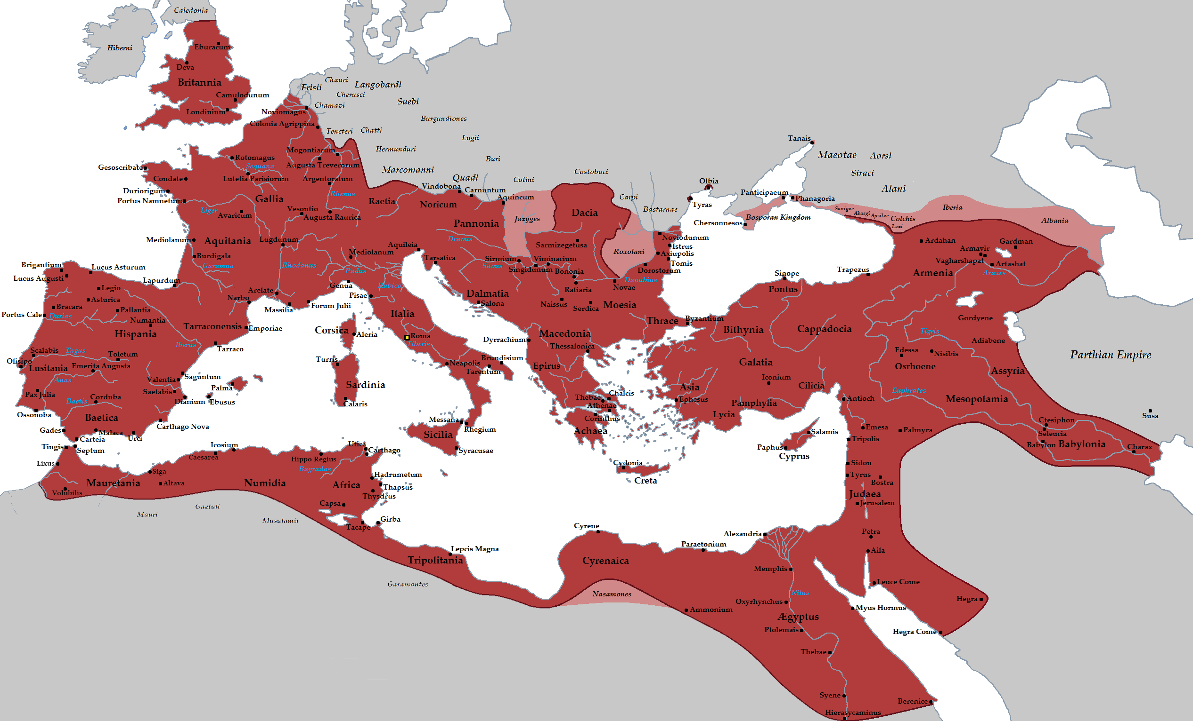
PART TWO: AUGUSTUS AND THE FREEDOM OF CITIZENSHIP
“… all the world should
be taxed.”

Slide 8
LUKE 2:
And it came to pass in those days, that there went out a decree from Caesar Augustus that all the world should be taxed. (And this taxing was first made when Quirinius was governor of Syria.) ³ And all went to be taxed, every one into his own city. (KJV)
And it came to pass in those days that a decree went out from Caesar Augustus that all the world should be registered. ² This census first took place while Quirinius was governing Syria. ³ So all went to be registered, everyone to his own city. (NKJV)

Slide 9
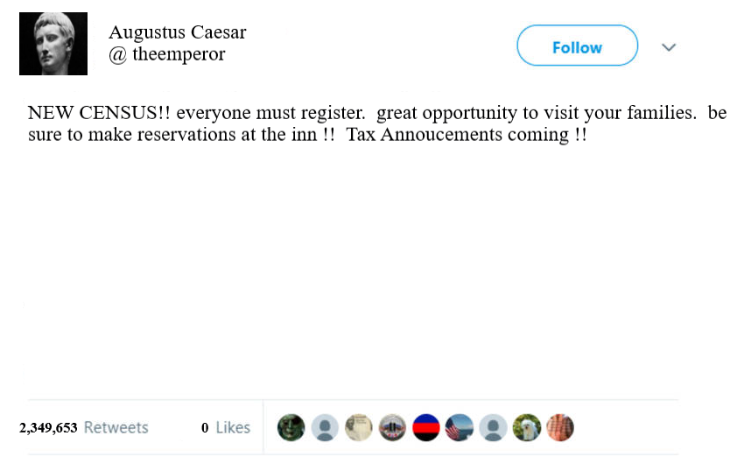

Slide 10
"From the Prefect of Egypt, Gaius Vibius Maximus: Being that the time has come for the house to house census, it is mandatory that all men who are living outside of their districts return to their own homelands, that the census may be carried out . . .”
“Because of the approaching census it is necessary that all those residing for any cause away from their homes should at once prepare to return to their own governments in order that they may complete the family registration of the enrollment and that the tilled lands may retain those belonging to them.“

Slide 11
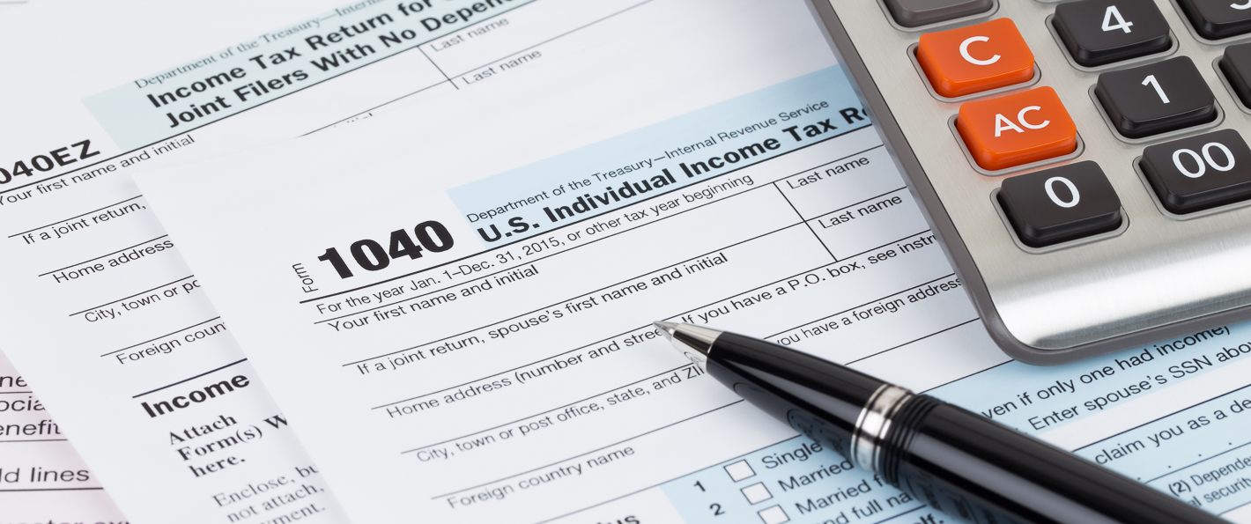
"I Thermoutharion along with Apollonius, my guardian, pledge an oath to Tiberius Claudius Caesar that the preceding document gives an accurate account of those returning, who live in my household, and that there is no one else living with me, neither a foreigner, nor an Alexandrian, nor a freedman, nor a Roman citizen, nor an Egyptian.
If I am telling the truth, may it be well with me, but if falsely, the reverse.
In the ninth year of the
reign of
Tiberius Claudius
Augustus Germanicus Emperor."

Slide 12
PART TWO: AUGUSTUS AND THE FREEDOM OF CITIZENSHIP
“… all the world should
be taxed.”

Slide 13
Then the commander came and said to him, “Tell me, are you a Roman?” [Paul] said, “Yes.”
The commander answered, “With a large sum I obtained this citizenship.” And Paul said, “But I was born a citizen.” Acts 22: 27 – 28
And the chief captain answered, “With a great sum I obtained this freedom.”

Slide 14
Then the commander came and said to him, “Tell me, are you a Roman?” [Paul] said, “Yes.”
The commander answered, “With a large sum I obtained this citizenship.” And Paul said, “But I was born a citizen.” Acts 22: 27 – 28
And the chief captain answered, “With a great sum I obtained this freedom.”
For our citizenship is in heaven, from which we also eagerly wait for the Savior, the Lord Jesus Christ. Philippians 3: 20

Slide 15
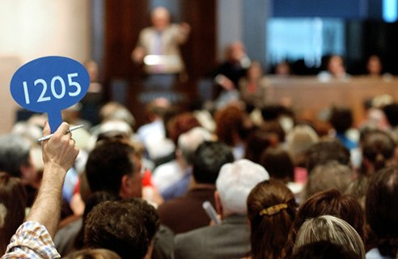
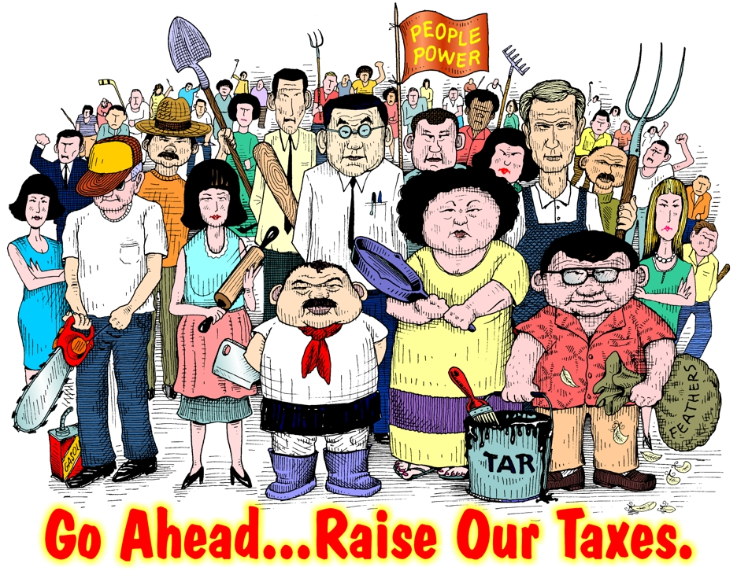
PART THREE: PUBLICANS AND ZEALOTS

Slide 16
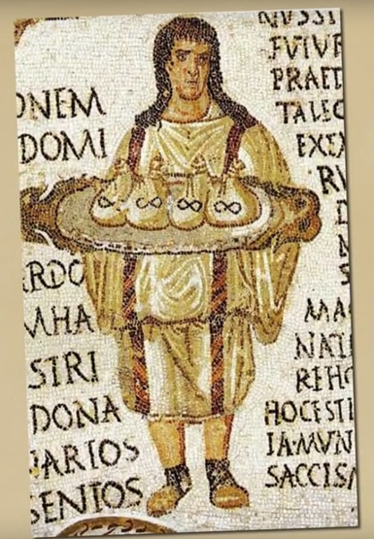
“tax farmers”
Publicani

Slide 17
“Men of Israel, take heed to yourselves what you intend to do regarding these men. For some time ago Theudas rose up, claiming to be somebody…. He was slain, and all who obeyed him were scattered and came to nothing. After this man, Judas of Galilee rose up in the days of the census, and drew away many people after him. He also perished, and all who obeyed him were dispersed.” Acts 5: 35 - 37
There was one Judas, a Galilean, …, who, taking with him Zadok, a Pharisee, became zealous to draw them to a revolt. Both said that this taxation was no better than an introduction to slavery, and exhorted the nation to assert their liberty … and this bold attempt proceeded to a great height. Flavius Josephus, Jewish Antiquities 18.4-6.

Slide 18
He called His disciples … and from them He chose twelve … Simon, whom He also named Peter, and Andrew his brother; James and John; Philip and Bartholomew; Matthew and Thomas; James the son of Alphaeus, and Simon called the Zealot; Judas the son of James, and Judas Iscariot who also became a traitor. Luke 6: 13 - 16

Slide 19
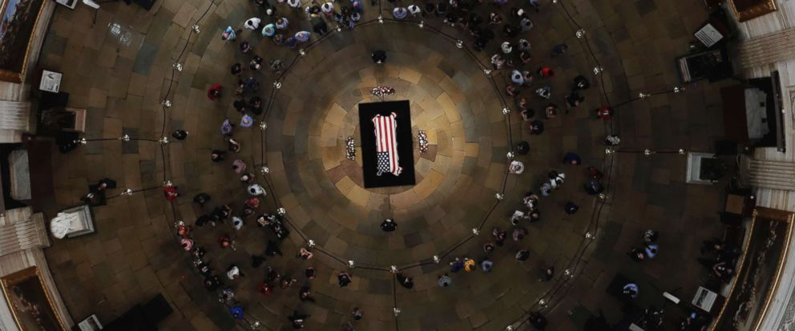
PART FOUR: QUIRINIUS AND THE BIRTH OF JESUS
This census first took place while Quirinius was governing Syria. Luke 2: 2

Slide 21
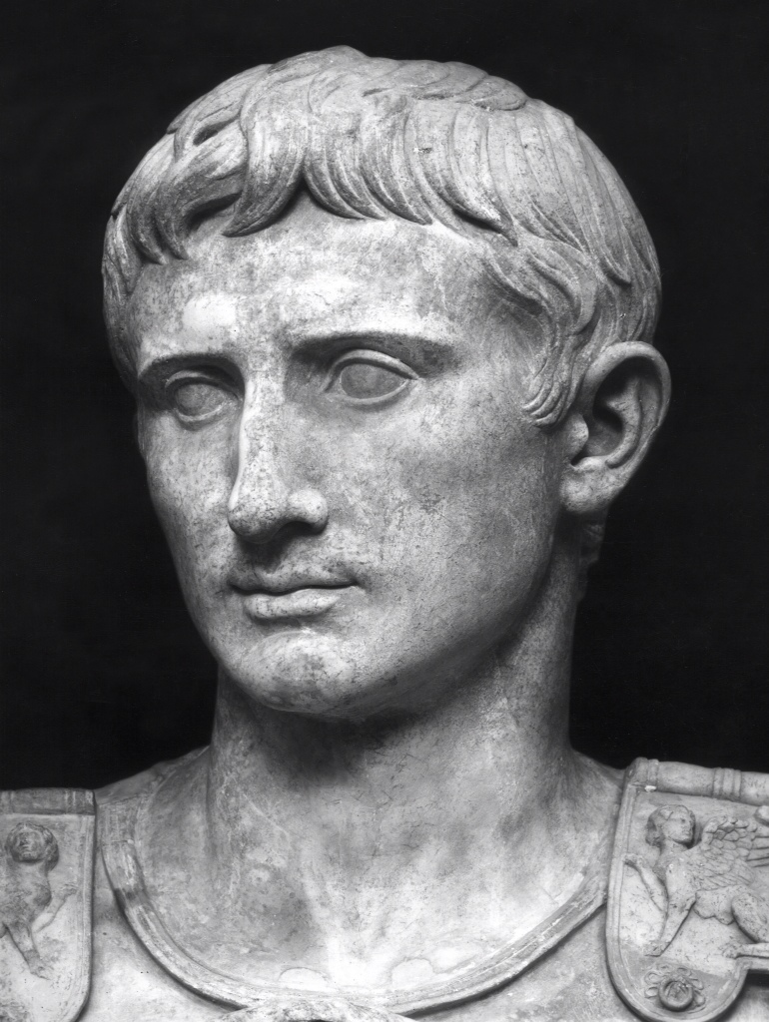
And this taxing was first made when Quirinius was governor of Syria. Luke 2: 2 (KJV)
This was the first enrollment made when Quirinius was governor of Syria.
Luke 2 : 2 (ASV)

Slide 22
“The precision with which Luke reported historical detail has been documented over and over again through the centuries by archaeologists and biblical scholars. In every instance, where sufficient archaeological evidence has surfaced, Luke has been vindicated as an accurate and meticulously precise writer.”

