Slide 1
You Are Worthy of My Praise
I will worship …(echo)
With all of my heart …(echo)
I will praise you …(echo)
With all of my strength …(all my strength)
I will seek you …(echo)
All of my days …(echo)
I will follow …(echo)
All of Your ways …(all Your ways)
1 of 4

Slide 2
I will give You all my worship
I will give You all my praise
You alone I long to worship
You alone are worthy of my praise
2 of 4

Slide 3
I will bow down …(echo)
Hail You as king …(echo)
I will serve You …(echo)
Give You everything …(echo)
I will lift up …(echo)
My eyes to Your throne …(echo)
And I will trust You …(echo)
Trust You alone …(trust in You alone)
3 of 4

Slide 4
I will give You all my worship
I will give You all my praise
You alone I long to worship
You alone are worthy of my praise
I will give You all my worship
I will give You all my praise
You alone I long to worship
You alone are worthy of my praise
4 of 4

Slide 5
HOLD THE DATE !!
Wednesday November 14, 2018
Fellowship Supper: 6:00; Meeting: 7:00
IAN BURNESS
Echoes of Service
Strategic Missions Reaching the World

Slide 6
Citizen Soldiers

Slide 7
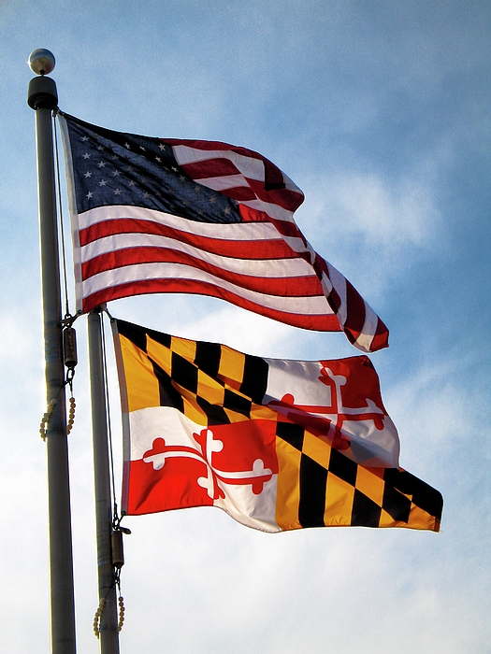
Presenting the Colors
Trail Life Troop 518
Opening Prayer
John Zeigenfuse
U.S. Army

Slide 8
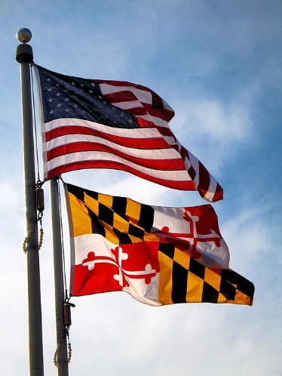
The Lord is my rock and my fortress and my deliverer;
The God of my strength, in whom I will trust;
My shield and the horn of my salvation,
My stronghold and my refuge;
My Savior, You save me from violence.
I will call upon the Lord, who is worthy to be praised;
So shall I be saved from my enemies.
II Samuel 22: 2 – 4
CITIZEN SOLDIERS

Slide 9
You therefore, my son, be strong in the grace that is in Christ Jesus. And the things that you have heard from me among many witnesses, commit these to faithful men who will be able to teach others also.
You therefore must endure hardship as a good soldier of Jesus Christ. No one engaged in warfare entangles himself with the affairs of this life, that he may please him who enlisted him as a soldier.
II Timothy 2: 1 – 4
CITIZEN SOLDIERS

Slide 10
For though we walk in the flesh, we do not war according to the flesh. For the weapons of our warfare are not carnal but mighty in God for pulling down strongholds, casting down arguments and every high thing that exalts itself against the knowledge of God, bringing every thought into captivity to the obedience of Christ.
II Corinthians 10: 2, 3
CITIZEN SOLDIERS

Slide 11
Then I saw heaven opened, and behold, a white horse! The one sitting on it is called Faithful and True, and in righteousness he judges and makes war. His eyes are like a flame of fire, and on his head are many diadems … and the name by which he is called is The Word of God. And the armies of heaven, arrayed in fine linen, white and pure, were following Him
Revelation 19: 11 – 14
CITIZEN SOLDIERS

Slide 12
“Have I not commanded you? Be strong and courageous. Do not be afraid; do not be discouraged, for the Lord your God will be with you wherever you go.”
Joshua 1: 9
CITIZEN SOLDIERS

Slide 13
Finally, my brethren, be strong in the Lord and in the power of His might. Put on the whole armor of God, that you may be able to stand against the wiles of the devil.
For we do not wrestle against flesh and blood, but against principalities, against powers, against the rulers of the darkness of this age, against spiritual hosts of wickedness in the heavenly places. Therefore take up the whole armor of God, that you may be able to withstand in the evil day, and having done all, to stand.
CITIZEN SOLDIERS

Slide 14
Stand therefore, having girded your waist with truth, having put on the breastplate of righteousness, and having shod your feet with the preparation of the gospel of peace; above all, taking the shield of faith with which you will be able to quench all the fiery darts of the wicked one. And take the helmet of salvation, and the sword of the Spirit, which is the word of God;
Ephesians 6: 10- 17
CITIZEN SOLDIERS

Slide 15
Citizen Soldiers

Slide 16
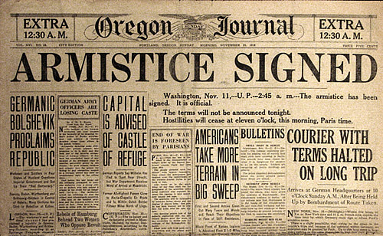
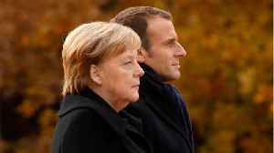
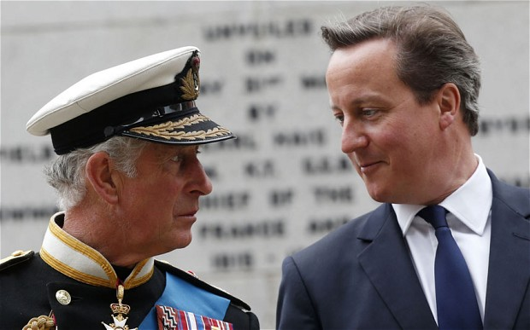
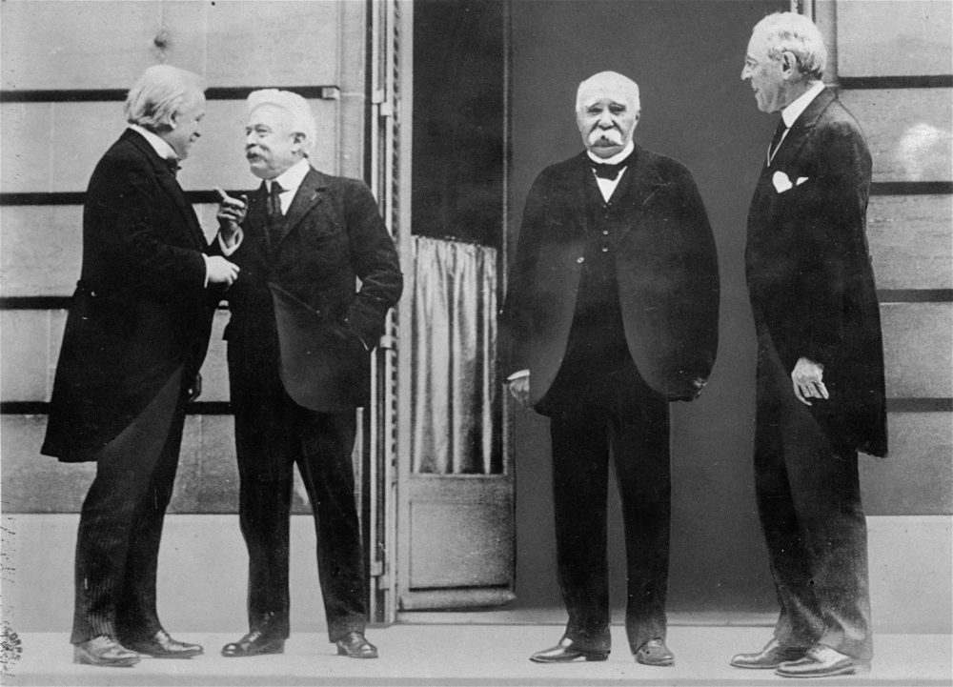
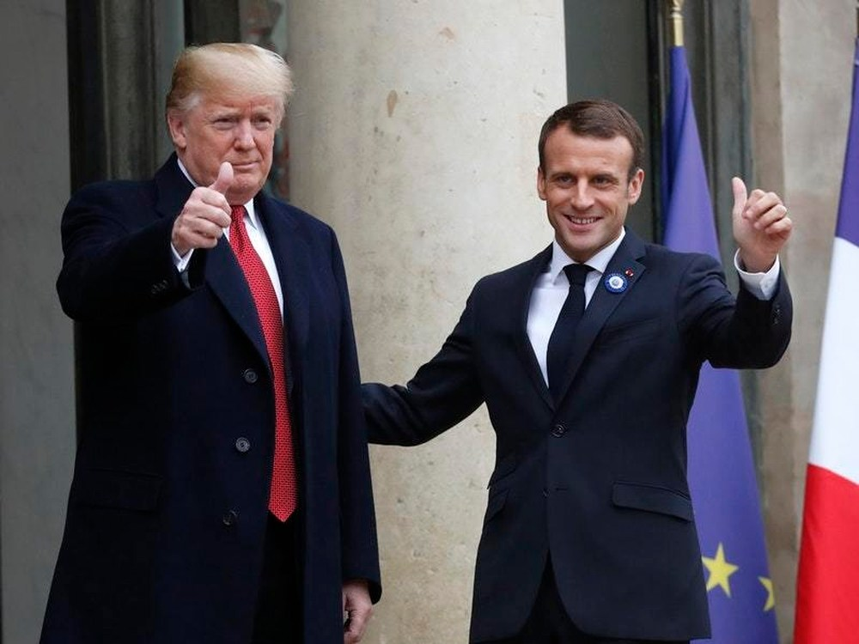

Slide 17
CITIZEN
SOLDIERS
Now, therefore, you are … fellow citizens with the saints and members of the household of God Ephesians 2: 19
You therefore must endure hardship as a good soldier of Jesus Christ. II Timothy 2: 1 – 3

Slide 18
Render therefore to all their due: taxes to whom taxes are due, customs to whom customs, fear to whom fear, honor to whom honor.
Romans 13: 7

Slide 19
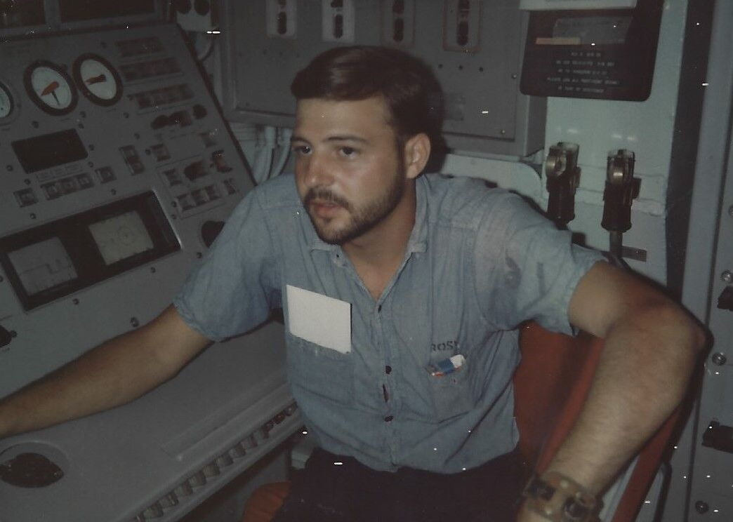
DAN ROSE
JOHN BERRY
JOE BERO

Slide 20
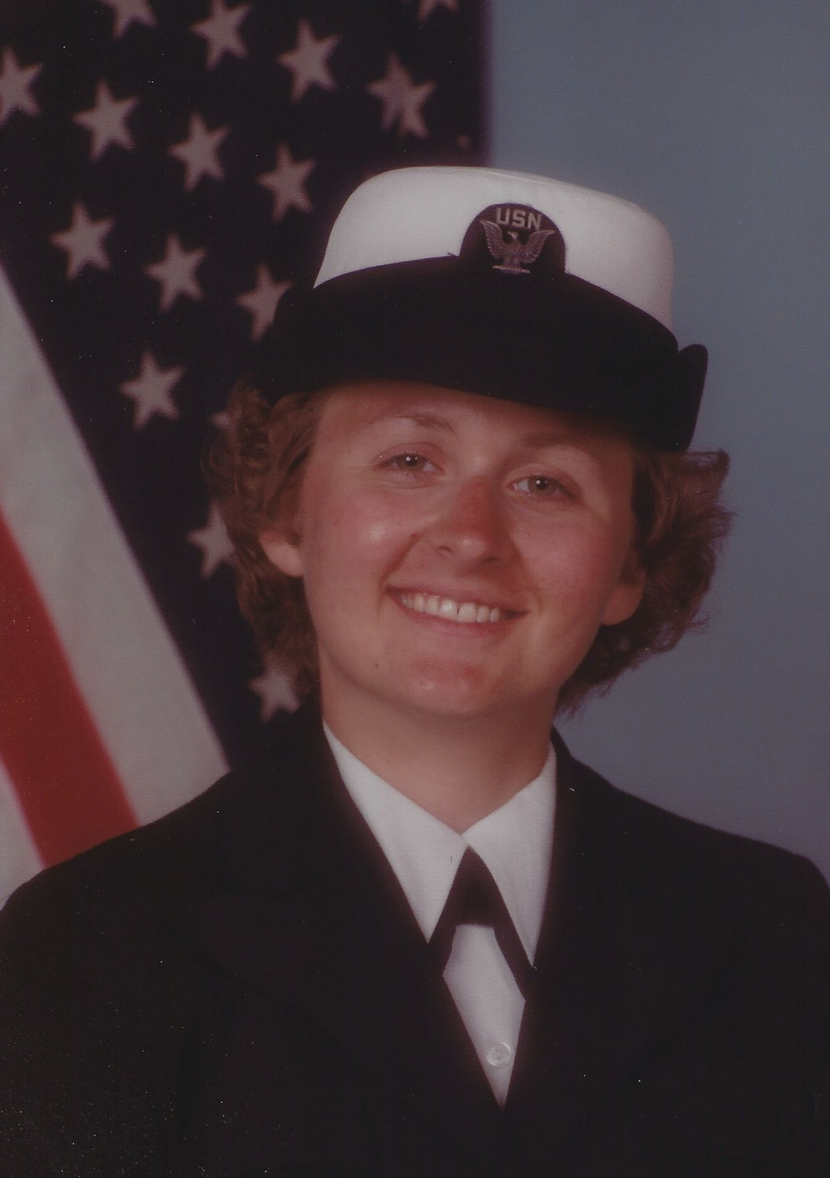
CORRINE NOGUERAS
MARC BLITZ
ROSE BLITZ

Slide 21
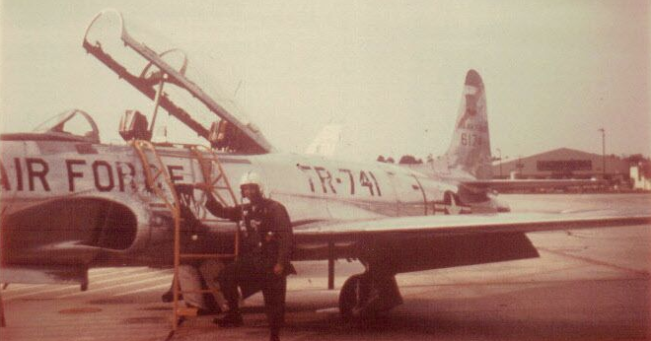
John Davids
Al Gibbons
Ed Lin

Slide 22
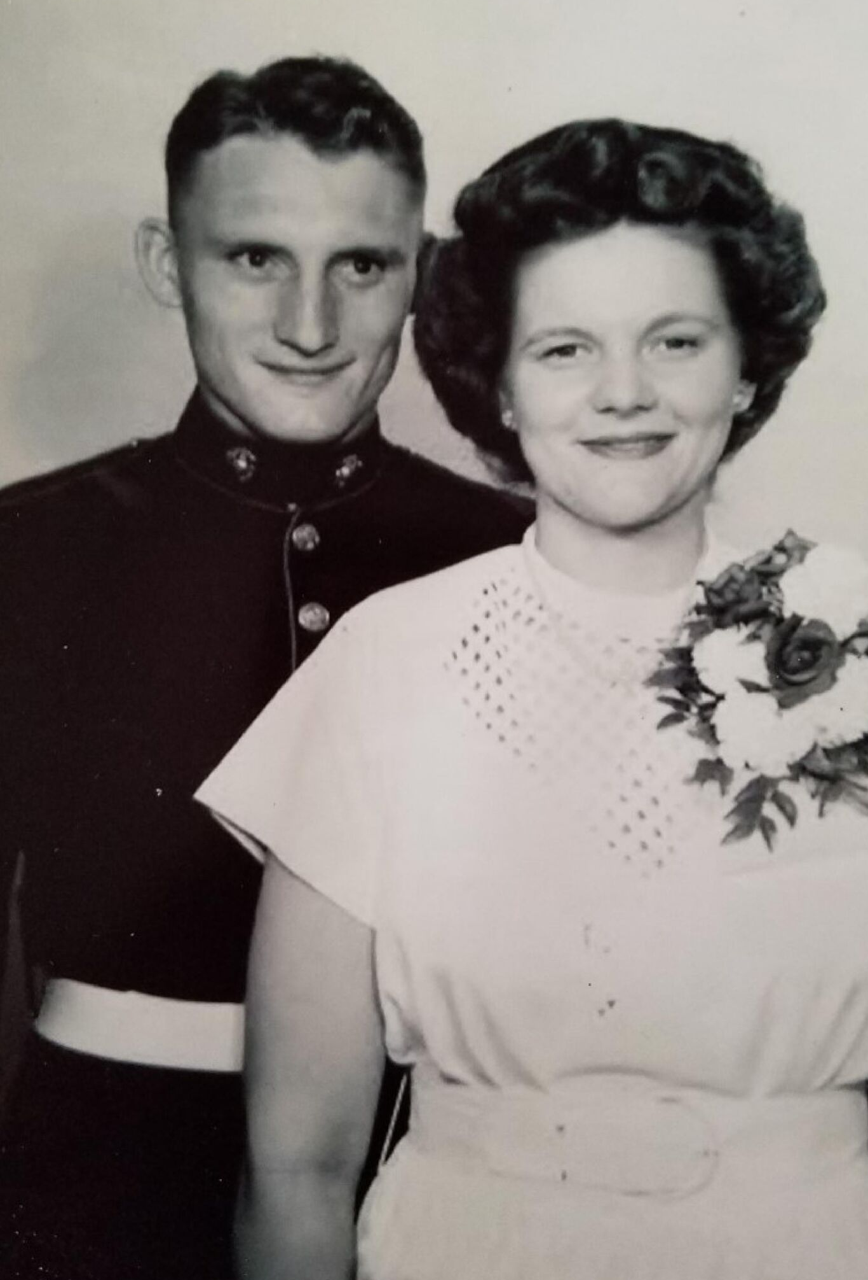
Parents of
Barb smith
Alfred moss
Us marines
Wwii
corporal
I. Lenore moss
Us marines
Wwii
Sergeant

Slide 23
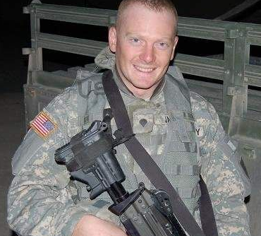
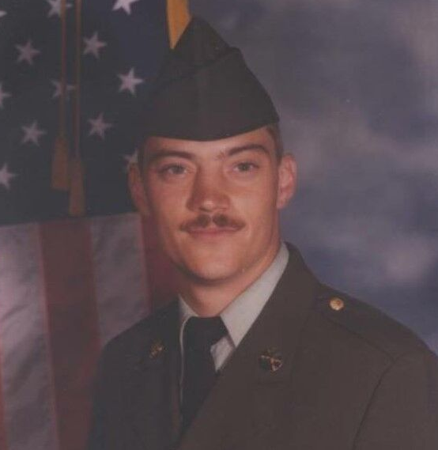
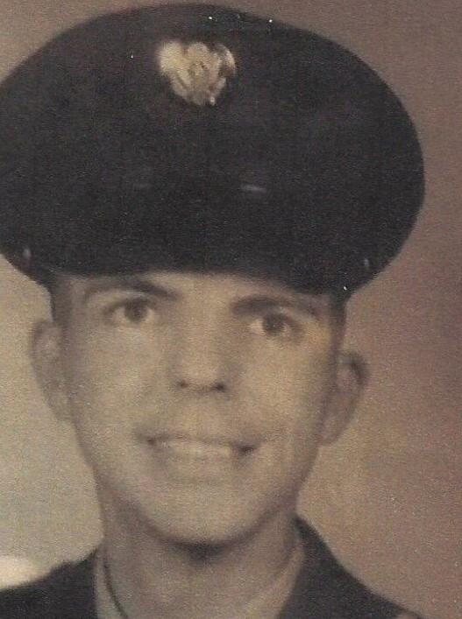
Chris
james
Randy
mccall
Robin
loizeaux

Slide 24
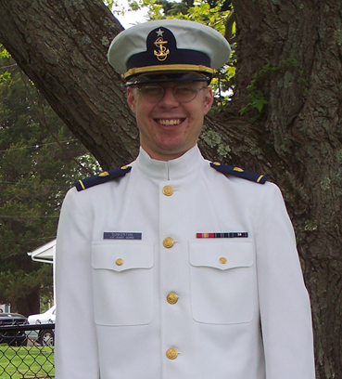
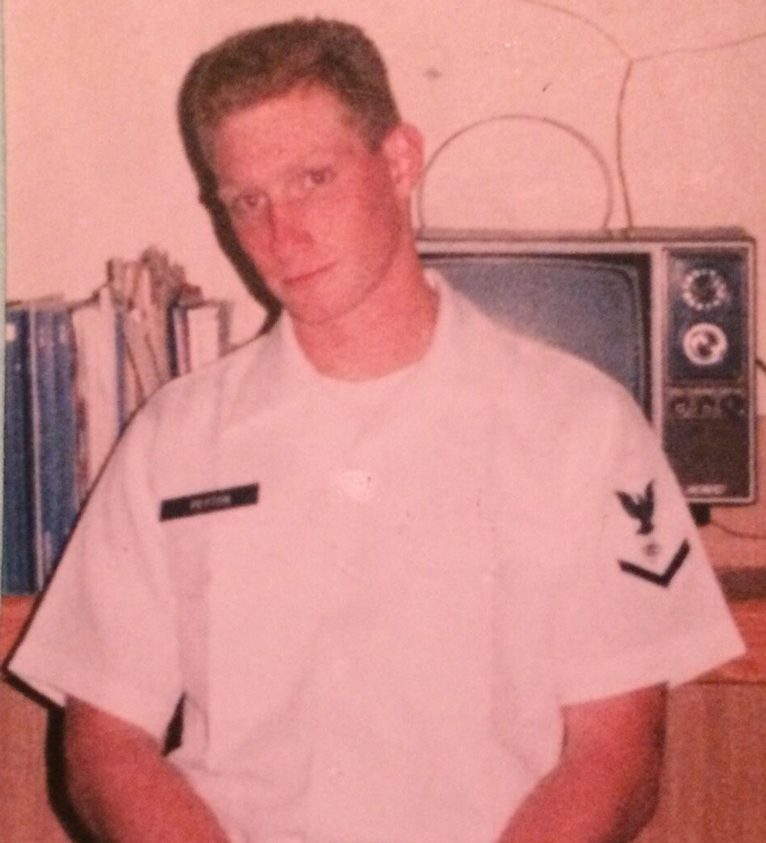
JEFF PEYTON
BEN DUNKERTON

Slide 25
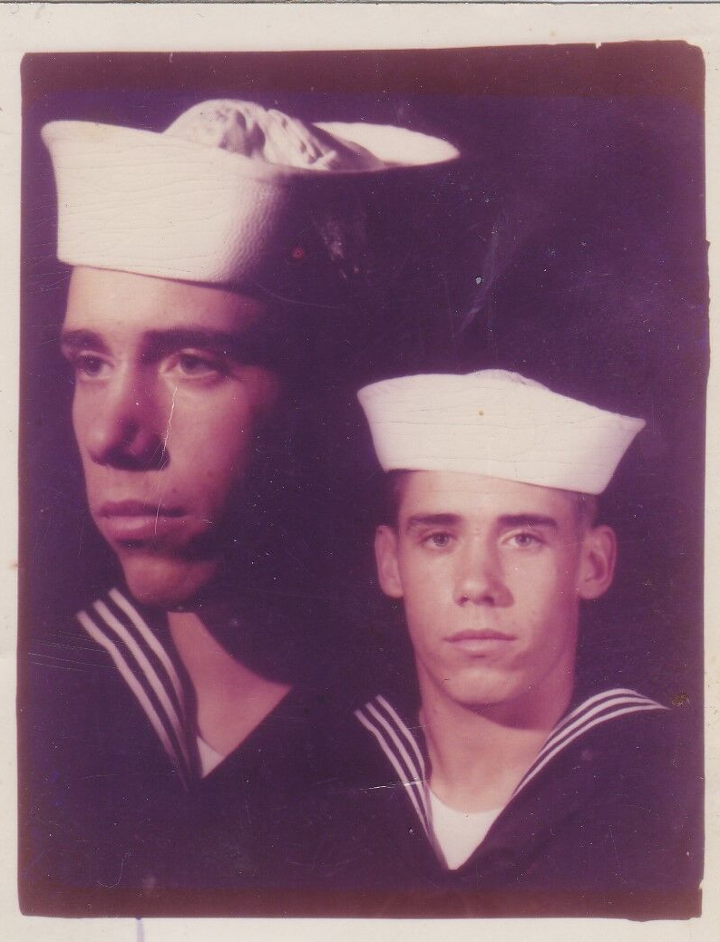
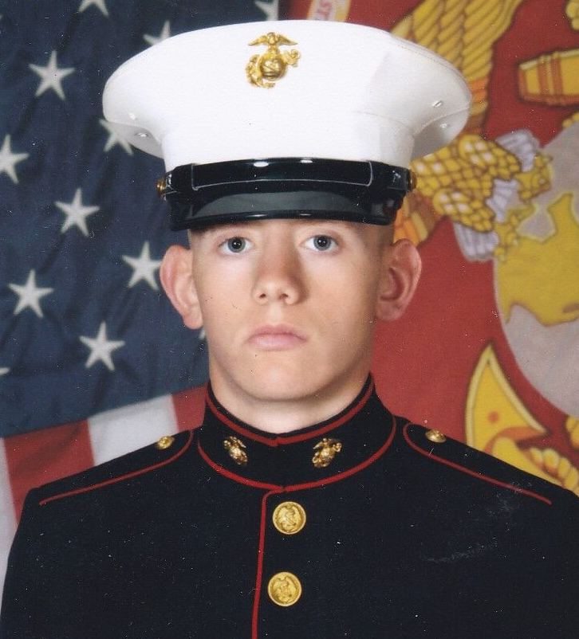
ROB ZELLER
MICHAEL ZELLER

Slide 26
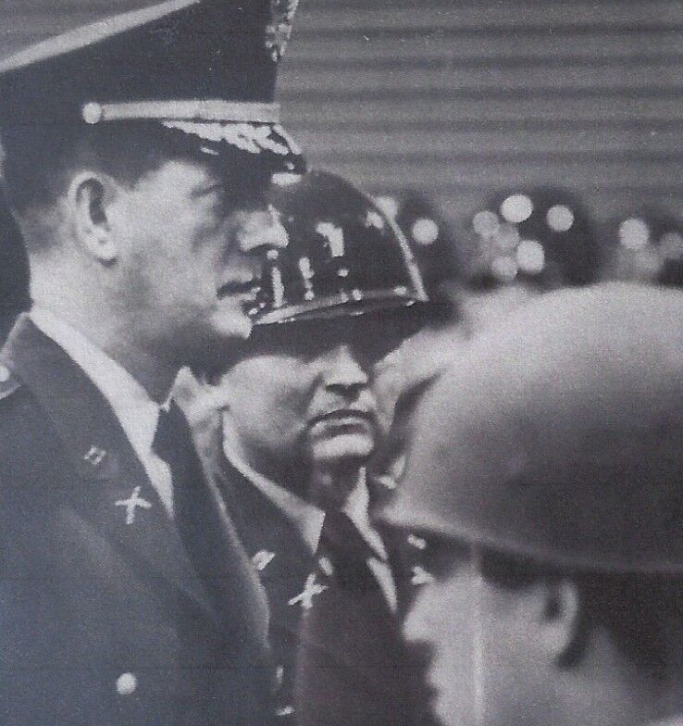
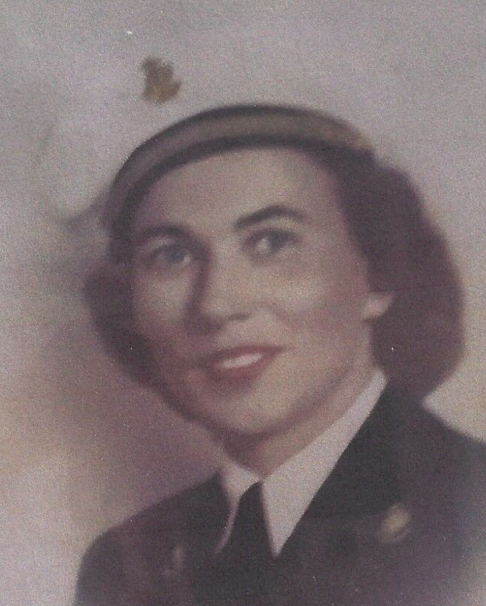
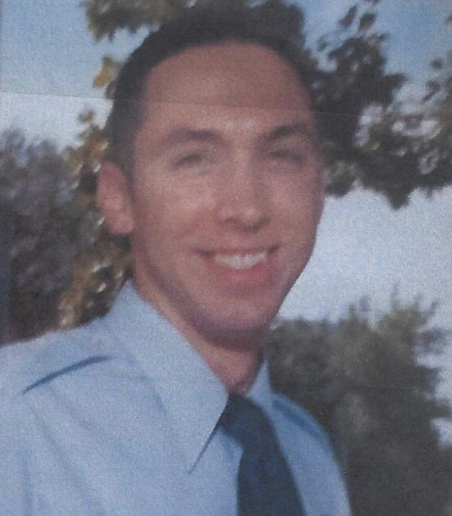
family of
Patrick nolan
Mary Nolan
mother
John Nolan
father
Christopher
Nolan son

Slide 27
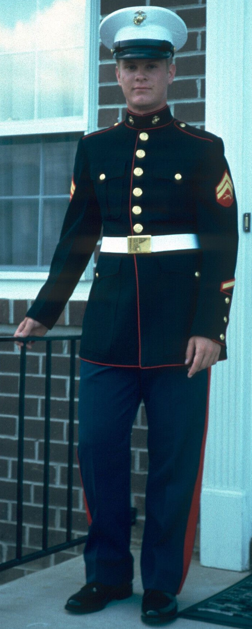
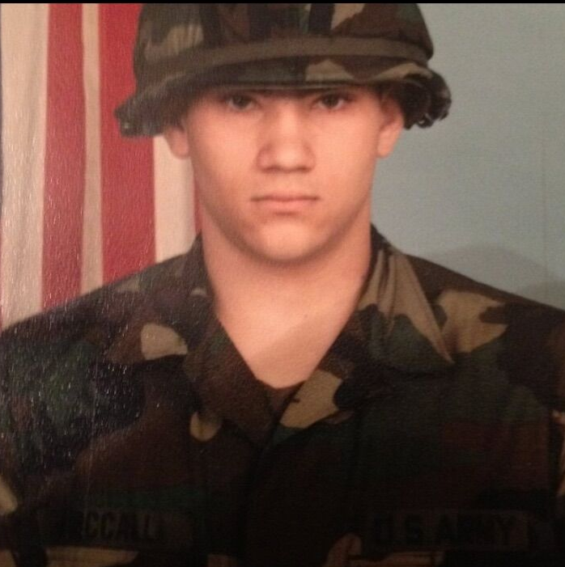
JOEL
LEININGER
ERIC MCCALL

Slide 28
Melvin ennis
Richard embelton
Paul loizeaux
Tom Loizeaux
Steven lutz
John moss, m.d.
Nora Nolan

Slide 29
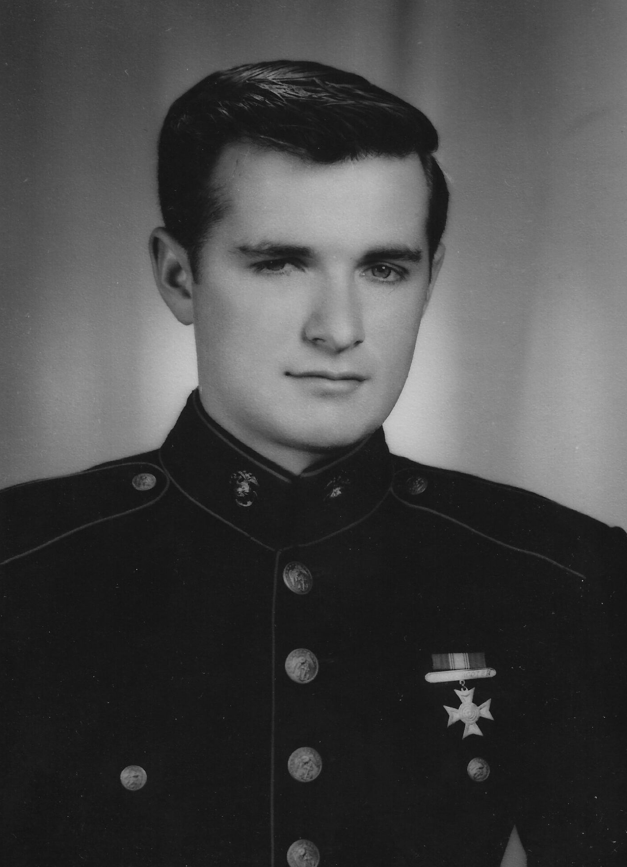
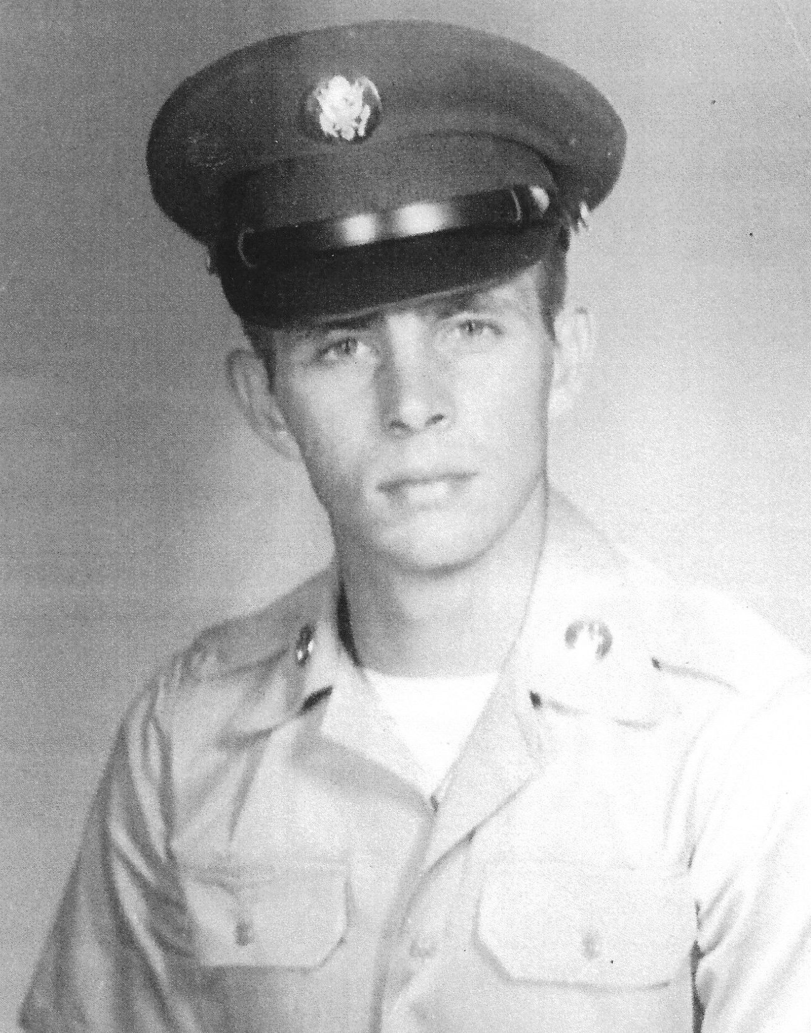
FRANK SLADKO, SR.
BILL
GARDINI

Slide 30
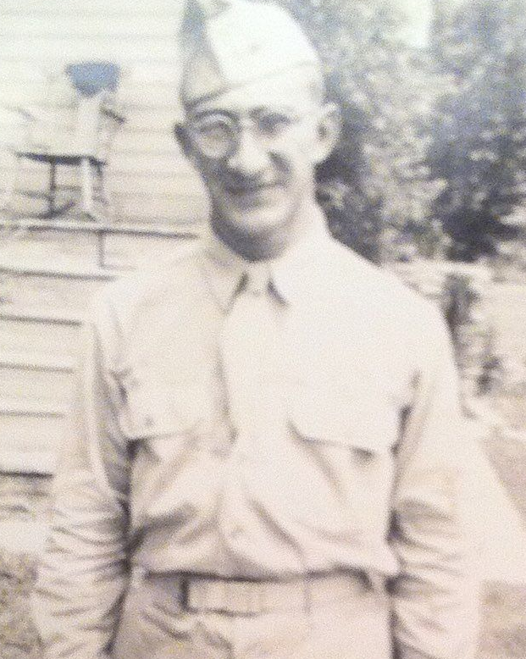
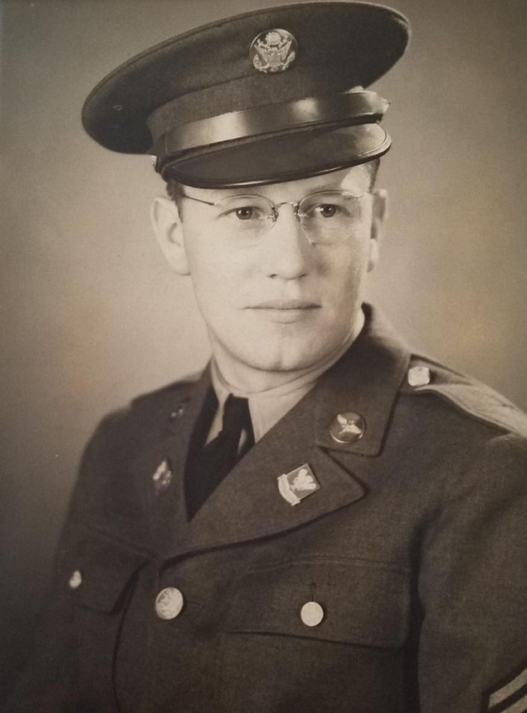
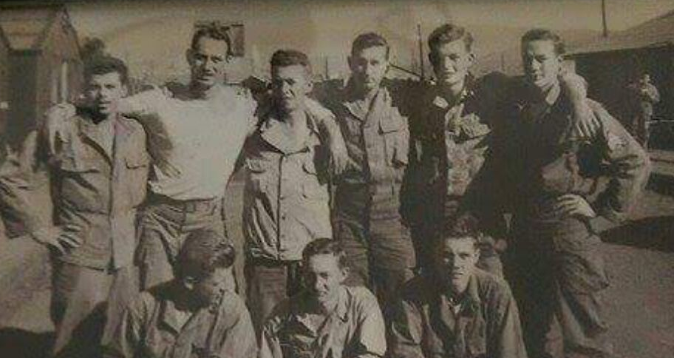
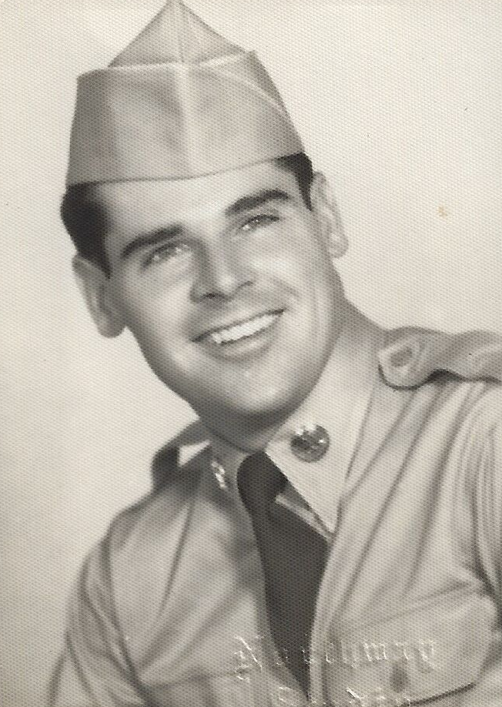
Fathers:
Gerald Jacobs
(jeff Jacobs)
Robert hurley
(dottie traband)
s. Burton Smith
(scott Smith)
Marlin Gorman
(Norris Gorman)

Slide 31
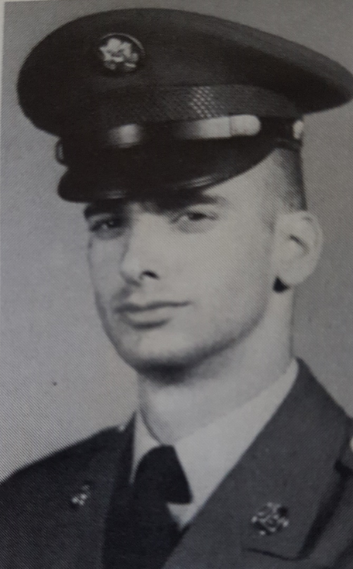
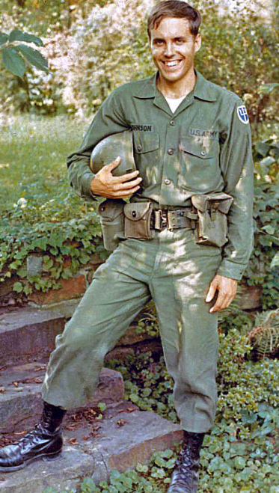
JOHN
ZEIGENFUSE
DAVID JOHNSON

Slide 32
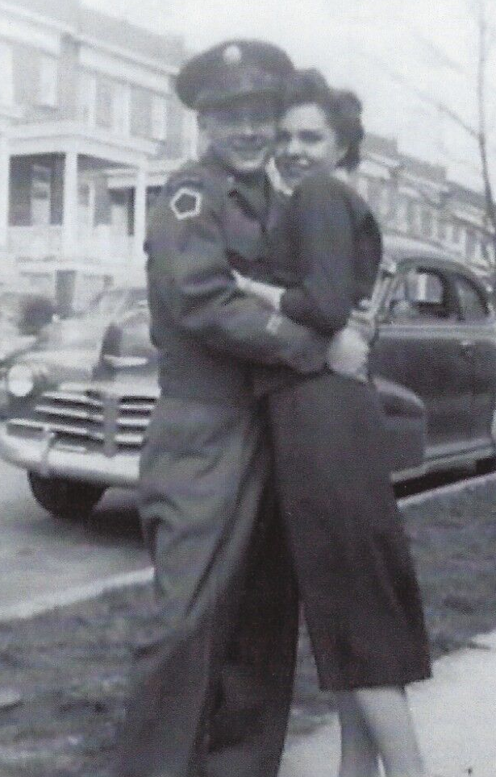
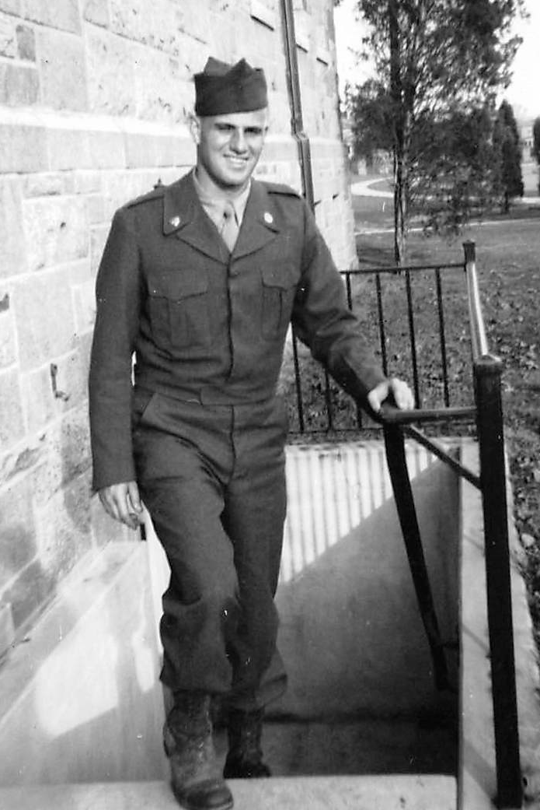
ALBERT LACEY
ALAN SCHETELICH

Slide 33
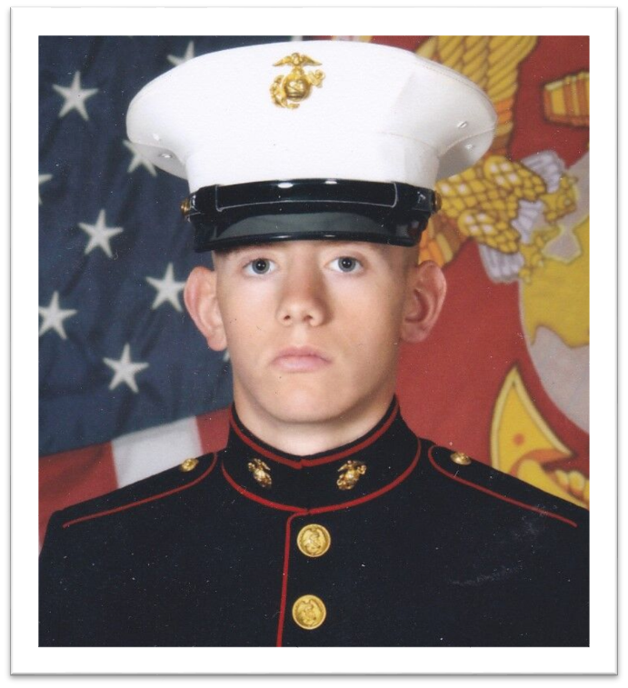
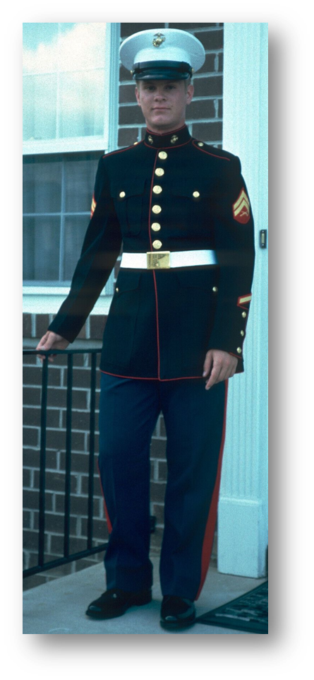
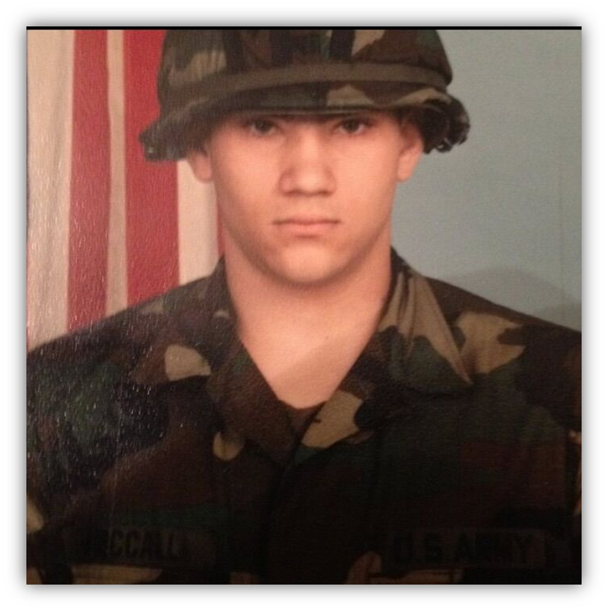
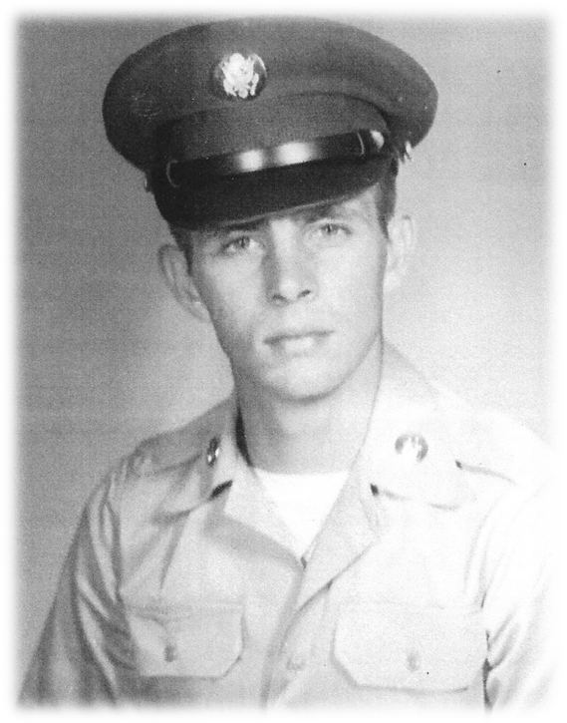
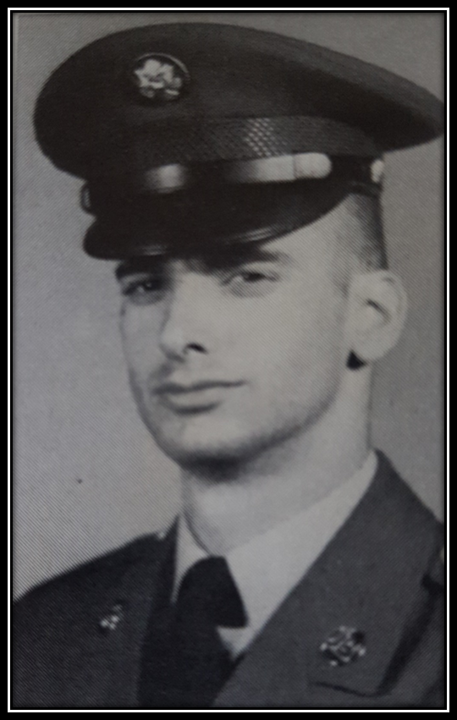
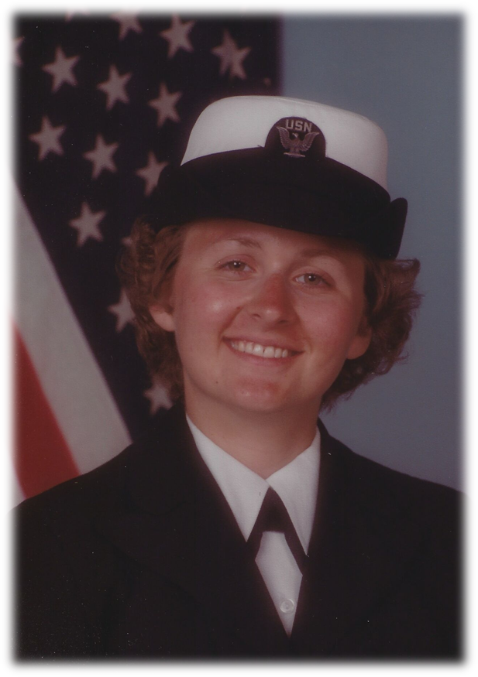
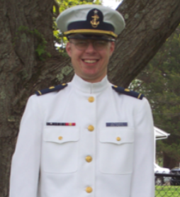
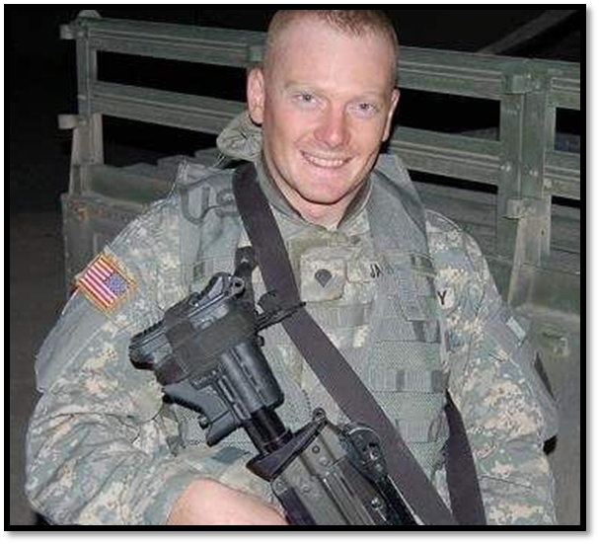
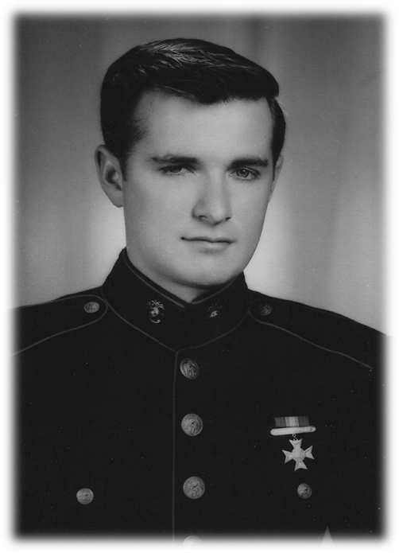
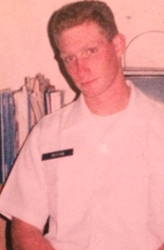
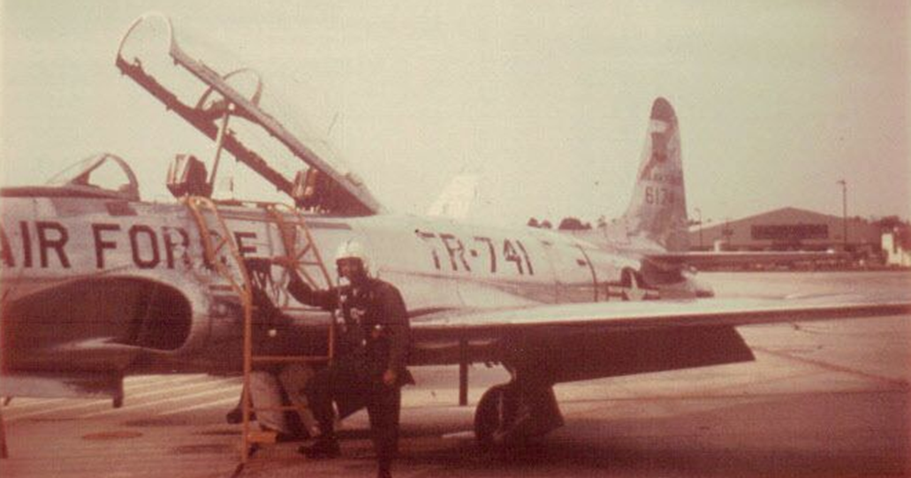
Render therefore to all their due: … honor to whom honor.
Romans 13: 7

Slide 35
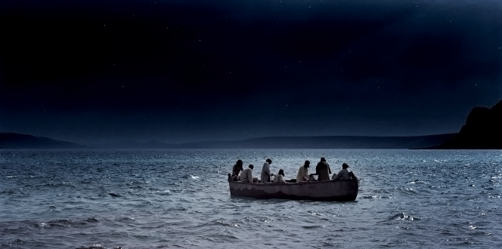
TRAINING the TWELVE
Service with Humility
Mathew 18, 23

Slide 36
Veterans Today
Air Force, Army, Coast Guard, Marine Corps, and Navy are all referred to as the Armed Services..
Current Etiquette tells us that it is appropriate, and even encouraged, to say to a veteran “Thank you for your service.”
One’s time spent in the military is referred as time in service to the country.
Notes:
Veterans Day and service go together
Being thanked for one’s service is relatively new. Coming home in the 60s and 70s you were shunned or worse. We are in a much better place now.

Slide 37
Oath of Enlistment
"I, (state name of enlistee), do solemnly swear (or affirm) that I will support and defend the Constitution of the United States against all enemies, foreign and domestic; that I will bear true faith and allegiance to the same; and that I will obey the orders of the President of the United States and the orders of the officers appointed over me, according to regulations and the Uniform Code of Military Justice. So help me God."
Notes:
When one enters the Armed Services one needs to agree to serve something. Note that the service man or woman agrees to serve the Constitution.
“Same” is Constitution

Slide 38
Officer Oath of Office
I, [name], do solemnly swear (or affirm) that I will support and defend the Constitution of the United States against all enemies, foreign and domestic; that I will bear true faith and allegiance to the same; that I take this obligation freely, without any mental reservation or purpose of evasion; and that I will well and faithfully discharge the duties of the office on which I am about to enter. So help me God
Notes:
Again, as with enlisted members officers agree to serve the Constitution. Not their political party, not their friends, not their family, not themselves but the Constitution.
So how does this apply to “Training the Twelve”; that is Jesus teaching His disciples?

Slide 39
Christians Today
… present your bodies a living sacrifice, holy, acceptable to God, which is your reasonable service. Romans 12:1
(NKJ used throughout)
Paul characterized serving the Lord as being in a fight.
I have fought the good fight, I have finished the race, I have kept the faith. 2 Timothy 4:16
This charge I commit to you … that ... you may wage the good warfare. 1 Tim 1:18
Today we only have to look around and see that the evil one is attacking Christ’s church on all sides
Notes:
Christians are told to serve.
Paul likens the Christian service to being in an armed conflict.
So like the veterans of today who are directly or indirectly involved in an armed conflict Christians are in a similar type of conflict.

Slide 40
Matthew 23
Jesus spoke to the multitudes and to His disciples, ² saying: “The scribes and the Pharisees sit in Moses’ seat. ³ Therefore whatever they tell you to observe, that observe and do, but do not do according to their works; for they say, and do not do. ⁴ For they bind heavy burdens, hard to bear, and lay them on men’s shoulders; but they themselves will not move them with one of their fingers.

Slide 41
Matthew 23
⁵ But all their works they do to be seen by men. They make their phylacteries broad and enlarge the borders of their garments. ⁶ They love the best places at feasts, the best seats in the synagogues, ⁷ greetings in the marketplaces, and to be called by men, ‘Rabbi, Rabbi.’ ⁸ But you, do not be called ‘Rabbi’; for One is your Teacher, the Christ, and you are all brethren. ⁹ Do not call anyone on earth your father; for One is your Father, He who is in heaven. ¹⁰ And do not be called teachers; for One is your Teacher, the Christ.

Slide 42
The Pharisees Got It Wrong
See Mat 23: 1-12
Knew and could teach God’s Word
Notes:
Jesus starts with the good about these educated religious leaders of the day
Apparently their reading the scriptures and telling the illiterate what was in the scripture was OK

Slide 43
The Pharisees Got It Wrong
See Mat 23: 1-12
Knew and could teach God’s Word
Their practice was motivated by self glorification not God’s glory
Notes:
However when it came to putting it into practice the Pharisees missed some major points.
Jesus said…but do not do according to their works; for they say, and do not do.
But all their works they do to be seen by men.
They thought that their service was to themselves and corrupted the things of God

Slide 44
The Pharisees Got It Wrong
See Mat 23: 1-12
Knew and could teach God’s Word
Their practice was motivated by self glorification not God’s glory
Their practice was twisted for their gain
Notes:
Not only that but they twisted, distorted, changed the scripture; we might say made a mockery out of it to legitimize their wrong doing.
In chapter 23 v 16 and following Jesus continues
Woe to you, blind guides, who say, ‘Whoever swears by the temple, it is nothing; but whoever swears by the gold of the temple, he is obliged to perform it.’ 17 Fools and blind! For which is greater, the gold or the temple that sanctifies the gold?
What we just read about nullifying oaths they took.

Slide 45
Matthew 18
At that time the disciples came to Jesus, saying, “Who then is greatest in the kingdom of heaven?”
² Then Jesus called a little child to Him, set him in the midst of them, ³ and said, “Assuredly, I say to you, unless you are converted and become as little children, you will by no means enter the kingdom of heaven. ⁴ Therefore whoever humbles himself as this little child is the greatest in the kingdom of heaven. ⁵ Whoever receives one little child like this in My name receives Me.
Notes:
We have another teaching moment

Slide 46
The Disciples Got It Wrong
The disciples were concerned with what they could do to improve their standing
Notes:
Evidenced by
Ask to sit on left and right
kind of like the Phar and seats at feasts
Ask who is to be the top dog
Ask their Mom to intercede with Jesus

Slide 47
The Disciples Got It Wrong
The disciples were concerned with what they could do to improve their standing
Jesus wanted them to understand that the purpose of service was to advance God and not one’s self.
Notes:
Jesus is more than patient with these guys. So he makes the point again.
They have been with him for about three years at this point
It is not about you but God

Slide 48
The Disciples Got It Wrong
The disciples were concerned with what they could do to improve their standing
Jesus wanted them to understand that the purpose of service was to advance God and not one’s self.
A little child has no power or status
Notes:
I think Jesus picked out a toddler or maybe a preschooler
Bottom of the ladder, had no say so
a little child, who had no rights according to the Law
He told the disciples a change in their thinking was necessary. Greatness in the kingdom was not based on great works or words, but on childlike humility of spirit.
.

Slide 49
The Disciples Got It Wrong
The disciples were concerned with what they could do to improve their standing
Jesus wanted them to understand that the purpose of service was to advance God and not one’s self.
A little child has no power or status
A little child is often an overlooked person
Notes:
Remember the saying the “Children should be seen and not heard”
Opinion is of no consequence
Not unloved but unimportant.

Slide 50
The Disciples Got It Wrong
The disciples were concerned with what they could do to improve their standing
Jesus wanted them to understand that the purpose of service was to advance God and not one’s self.
A little child has no power or status
A little child is often an overlooked person
A little child functions through love – they love the adult and want to do things for that person just to show love
Romans 12: 3
Notes:
The point is love and innocence
Things are done for someone because they love the object.
Think of how your own little children treated you or your grand children so you can remember
Rom 12: For I say, through the grace given to me, to everyone who is among you, not to think of himself more highly than he ought to think, but to think soberly, as God has dealt to each one a measure of faith

Slide 51
The Greatest Commandment
Matthew 22:36 “Teacher, which is the great commandment in the law?”
37 Jesus said to him, “ ‘You shall love the LORD your God with all your heart, with all your soul, and with all your mind.’ 38 This is the first and great commandment.
Notes:
This is what God thinks is most important under Law so think how much more we who have accepted God’s so costly a gift of salvation should serve for love’s sake.

Slide 52
The Greatest Commandment
Matthew 22:36 “Teacher, which is the great commandment in the law?”
37 Jesus said to him, “ ‘You shall love the LORD your God with all your heart, with all your soul, and with all your mind.’ 38 This is the first and great commandment.
Serve because you love God

Slide 53
Christian Pledge of Service
I, [name], do solemnly state that I will serve God through my life as directed by the Holy Spirit in such a manner as to bring glory to God.
Notes:
This is a suggestion of a Christian parallel to the veteran’s oath we looked at earlier

Slide 54
Diversity in Servicce
The Armed Services differ from one another in mission, make up, function, and equipment
Each service had hundreds of different specialties that its members perform
Members can and do move from one specialty to another as the mission requirements change
Each member is part of an orchestrated team to accomplish the mission
Each member is important to the functioning of the team
Notes:
Student pilot, B-52 pilot, rotary wing pilot, safety staff officer, engineering staff officer, program manager

Slide 55
Christian Service Diversity
Difference in race, culture, language – Revelation 5: 9
And they sang a new song, saying:
“You are worthy to take the scroll,
And to open its seals;
For You were slain,
And have redeemed us to God by Your blood
Out of every tribe and tongue and people and nation,
Notes:
We have here at Forge Road people from American, European, Asian, African, South American cultures. All that is missing is Antarctica and I do not penguins count.

Slide 56
Christian Service Diversity
Difference in race, culture, language – Revelation 5: 9
Difference in spiritual gifts – Romans 12: 6-8
Having then gifts differing according to the grace that is given to us, let us use them: if prophecy, let us prophesy in proportion to our faith; 7 or ministry, let us use it in our ministering; he who teaches, in teaching; 8 he who exhorts, in exhortation; he who gives, with liberality; he who leads, with diligence; he who shows mercy, with cheerfulness.
Notes:
Just like the Armed Services uses different skill sets God give different skill sets to fill the need of that place, that time, that ministry.
As I moved around the country the Lord used Donna and me to meet different needs in different churches

Slide 57
Christian Service Diversity
Difference in race, culture, language – Revelation 5: 9
Difference in spiritual gifts – Romans 12: 6-8
Difference in ministries – 1 Cor 12: 4-6`
4 There are diversities of gifts, but the same Spirit. 5 There are differences of ministries, but the same Lord. 6 And there are diversities of activities, but it is the same God who works all in all.
Notes:
Think of the various ministries that FRBC support and in which congregants are involved
Andy, Peter, Woody, Jim, Brad and Nathaly came out from here – people are involved in Jail Ministry, CEF, Samaritan Woman, Center for Pregnancy Concerns to name a few

Slide 58
Christian Service Diversity
Difference in race, culture, language – Revelation 5: 9
Difference in spiritual gifts – Romans 12: 6-8
Difference in ministries – 1 Cor 12: 4-6
Difference in activities – 1 Cor 12: 4-6
6 And there are diversities of activities, but it is the same God who works all in all.
Notes:
Activities differ
Making Coffee, setting up elements, opening the building, cleaning up, maintenance, teaching, leading, music etc

Slide 59
Team Members
Just as veterans had to work together in their respective unit’s mission so Christians need to work together to have a fully functioning local church
Paul likens the church to a body – different parts have different functions but each performs a job to keep the body functioning. Romans 12; 4,5 1 Corinthians 12: 12 - 26
Peter likens the church to a building – different parts must work jointly to give strength to the structure 1 Peter 2: 4 - 5
Notes:
Romans 12:4 For as we have many members in one body, but all the members do not have the same function, 5 so we, being many, are one body in Christ, and individually members of one another.
1 Cor 12 see inserted page
1 Peter 2:4 Coming to Him as to a living stone, rejected indeed by men, but chosen by God and precious, 5 you also, as living stones, are being built up a spiritual house, a holy priesthood, to offer up spiritual sacrifices acceptable to God through Jesus Christ.

Slide 60
Today we have honored our veterans for their service
We have drawn parallels between serving in the Armed Services and serving Christ
In our service we must serve God, not furthering ourselves
We must serve humbly, honoring God, not us
We will serve with others who are different from us
We must stand shoulder to shoulder with those God puts next to us
Veterans - Again, thank you for your service

Slide 61
Sunday November 11
Family Bible Hour

