Slide 1
Absalom, the Son of David
2 Samuel 18

Slide 2
Psalm 3:1-2
Lord, how they are increased who trouble me! Many are they who rise up against me. Many are they who say of me, “There is no help for him in God.”

Slide 3
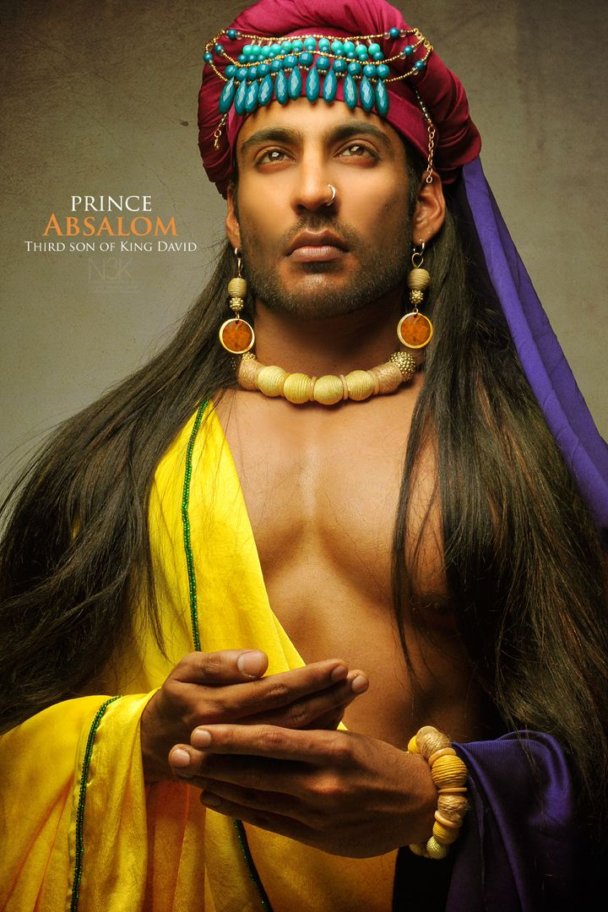

Slide 4
2 Samuel 14: 25-26
“(25) Now in all of Israel was no one as handsome as Absalom, so highly praised; from the sole of his foot to the crown of his head there was no defect in him. (26) When he cut the hair of his head (and it was at the end of every year that he cut it, for it was heavy on him so he cut it), he weighed the hair of his head at 200 shekels by the king’s weight.”
NASB

Slide 6
John 15:1-6
(1)“I am the true vine, and my Father is the vinedresser. (2) Every branch in Me that does not bear fruit, He takes away; and every branch that bears fruit, He prunes it so that it may bear more fruit. (3) You are already clean because of the word which I have spoken to you. (4) Abide in Me, and I in you. As the branch cannot bear fruit of itself unless it abides in the vine, so neither can you unless you abide in Me. (5) I am the vine, you are the branches; he who abides in Me and I in him, he bears much fruit, for apart from Me you can do nothing. (6) If anyone does not abide in Me, he is thrown away as a branch and dries up; and they gather them, and cast them into the fire and they are burned.”

Slide 7
2 Samuel 18:30-33
“(31) Behold the Cushite arrived, and the Cushite said, “Let my lord the king receive good news, for the Lord has freed you this day form the hand of all those who rose up against you.” (32) Then the king said to the Cushite, “Is it well with the young man Absalom?” And the Cushite answered, “Let the enemies of my lord the king, and all who rise up against you for evil, be as that young man!” (33) The king was deeply moved and went up to the chamber over the gate and wept. And thus he said as he walked, “O my son Absalom, my son, my son Absalom! Would I had died instead of you, O Absalom, my son, my son!”

Slide 8
Dying as God’s enemy is senseless…
Romans 5:10
“For if while we were enemies, we were reconciled to God through the death of His Son, much more, having been reconciled, we shall be saved by His life.”

