Slide 2
Then he was afraid...
(I Kings 19:3)
Elijah was a person just like us... (James 5:17)

Slide 3
Elijah Lived in a context of spiritual darkness I Kings 16:29-33
I Kgs. 16:29 In the thirty-eighth year of Asa king of Judah, Ahab the son of Omri began to reign over Israel, and Ahab the son of Omri reigned over Israel in Samaria twenty-two years.
30 And Ahab the son of Omri did evil in the sight of the LORD, more than all who were before him.

Slide 4
16:31 And as if it had been a light thing for him to walk in the sins of Jeroboam the son of Nebat, Ahab took for his wife Jezebel, the daughter of Ethbaal, king of the Sidonians. He went and served Baal and worshiped him.
32 Ahab erected an altar for Baal in the house of Baal, which he built in Samaria.
33 And Ahab made an Asherah. Ahab did more to provoke the LORD, the God of Israel, to anger than all the kings of Israel who were before him.

Slide 5
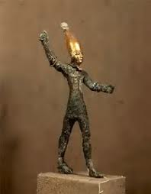
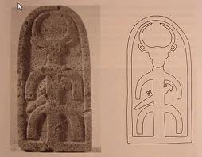
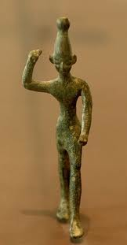
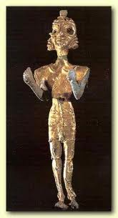
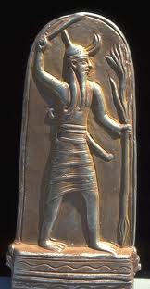
Figurines of Baal

Slide 6
II. Elijah Lived During a Time of Great Physical Crisis
(I Kings 17:1-24)
He was being trained to confront Baal worship, the religious system endorsed by the monarchy

Slide 7
17:1 Now Elijah the Tishbite, of Tishbe in Gilead, said to Ahab, “As the LORD, the God of Israel, lives, before whom I stand, there shall be neither dew nor rain these years, except by my word.”

Slide 8
Jezebel: Phoenician princess. Tyre and Sidon, center of Baal worship
Ahab and Jezebel: Worshiping Baal in Samaria, capital of Israel
Gilead: Wilderness where Elijah was Developing a Passion for Yahweh
Jerusalem: Capital of Judah
Elijah and the Famine: I Kings 17

Slide 9
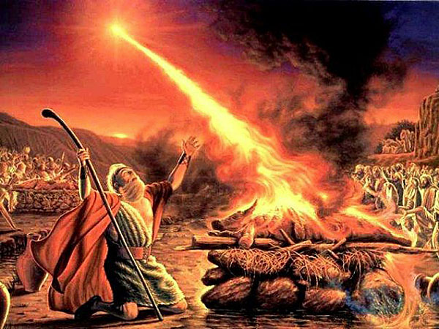
III. Elijah Was Called to take his Message to the Public Stage I Kings 18:1-46

Slide 10
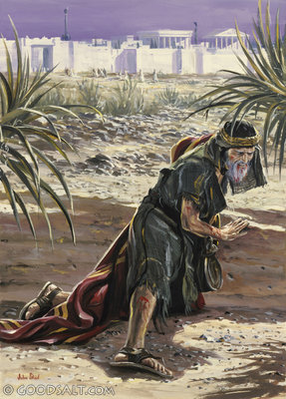
IV. The Spiritual Warfare, Famine, and Confrontation had Taken its Toll - I Kings 19:1-14

Slide 11
(After Mount Carmel)
1 Kings 18:45 ...And Ahab rode and went to Jezreel.
46 Then the hand of the LORD was on Elijah, and he gathered up his garment and outran Ahab to the entrance of Jezreel.

Slide 12
Jezreel: Where we become afraid. 30 miles from Mt. Carmel
Mt. Carmel (50 miles): Where God’s Uniqueness is Displayed
Samaria: Seat of Idolatry
Gilead: Where the Ways of God are Best Learned
Jerusalem: Capitol of Judah
Elijah’s Flight from Jezebel

Slide 13
I Kings 19:1 Ahab told Jezebel all that Elijah had done, and how he had killed all the prophets with the sword.
2 Then Jezebel sent a messenger to Elijah, saying, “So may the gods do to me and more also, if I do not make your life as the life of one of them by this time tomorrow.”
3 Then he was afraid...

Slide 14
3 Then he was afraid, and he arose and ran for his life and came to Beersheba, which belongs to Judah, and left his servant there.
4 But he himself went a day's journey into the wilderness and came and sat down under a broom tree.
And he asked that he might die, saying, “Enough! Now, LORD, take my life,
for I am no better than my fathers.”

Slide 15
8 And he arose and ate and drank, and went in the strength of that food forty days and forty nights to Horeb, the mountain of God.

Slide 16
Elijah in Pursuit of God
Mt. Carmel: Where God’s Uniqueness is Displayed
Jezreel: Where We Become Afraid
Samaria: Where idolatry is practiced
Gilead: Where the Ways of God are Best Learned
Beer-Sheva (95 miles): Where we hit rock bottom
In the wilderness (10-20 miles): Where we find comfort on our journey
Mt. Sinai (120 miles): Where we encounter God

Slide 17
9 There he came to a cave and lodged in it. And behold, the word of the LORD came to him, and he said to him, “Why are you here, Elijah?”
10 He said, “I have been very zealous for the LORD, the God of hosts.
For the people of Israel have forsaken your covenant, torn down your altars, and killed your prophets with the sword, and I, even I only, am left, and they seek my life, to take it away.”

Slide 18
1. You are a mere mortal and life can be stressful.
2. Escaping for recovery and restoration has great value.
3. Escaping should be to have an encounter with God.
4. Expect God to surprise you when and how he meets you in your weakness.
5. Remember that you belong to God, that the work is the Lord’s, and that you are expendable. God has many others who are equally passionate for him.

