Slide 1
James 2: 14
What does it profit, my brethren, if someone says he has faith but does not have works?
Can faith save him?

Slide 2
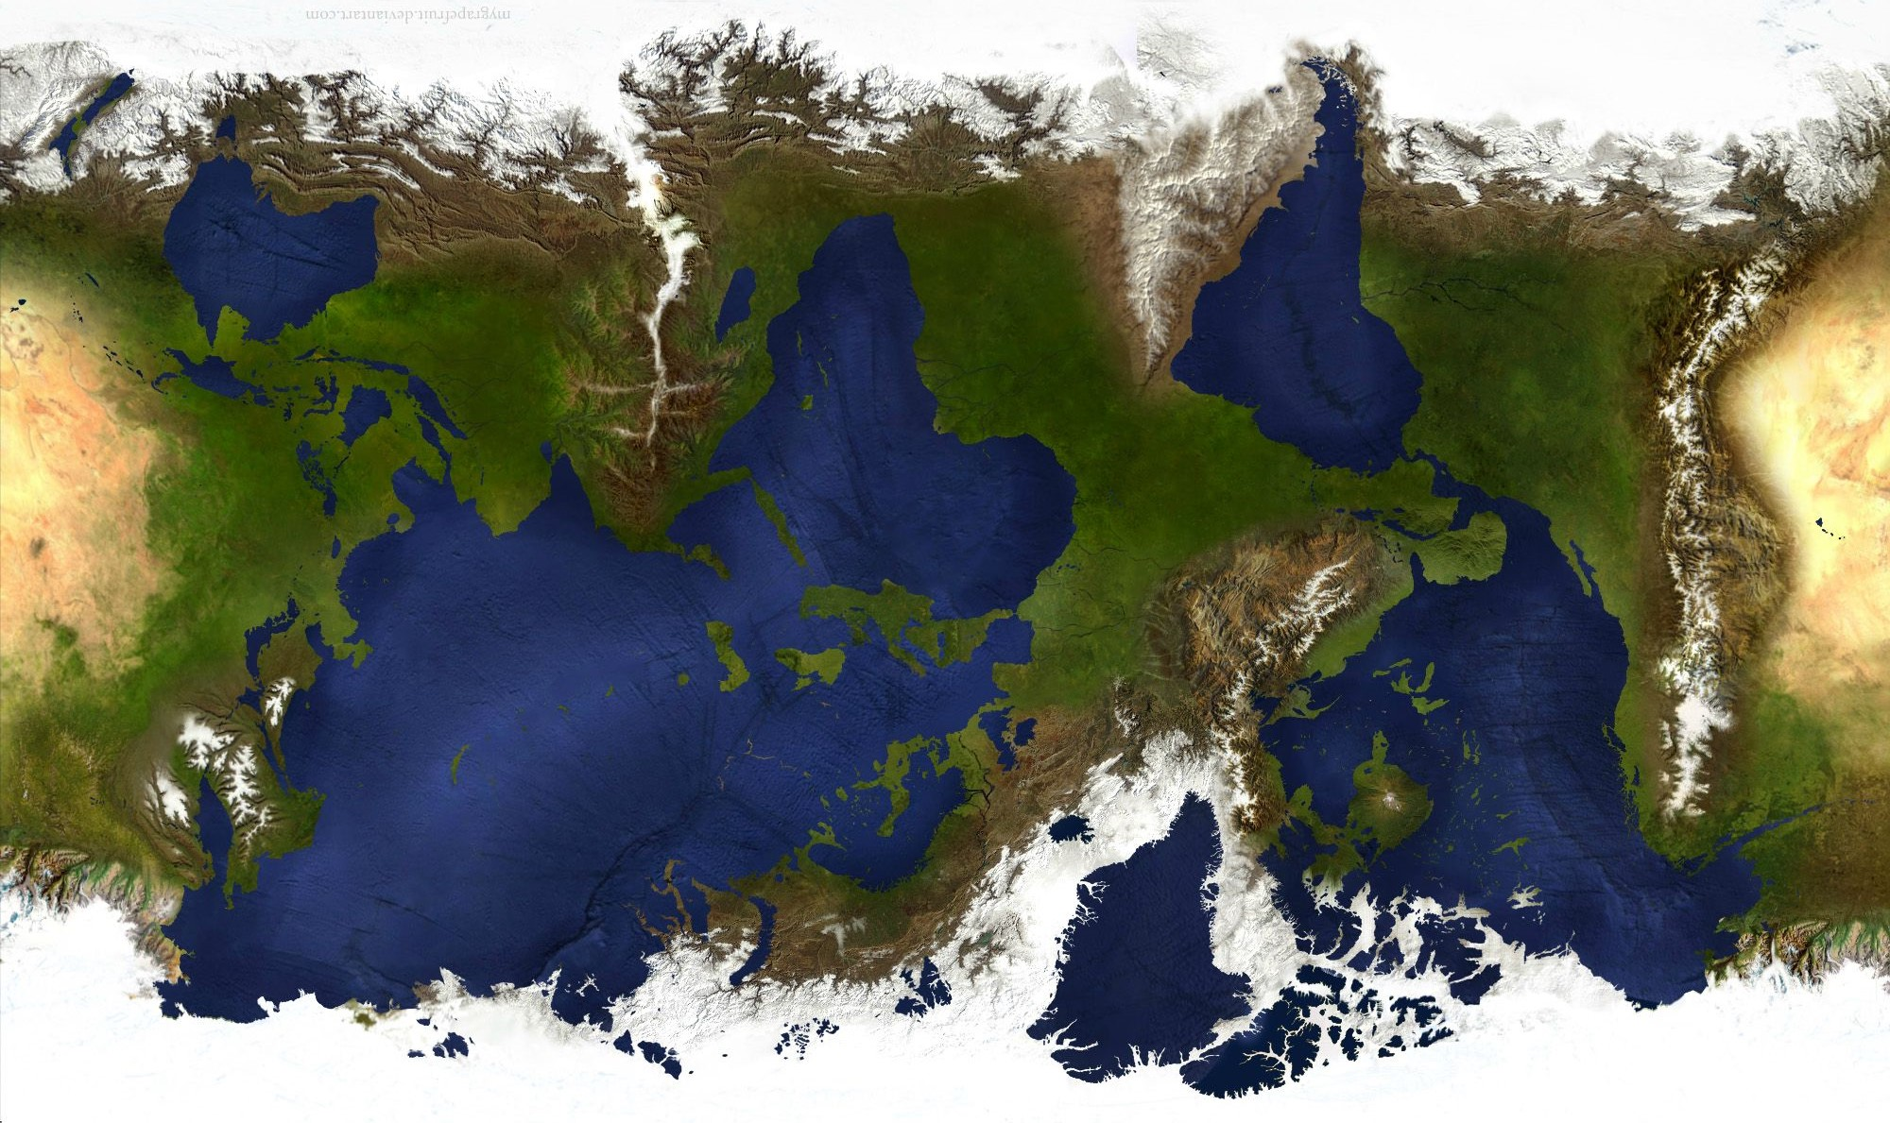

Slide 3
Romans 14: 6
Therefore do not let your good be spoken of as evil.

Slide 4
Matthew, Mark, Luke, John, Acts
Romans, I & II Corinthians, Galatians, Ephesians, Philippians, Colossians,
I & II Thessalonians,
I & II Timothy, Titus, Philemon
Hebrews, James, I & II Peter,
I, II, & III John, Jude
Revelation

Slide 5
James, Galatians
I & II Thessalonians
I Corinthians, Philippians,
II Corinthians, Romans,
I Timothy, Titus
Mark, Matthew, I Peter, Hebrews, Luke, Acts
Ephesians, Colossians, Philemon
II Peter, II Timothy, Jude
John, I, II, & III John, Revelation

Slide 6
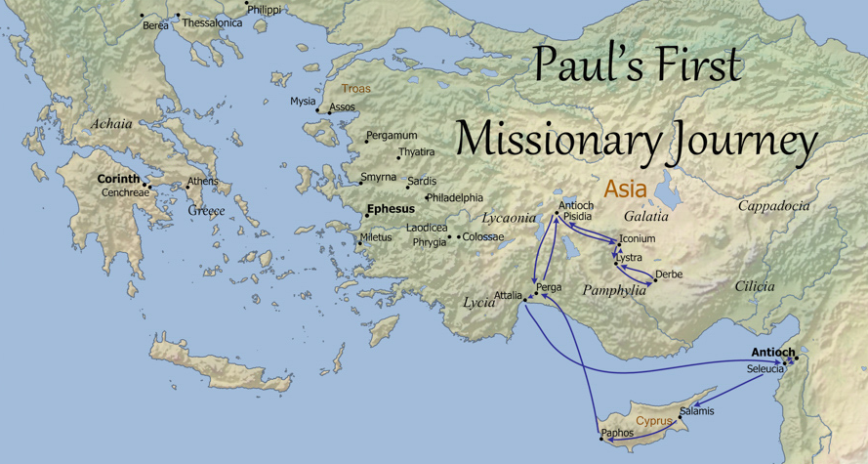
James
Galatians

Slide 7
James
Galatians
… no small dissension and dispute …
Acts 15: 2

Slide 8
James
Galatians

Slide 9
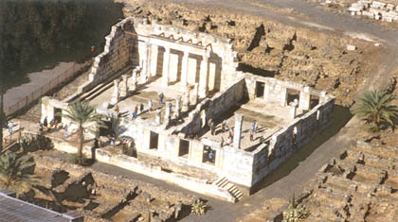
James
Galatians

Slide 10
James
Galatians

Slide 11
We who are Jews by nature, and not sinners of the Gentiles, knowing that a man is not justified by the works of the law but by faith in Jesus Christ, even we have believed in Christ Jesus, that we might be justified by faith in Christ and not by the works of the law; for by the works of the law no flesh shall be justified. Galatians 2: 15, 16
What does it profit, my brethren, if someone says he has faith but does not have works? Can faith save him?
If a brother or sister is naked and destitute of daily food, and one of you says to them, “Depart in peace, be warmed and filled,” but you do not give them the things which are needed for the body, what does it profit? Thus also faith by itself, if it does not have works, is dead. James 2: 14 - 17

Slide 12
Abraham “believed God, and it was accounted to him for righteousness.” Therefore know that only those who are of faith are sons of Abraham. And the Scripture, foreseeing that God would justify the Gentiles by faith, preached the gospel to Abraham beforehand, saying, “In you all the nations shall be blessed.” So then those who are of faith are blessed with believing Abraham.
Galatians 3: 6 - 9
Was not Abraham our father justified by works when he offered Isaac his son on the altar? Do you see that faith was working together with his works, and by works faith was made perfect? And the Scripture was fulfilled which says, “Abraham believed God, and it was accounted to him for righteousness.” And he was called the friend of God. _{James 2: 21 - 23}

Slide 13
He who supplies the Spirit to you and works miracles among you, does He do it by the works of the law, or by the hearing of faith?
Galatians 3: 5
You have faith, and I have works. Show me your faith without your works, and I will show you my faith by my works.
James 2: 18

Slide 14
The Scripture has confined all under sin, that the promise by faith in Jesus Christ might be given to those who believe.
Galatians 3: 22
You believe? … Even the demons believe — and tremble!
James 2: 19

Slide 15
A Generation Younger.
From Tarsus.
Born a Roman Citizen.
“… from Tarsus, in Cilicia, a citizen of no mean city … brought up in [Jerusalem] at the feet of Gamaliel.”
“I was born a [Roman] citizen”
_{Acts 21: 39; 22: 3, 28}
A Generation Older.
From Galilee.
Poor.
Let the lowly brother glory in his exaltation but the rich in his humiliation,
Come now, you rich, weep and howl for your miseries that are coming upon you!
James 1: 9, 10; 5: 1

Slide 16
“I preach among the Gentiles”
“The law was our tutor to bring us to Christ … But after faith has come, we are no longer under a tutor.”
“the two covenants: the one from Mount Sinai which gives birth to bondage …”
Galatians 2:2; 3:24,25; 4:24
“To the twelve tribes scattered abroad.”
“The royal law according to the Scriptures …”
“The perfect law of liberty …”
James 1: 2, 25; 2: 8

Slide 17
Then after fourteen years I went up again to Jerusalem with Barnabas, and also took Titus with me.
And I went up by revelation, and communicated to them that gospel which I preach among the Gentiles, but privately to those who were of reputation,…

Slide 18
But from those who seemed to be something—whatever they were, it makes no difference to me; God shows personal favoritism to no man—for those who seemed to be something added nothing to me. … and when James, Cephas, and John, who seemed to be pillars, perceived the grace that had been given to me, they gave me and Barnabas the right hand of fellowship, that we should go to the Gentiles and they to the circumcised.
Galatians 2: 1 - 9

Slide 19
But from those who seemed to be something—whatever they were, it makes no difference to me; God shows personal favoritism to no man—for those who seemed to be something added nothing to me. … and when James, Cephas, and John, who seemed to be pillars, perceived the grace that had been given to me, they gave me and Barnabas the right hand of fellowship, that we should go to the Gentiles and they to the circumcised.
Galatians 2: 1 - 9

Slide 20
But from those who seemed to be something—whatever they were, it makes no difference to me; God shows personal favoritism to no man—for those who seemed to be something added nothing to me. … and when James, Cephas, and John, who seemed to be pillars, perceived the grace that had been given to me, they gave me and Barnabas the right hand of fellowship, that we should go to the Gentiles and they to the circumcised.
Galatians 2: 1 - 9

Slide 21
… for before certain men came from James, he would eat with the Gentiles; but when they came, he withdrew and separated himself, fearing those who were of the circumcision Galatians 2: 12
But do you want to know, O foolish man, that faith without works is dead?
James 2: 20

Slide 22
Romans 14: 6
Therefore do not let your good be spoken of as evil.

Slide 23
Where do wars and fights come from among you?
Do not speak evil of one another, brethren. James 4: 1, 11
But if you bite and devour one another, beware lest you be consumed by one another!
Let us not become conceited, provoking one another, envying one another.
Galatians 5: 15, 26

Slide 24
Romans 14: 6
Therefore do not let your good be spoken of as evil.

Slide 25
But let him ask in faith … James 1: 6
… hold the faith of our Lord Jesus Christ, … be rich in faith James 2: 1, 5
What does it profit, my brethren, if someone says he has faith but does not have works? … If a brother or sister is naked and destitute of daily food, and one of you says to them, “Depart in peace …”
James 2: 14 - 16

Slide 26
What does it profit, my brethren, if someone says he has faith …
James 2: 14
These things indeed have an appearance of wisdom in self-imposed religion, false humility, and neglect of the body, but are of no value against the indulgence of the flesh.
Colossians 2: 20 - 23

Slide 27
And when we had come to Jerusalem, the brethren received us gladly…. Paul went in with us to James … When he had greeted them, he told in detail those things which God had done among the Gentiles through his ministry. And when they heard it, they glorified the Lord.
And they said to him, “You see, brother, how many myriads of Jews there are who have believed, and they are all zealous for the law … Acts 21: 17 - 20

Slide 28
For you have heard of my previous way of life in Judaism, how intensely I persecuted the church of God and tried to destroy it.
Galatians 1: 13
When his family heard about this, they went to take charge of Him, for they said, “He is out of his mind.” … Then Jesus’ mother and brothers … sent someone in to call Him.
Mark 3: 21, 31
For even His own brothers did not believe in Him.
John 7: 5

Slide 29
Christ died for our sins according to the Scriptures … that He rose again the third day … that He was seen by Cephas, then by the twelve. After that He was seen by over five hundred brethren … After that He was seen by James … Then last of all He was seen by me also, as by one born out of due time.
I Corinthians 15: 3 - 8

Slide 30
James, Galatians
I & II Thessalonians
I Corinthians, Philippians,
II Corinthians, Romans,
I Timothy, Titus
Mark, Matthew, I Peter, Hebrews, Luke, Acts
Ephesians, Colossians, Philemon
II Peter, II Timothy, Jude
John, I, II, & III John, Revelation

