Slide 1
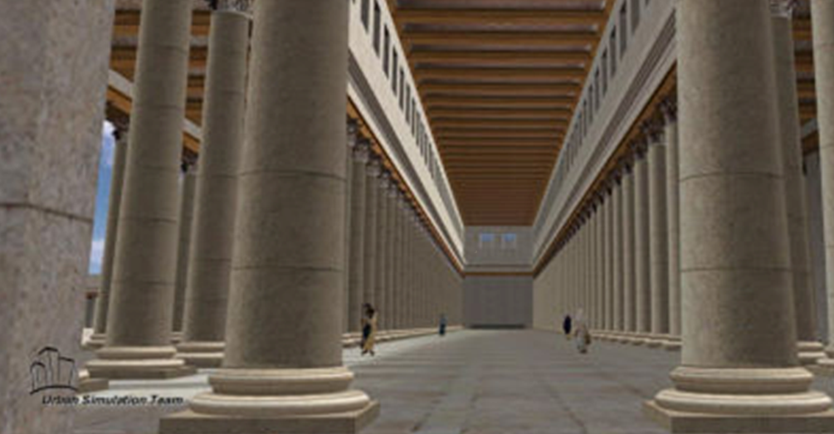
Now it was the Feast of Dedication in Jerusalem, and it was winter. And Jesus walked in the temple, in Solomon's porch. John 10: 22, 23

Slide 2
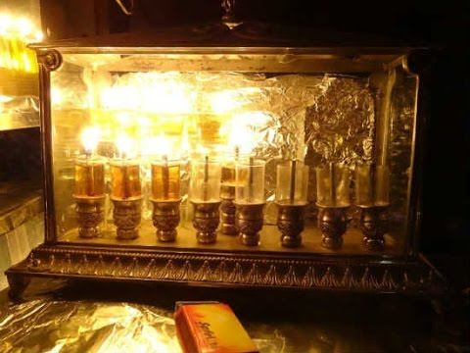

Slide 3
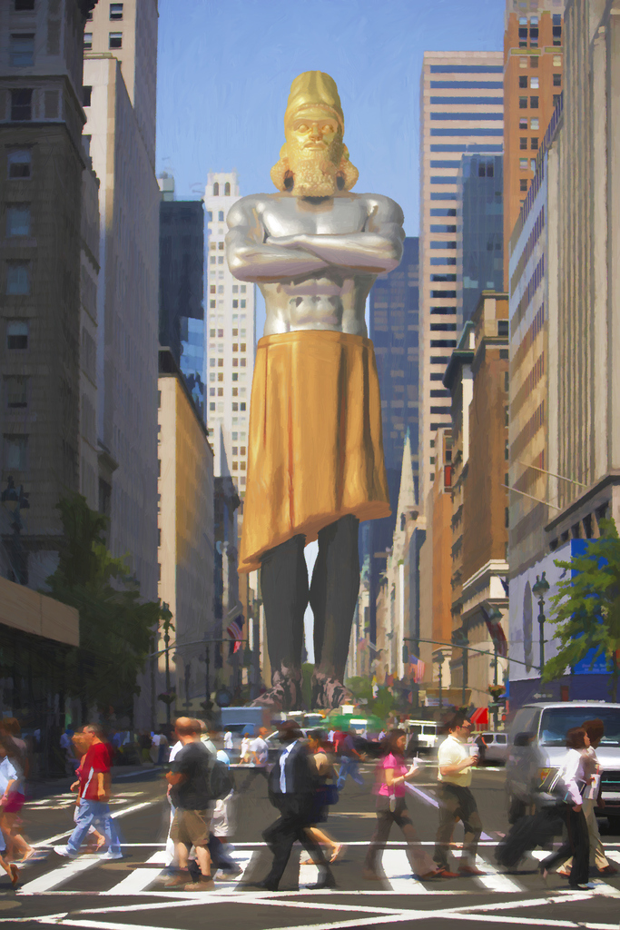
… behold, a great image! This great image, whose splendor was excellent, … its form was awesome. Daniel 2: 31

Slide 4
a stone was cut out without hands, which struck the image … the stone that struck the image became a great mountain and filled the whole earth. … The God of heaven will set up a kingdom which shall never be destroyed … and it shall stand forever. Daniel 2: 34 - 44

Slide 5
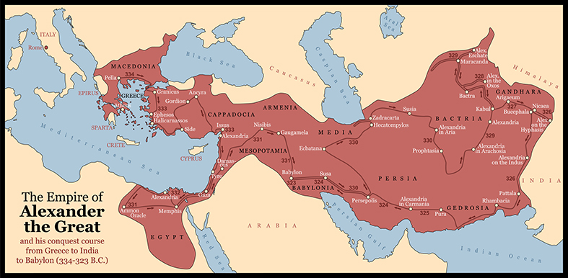
Then a mighty king shall arise, who shall rule with great dominion, and do according to his will. … his kingdom shall be broken up and divided toward the four winds of heaven, but not among his posterity. Daniel 11: 3, 4

Slide 6
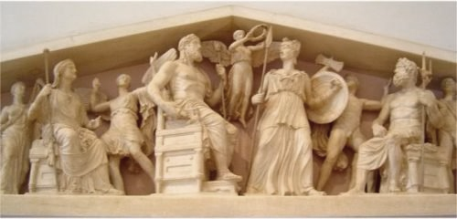

Slide 7
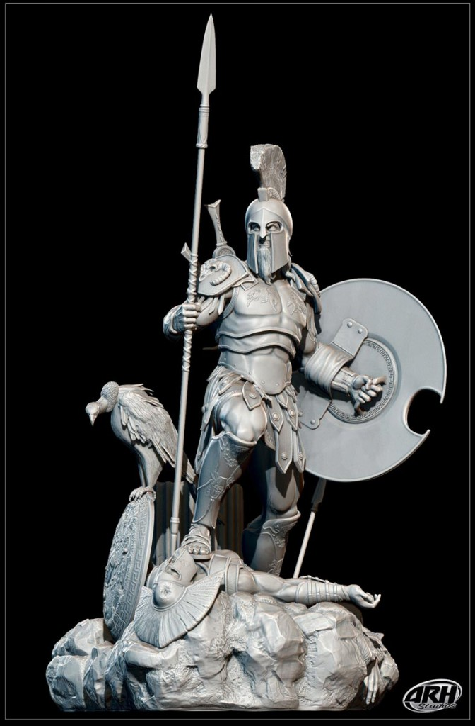
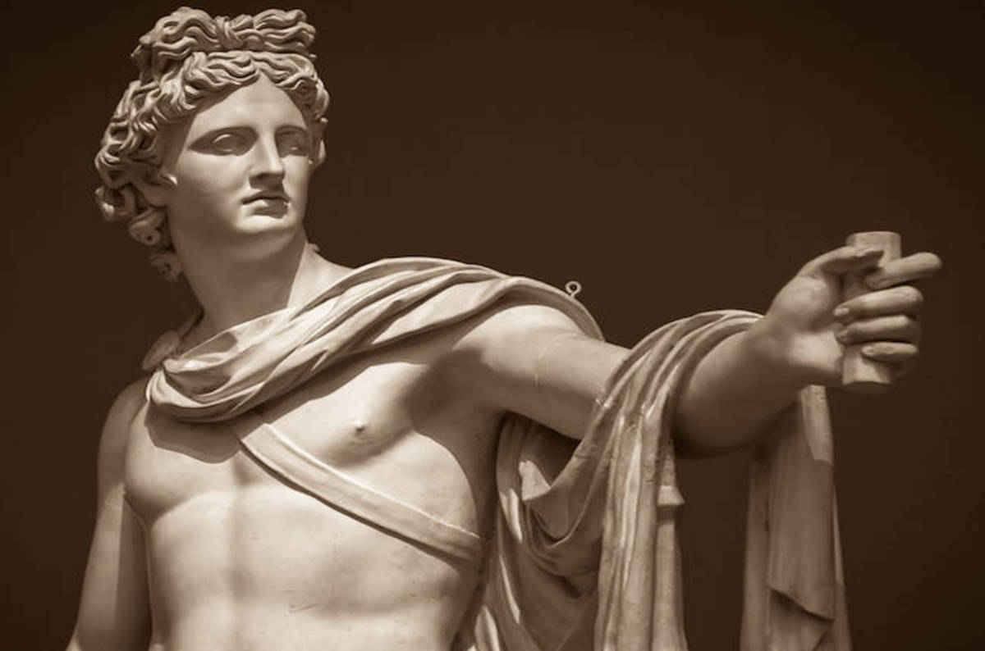
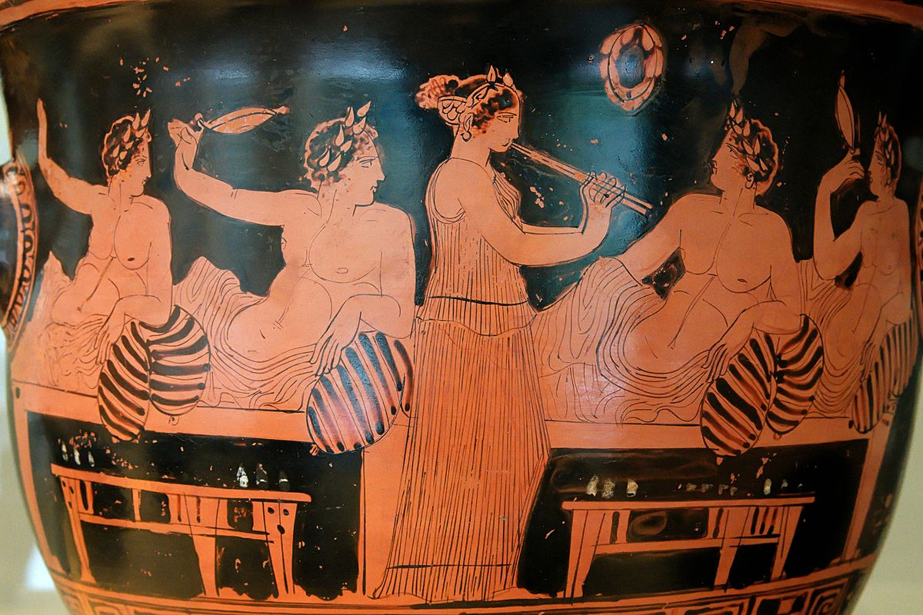

Slide 8
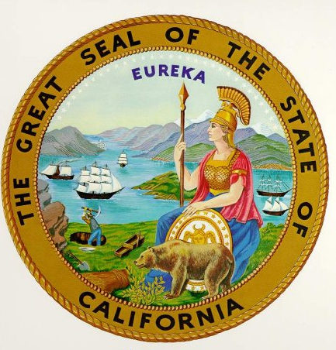

Slide 10
Then a mighty king shall arise, who shall rule with great dominion, and do according to his will. … his kingdom shall be broken up and divided toward the four winds of heaven, but not among his posterity. Daniel 11: 3, 4

Slide 11
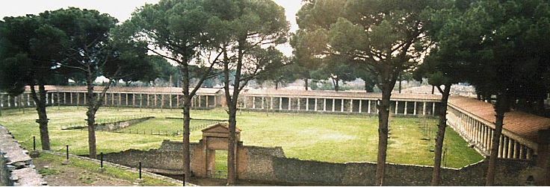
THE GYMNASIUM
gymnos

Slide 12
Peter, an apostle of Jesus Christ, to the pilgrims of the Dispersion in Pontus, Galatia, Cappadocia, Asia, and Bithynia …
I Peter 1: 1

Slide 13
Therefore, since Christ suffered for us in the flesh, arm yourselves also with the same mind, for he who has suffered in the flesh has ceased from sin, that he no longer should live the rest of his time in the flesh for the lusts of men, but for the will of God. For we have spent enough of our past lifetime in doing the will of the Gentiles--when we walked in lewdness, lusts, drunkenness, revelries, drinking parties, and abominable idolatries. In regard to these, they think it strange that you do not run with them in the same flood of dissipation, speaking evil of you.
I Peter 4: 1 - 4

Slide 14
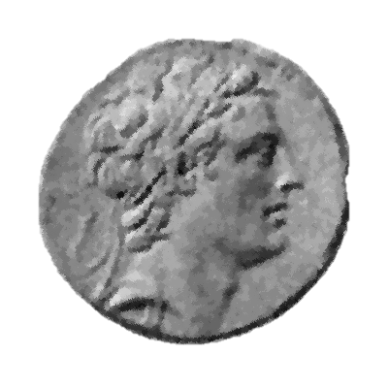
King Antiochus IV
(Antiochus Epiphanes)

Slide 15
[The sons of Tobias] … retired to Antiochus and informed him that they were desirous to leave the laws of their country, and the Jewish way of living according to them, and to follow the king’s laws, and the Grecian way of living, and wherefore they desired his permission to build them a Gymnasium at Jerusalem. And when he had given them leave, they also hid the circumcision of their genitals, that even when they were naked they might appear to be Greeks. Accordingly, they left off all the customs that belonged to their own country, and imitated the practices of other nations.
Josephus, The Antiquities of the Jews, Book 12, Chapter 5
So he shall … show regard for those who forsake the holy covenant. Daniel 11: 30

Slide 16
King Antiochus … made an expedition against the city Jerusalem. … And when he had gotten possession of Jerusalem, he slew many of the opposite party; and [he]… plundered it of a great deal of money.
Josephus, The Antiquities of the Jews, Book 12, Chapter 5
[Antiochus] … took Jerusalem by storm. He ordered his soldiers to cut down without mercy those whom they met and to slay those who took refuge in their houses. There was a massacre of young and old, a killing of women and children, a slaughter of virgins and infants. In the space of three days, eighty thousand were lost…
II Maccabees 5:11-14

Slide 17
So he left the temple bare, and took away the golden candlesticks, and the golden altar, and table of showbread, and the altar of burnt offering, and did not abstain from even the veils.
Josephus, The Antiquities of the Jews, Book 12, Chapter 5
… he shall … return in rage against the holy covenant, and do damage. So he shall return and show regard for those who forsake the holy covenant. And forces shall be mustered by him, and they shall defile the sanctuary… ; yet for many days they shall fall by sword and flame, by captivity and plundering.
Daniel 11: 30, 31

Slide 18
Moreover king Antiochus wrote to his whole kingdom, that all should be one people, and every one should leave his laws: so all the heathen agreed according to the commandment of the king. Yea, many also of the Israelites consented to his religion, and sacrificed unto idols, and profaned the Sabbath. For the king … forbid burnt offerings, and sacrifice, and drink offerings, in the temple; and that they should profane the Sabbaths and festival days and pollute the sanctuary and holy people: set up altars, and groves, and chapels of idols, and sacrifice swine's flesh, and unclean beasts: that they should also leave their children uncircumcised, and make their souls abominable with all manner of uncleanness and profanation: to the end they might forget the law, and change all the ordinances. And whosoever would not do according to the commandment of the king, he said, he should die.
I Maccabees 1: 41 - 50

Slide 19
Not long after this the king sent … to force the Jews to abandon the customs of their ancestors and live no longer by the laws of God; also to profane the temple in Jerusalem and dedicate it to Olympian Zeus … They also brought into the temple things that were forbidden, so that the altar was covered with abominable offerings prohibited by the laws. A man could not keep the Sabbath or celebrate the traditional feasts, nor even admit that he was a Jew. … a decree was issued ordering the neighboring Greek cities to act in the same way against the Jews: oblige them to partake of the sacrifices, and put to death those who would not consent to adopt the customs of the Greeks….
2 Maccabees 6: 1 – 11
…then they shall take away the daily sacrifices, and place there the abomination of desolation. Daniel 11: 31

Slide 20
Now Judas celebrated the festival of the restoration of the sacrifices of the temple for eight days … and he honored God, and delighted them by hymns and psalms. Nay, they were so very glad that at the revival of their customs, when after a long time … [they] had regained the freedom of their worship, that they made it a law for their posterity, that they should keep a festival on account of the restoration of their temple worship, for eight days. And from that time to this we celebrate this festival, and call it Lights.
And this … came to pass according to the prophecy of Daniel, which was given four hundred and eight years before.
Josephus, The Antiquities of the Jews, Book 12, Chapter 7

Slide 21
Political and Religious Freedom

Slide 22
Fulfillment of Prophecy

Slide 23
Historical Significance

Slide 24
If one could nominate an absolutely tragic day in human history, it would be the occasion that is now commemorated by the vapid and annoying holiday known as Hanukkah.
Christopher Hitchens
God Is Not Great @ 273

Slide 25
A FEAST of REDEDICATION

