Slide 1
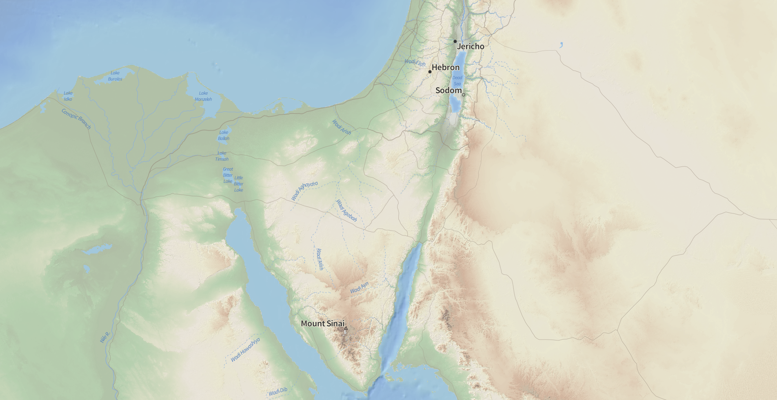
The Wilderness of Shur:
The Wilderness of Worldliness

Slide 2
Then Moses made Israel set out from the Red Sea, and they went into the wilderness of Shur. They went three days in the wilderness and found no water. When they came to Marah, they could not drink the water of Marah because it was bitter; therefore it was named Marah. And the people grumbled against Moses, saying, “What shall we drink?” And he cried to the LORD, and the LORD showed him a log, and he threw it into the water, and the water became sweet.
There the LORD made for them a statute and a rule, and there He tested them, saying, “If you will diligently listen to the voice of the LORD your God, and do that which is right in His eyes, and give ear to His commandments and keep all His statutes, I will put none of the diseases on you that I put on the Egyptians, for I am the LORD, your healer.”
Exodus 15:22-27

Slide 3
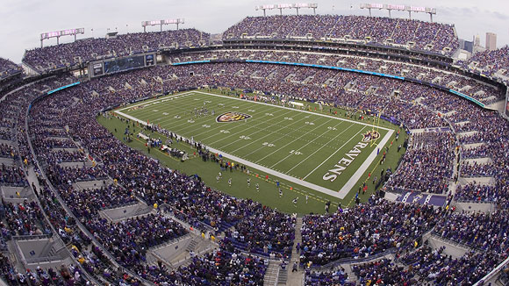
71,008
X 28

Slide 4
With joy you will draw water from the wells of salvation. And you will say in that day: “Give thanks to the LORD, call upon His name, make known His deeds among the peoples, proclaim that His name is exalted.”
Isaiah 12:3-4
“If you knew the gift of God, and who it is that is saying to you, ‘Give me a drink,’ you would have asked Him, and He would have given you living water.”
John 4:10
“If anyone thirsts, let him come to Me and drink. Whoever believes in Me, as the Scriptures has said, ‘Out of His heart will flow rivers of living water.’”
John 7:37-38

Slide 7
“I do not ask that You take them out of the world, but that You keep them from the evil one.”
John 17:15

Slide 8
“If the world hates you, know that it has hated me before it hated you. If you were of the world, the world would love you as its own; but because you are not of the world, but I chose you out of the world, therefore the world hates you.”
John 15:18-19
“I have said these things to you, that in Me you may have peace. In the world you will have tribulation. But take heart; I have overcome the world.”
John 16:33
But even if you should suffer for righteousness' sake, you will be blessed. Have no fear of them, nor be troubled, but in your hearts honor Christ the Lord as holy, always being prepared to make a defense to anyone who asks you for a reason for the hope that is in you; yet do it with gentleness and respect, having a good conscience, so that, when you are slandered, those who revile your good behavior in Christ may be put to shame.
1 Peter 3:14-16

Slide 9
“That’s why I think we have to walk on this road of Saint Benedict, in this Benedict Option. This is a season for saving the seed. If we don’t save the seed now, we won’t have a harvest in the years to come.”

Slide 10
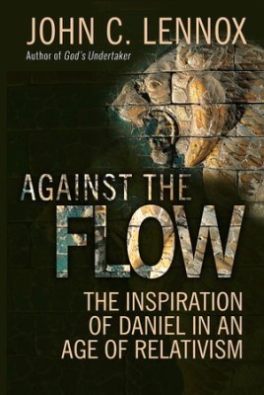
“We should take careful note, however, that Daniel did not protest against the education in the University of Babylon as such. He clearly devoted himself to it, and we can well imagine that he enjoyed his university course. He and his friends put such energy into the learning of languages, literature, philosophy, science, economics, history, and so on, that they were star pupils and ended up with top distinctions, far ahead of the rest. Daniel did not protest as an observer outside the system he protested as a participant…
[F]ar from leading him to run away from society and responsibility, the revelation he had of the future led him to live a very full professional life at the highest levels of administration in the empire. Daniel’s understanding of God did not lead to his developing a ghetto mentality but to taking a full and prominent part in the life of Babylon.”

Slide 11
“Thus says the LORD of hosts, the God of Israel, to all the exiles whom I have sent into exile from Jerusalem to Babylon: Build houses and live in them; plant gardens and eat their produce. Take wives and have sons and daughters; take wives for your sons, and give your daughters in marriage, that they may bear sons and daughters; multiply there, and do not decrease. But seek the welfare of the city where I have sent you into exile, and pray to the LORD on its behalf, for in its welfare you will find your welfare.”
Jeremiah 29:4-7

Slide 12
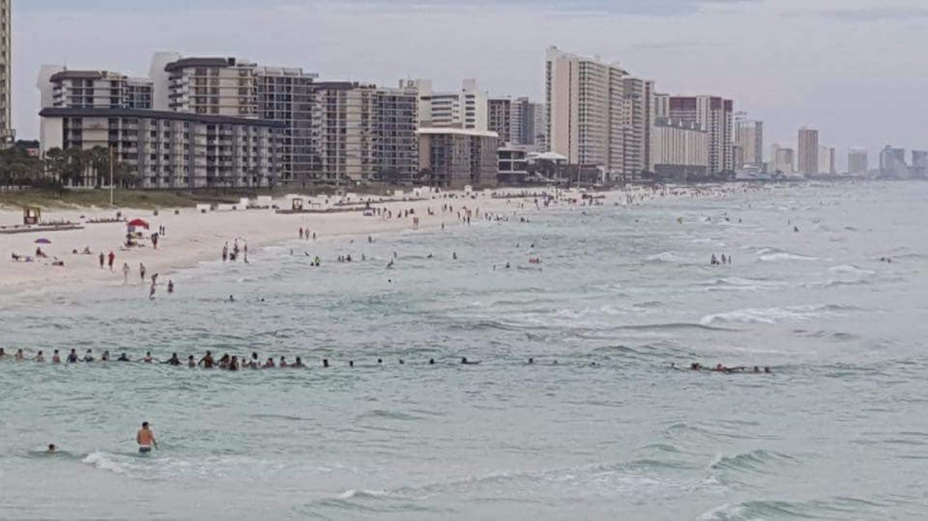
The Washington Post
“Rip Currents Swept Away A Florida Family. Then Beachgoers Formed A Human Chain.”

Slide 13
Then Moses made Israel set out from the Red Sea, and they went into the wilderness of Shur. They went three days in the wilderness and found no water. When they came to Marah, they could not drink the water of Marah because it was bitter; therefore it was named Marah. And the people grumbled against Moses, saying, “What shall we drink?” And he cried to the LORD, and the LORD showed him a log, and he threw it into the water, and the water became sweet.
There the LORD made for them a statute and a rule, and there He tested them, saying, “If you will diligently listen to the voice of the LORD your God, and do that which is right in His eyes, and give ear to His commandments and keep all His statutes, I will put none of the diseases on you that I put on the Egyptians, for I am the LORD, your healer.”
Exodus 15:22-27

Slide 14
“I have given them your word, and the world has hated them because they are not of the world, just as I am not of the world. I do not ask that You take them out of the world, but that You keep them from the evil one. They are not of the world, just as I am not of the world. Sanctify them in the truth; your word is truth. As you sent Me into the world, so I have sent them into the world. And for their sake I consecrate myself, that they also may be sanctified in truth.”
John 17:14-19

