Slide 1
Purim
(lots)

Slide 2
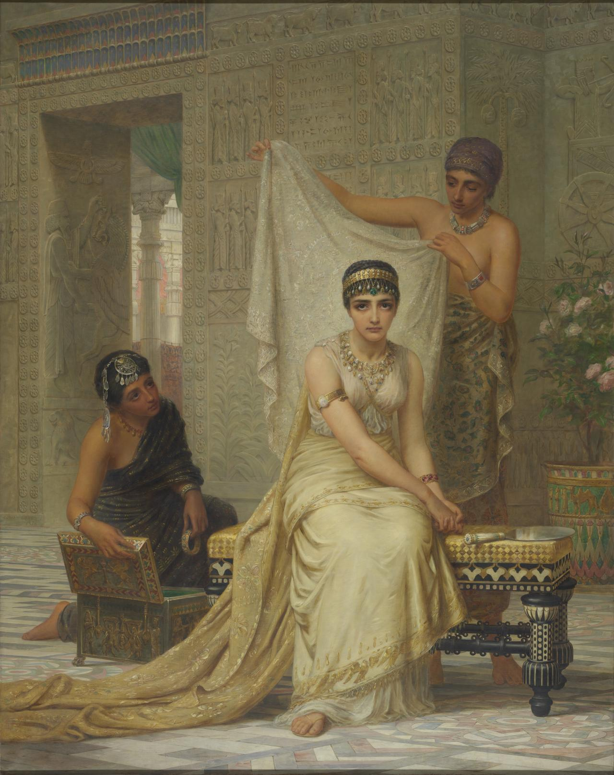
Gone With
the Whim
Esther 1 and 2

Slide 3
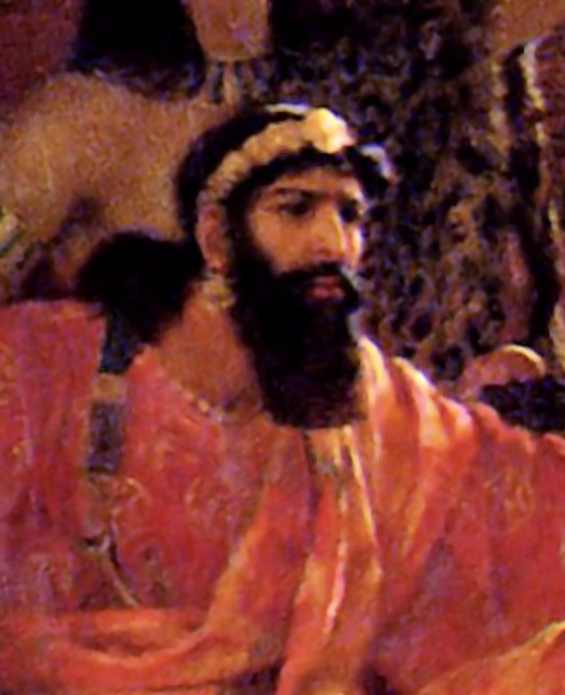
Ahasuerus (or Xerxes)
lived 519 – 464 B.C.
reigned 486-464 B.C.

Slide 4
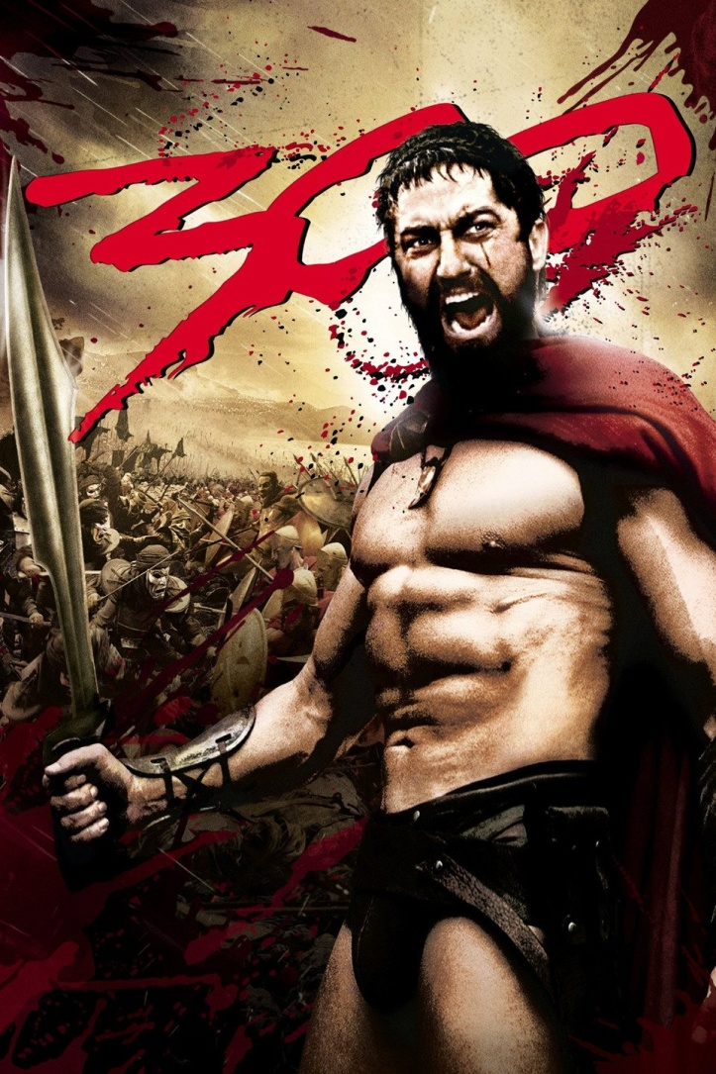

Slide 5
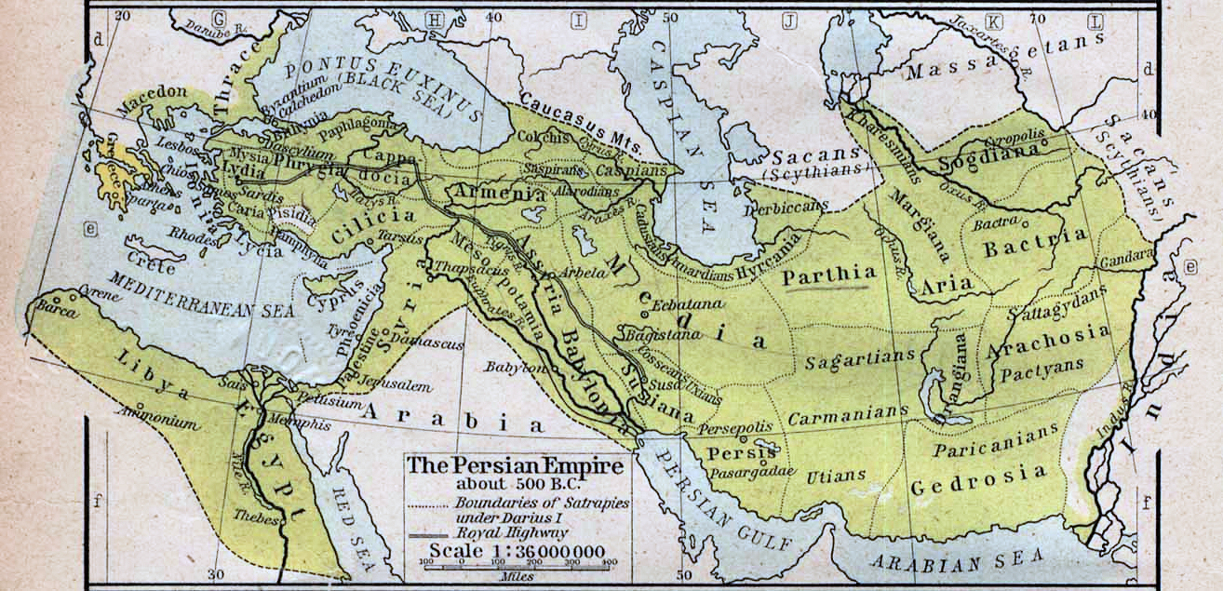

Slide 7
Biblical Chronology
B.C.
537 515 483 473 458 444 432
“Rebuild the temple”
Ezra 1-6
Esther
“Restore God’s Law”
Ezra 7-10
“Rebuild the walls”
Nehemiah
First return of
Jews to Jerusalem
Second return of
Jews to Jerusalem
Third return of
Jews to Jerusalem

Slide 8
Biblical Chronology
B.C.
537 515 483 473 458 444 432
“Rebuild the temple”
Ezra 1-6
Esther
“Restore God’s Law”
Ezra 7-10
“Rebuild the walls”
Nehemiah
First return of
Jews to Jerusalem
Second return of
Jews to Jerusalem
Third return of
Jews to Jerusalem

Slide 9
Biblical Chronology
B.C.
537 515 483 473 458 444 432
“Rebuild the temple”
Ezra 1-6
Esther
“Restore God’s Law”
Ezra 7-10
“Rebuild the walls”
Nehemiah
First return of
Jews to Jerusalem
Second return of
Jews to Jerusalem
Third return of
Jews to Jerusalem

Slide 10
Biblical Chronology
B.C.
537 515 483 473 458 444 432
“Rebuild the temple”
Ezra 1-6
Esther
“Restore God’s Law”
Ezra 7-10
“Rebuild the walls”
Nehemiah
First return of
Jews to Jerusalem
Second return of
Jews to Jerusalem
Third return of
Jews to Jerusalem

Slide 11
Now in the days of Ahasuerus, the Ahasuerus who reigned from India to Ethiopia over 127 provinces, in those days when King Ahasuerus sat on his royal throne in Susa, the citadel, in the third year of his reign he gave a feast for all his officials and servants. The army of Persia and Media and the nobles and governors of the provinces were before him, while he showed the riches of his royal glory and the splendor and pomp for many days, 180 days.
-- Esther 1:1-4

Slide 12
On the seventh day, when the heart of the king was merry with wine, he commanded…the seven eunuchs…to bring Queen Vashti before the king with her royal crown, in order to show the peoples and the princes her beauty, for she was lovely to look at.
-- Esther 1:10-11

Slide 13
On the seventh day, when the heart of the king was merry with wine, he commanded…the seven eunuchs…to bring Queen Vashti before the king with her royal crown, in order to show the peoples and the princes her beauty, for she was lovely to look at.
-- Esther 1:10-11

Slide 14
But Queen Vashti refused to come at the king’s command delivered by the eunuchs. At this the king became enraged, and his anger burned within him.
-- Esther 1:10-11

Slide 15
Then the king said to the wise men who knew the times (for this was the king’s procedure toward all who were versed in law and judgment…the seven princes of Persia and Media, who saw the king’s face, and sat first in the kingdom): “According to the law, what is to be done to Queen Vashti, because she has not performed the command of King Ahasuerus delivered by the eunuchs?”
-- Esther 1:13-15

Slide 16
“Not only against the king has Queen Vashti done wrong, but also against all the officials and all the peoples who are in all the provinces of King Ahasuerus. For the queen’s behavior will be made known to all women, causing them to look at their husbands with contempt … This very day the noble women of Persia and Media who have heard of the queen’s behavior will say the same to all the king’s officials, and there will be contempt and wrath in plenty.” -- Esther 1:16-18

Slide 17
#VashtiSaysNo!

Slide 18
“If it please the king, let a royal order go out from him, and let it be written among the laws of the Persians and the Medes so that it may not be repealed, that Vashti is never again to come before King Ahasuerus. And let the king give her royal position to another who is better than she. So when the decree made by the king is proclaimed throughout the kingdom, for it is vast, all women will give honor to their husbands, high and low alike.” -- Esther 1:16-18

Slide 19
“If it please the king, let a royal order go out from him, and let it be written among the laws of the Persians and the Medes so that it may not be repealed, that Vashti is never again to come before King Ahasuerus. And let the king give her royal position to another who is better than she. So when the decree made by the king is proclaimed throughout the kingdom, for it is vast, all women will give honor to their husbands, high and low alike.” -- Esther 1:16-18

Slide 20
The king answered and said, “The thing stands fast, according to the law of the Medes and Persians, which cannot be revoked. Then they answered and said before the king, “Daniel, who is one of the exiles from Judah, pays no attention to you, O king, or the injunction you have signed, but makes his petition three times a day.” Then the king, when he heard these words, was much distressed and set his mind to deliver Daniel.
-- Daniel 6:12-14

Slide 21
But he is unchangeable,
and who can turn him back?
What he desires, that he does.
-- Job 23:13
…the Father of lights, with whom there is no variation or shadow due to change.
--James 1:17

Slide 22
But he is unchangeable,
and who can turn him back?
What he desires, that he does.
-- Job 23:13
…the Father of lights, with whom there is no variation or shadow due to change.
--James 1:17

Slide 23
God’s purpose never alters. One of two things causes a man to change his mind and reverse his plans:
want of foresight to anticipate everything,
or
lack of foresight to execute them.
But as God is both omniscient and omnipotent there is never any need for Him to revise his decrees.
-- A.W. Pink
The Attributes of God

Slide 24
“Let beautiful young virgins be sought out for the king. And let the king appoint officers in all the provinces of his kingdom to gather all the beautiful young virgins to the harem in Susa the citadel, under custody of Hegai, the king’s eunuch, who is in charge of the women. Let their cosmetics be given them. And let the young woman who pleases the king be queen instead of Vashti.” This pleased the king, and he did so.
-- Esther 2:2-4

Slide 25
Now there was a Jew in Susa the citadel whose name was Mordecai, the son of Jair, son of Shimei, son of Kish, a Benjaminite… He was bringing up Hadassah, that is Esther, the daughter of his uncle, for she had neither father nor mother. The young woman had a beautiful figure and was lovely to look at, and when her father and her mother died, Mordecai took her as his own daughter.
-- Esther 2:5-7

Slide 26
Now there was a Jew in Susa the citadel whose name was Mordecai, the son of Jair, son of Shimei, son of Kish, a Benjaminite… He was bringing up Hadassah, that is Esther, the daughter of his uncle, for she had neither father nor mother. The young woman had a beautiful figure and was lovely to look at, and when her father and her mother died, Mordecai took her as his own daughter.
-- Esther 2:5-7

Slide 27
Now there was a Jew in Susa the citadel whose name was Mordecai, the son of Jair, son of Shimei, son of Kish, a Benjaminite… He was bringing up Hadassah, that is Esther, the daughter of his uncle, for she had neither father nor mother. The young woman had a beautiful figure and was lovely to look at, and when her father and her mother died, Mordecai took her as his own daughter.
-- Esther 2:5-7

Slide 29
He who observes providence
will never be long
without a providence to observe.
-- John Flavel

Slide 30
And after all that has come upon us for our evil deeds and for our great guilt, seeing that you, our God, have punished us less than our iniquities deserved and have given us such a remnant as this, shall we break your commandments again and intermarry with the peoples who practice these abominations? Would you not be angry with us until you consumed us, so that there should be no remnant, nor any to escape?
-- Ezra 9:13-14

Slide 31
God, as one observes, can strike a strait Blow with a crooked Stick; ‘tis not for the worthiness of the Instruments, that he doth work, but for his own Glory.
-- Benjamin Keach (London 1694)

Slide 32
In those days as Mordecai was sitting at the king’s gate, Bigthan and Teresh, two of the king’s eunuchs, who guarded the threshold, became angry and sought to lay hands on King Ahasuerus. And this came to the knowledge of Mordecai, and he told it to Queen Esther, and Esther told the king in the name of Mordecai. When the affair was investigated and found to be so, the men were hanged on the gallows.
-- Esther 2:21-23a

Slide 33
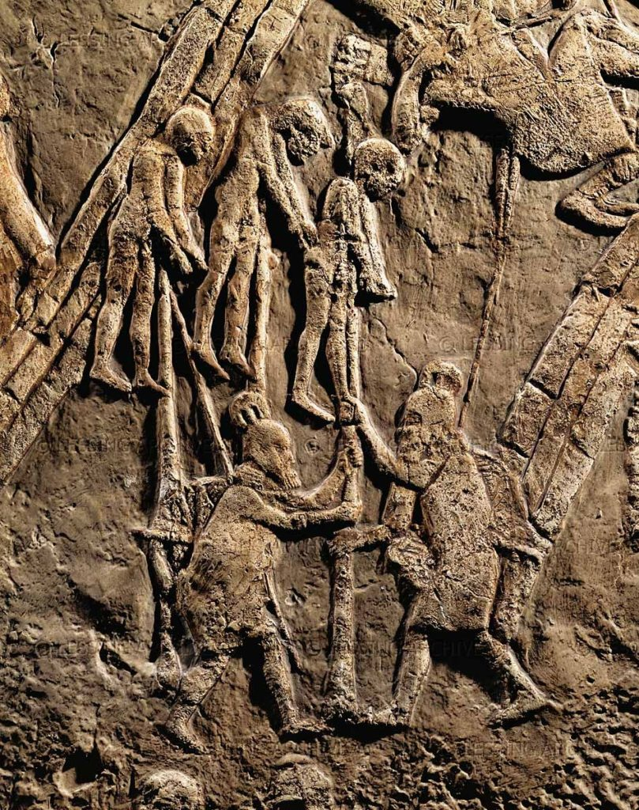

Slide 34
And it was recorded in the book of the chronicles in the presence of the king.
-- Esther 2:23b

Slide 36
To be full of care, to view our situation with dark forebodings, to anticipate tomorrow with sad anxiety, is to reflect poorly upon the faithfulness of God. He who has cared for His child through all the years will not forsake him in old age. He who has heard your prayers in the past will not refuse to supply your need in the present emergency.
-- A.W. Pink
The Attributes of God

Slide 37
for I am God and there is no other;
I am God, and there is none like me,
declaring the end from the beginning
and from ancient times things not yet done
saying, ‘My counsel shall stand,
and I will accomplish all my purpose…
I have spoken, and I will bring it to pass;
I have purposed, and I will do it.’
-- Isaiah 46:9-11

